Slide 1
Progressively Building a Dynamic Report
Some helpful SAS software features for beginning & intermediate users

Slide 2
Business Problem: “I need a report!”
You work for a company that wants to enter the luxury car market in the USA.
Your bosses are aware that SAS software has a built-in data set called “CARS” with information from the year 2004.
They want you to use it to help them better understand their competition with respect to variables like Miles Per Gallon (MPG), Engine Size, Horsepower, and Weight.

Slide 3
Built-in SASHELP Data Sets

Slide 4
What are SASHELP data sets?
SAS software comes with over 200 built-in data sets.
These data sets are stored in the SASHELP library.
They are used for examples in the SAS documentation.
Here is the complete reference and link for them:
SAS Institute Inc. 2018. Sashelp Data Sets. Cary, NC: SAS Institute Inc.
https://support.sas.com/documentation/tools/sashelpug.pdf

Slide 5
Why use SASHELP data sets?
They are great for SAS conference presentations because most people should have them already installed.
Your built-in SASHELP data sets depend on which SAS products you have licensed.
With SAS/STAT, SAS/IML, and SAS/QC, I only have 119 data sets.
An employee in SAS Education said she had 199 data sets installed, because she does not have every SAS product installed on her computer.

Slide 6
Which SASHELP data sets do I have?
To see which ones you have (and how many variables are in each one) with your SAS products, try the following:
proc contents data = sashelp._all_ noprint out = work.proccontentsout ;
run;
proc freq data = work.proccontentsout ;
where contents = “DATA” ;
tables MEMNAME ;
run;

Slide 7
The SASHELP.CARS data set
Contains 428 rows/observations from the year 2004
Has one row per Make and Model
Contains 15 variables:
Make
Model
Type
Origin
DriveTrain
MSRP
Invoice
EngineSize
Cylinders
Horsepower
MPG_City
MPG_Highway
Weight
Wheelbase
Length

Slide 8
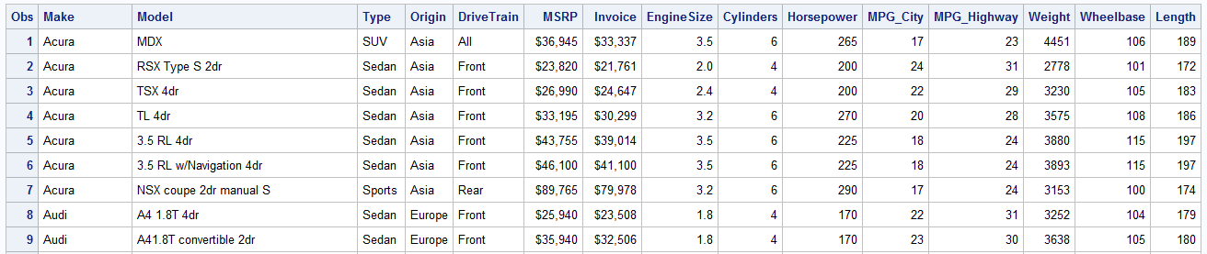
The SASHELP.CARS data set
PROC CONTENTS of first 9 rows:

Slide 9
Preliminary Programming
Selecting the Variables and Records of Interest

Slide 10
Business Problem: “I need a report!”
“We only want to see the luxury brands.”
“Show us all of the luxury brands on the same worksheet in an Excel workbook.”
“We want to see the following 7 variables: Make, Model, Type, Drive Train, Miles Per Gallon (MPG) in the City, Horsepower.”

Slide 11
1). Create a Temporary Data Set in WORK
To read the CARS data set into the temporary WORK library, run the following lines of code:
data work.cars_demonstration ;
set sashelp.cars ;
run;
Your bosses only want the luxury models. In the 2004 data set, the following are 11 luxury brands:
Acura, Audi, BMW, Cadillac, Hummer, Jaguar, Land Rover, Lexus, Lincoln, Mercedes-Benz, and Porsche

Slide 12
2). Select the Luxury Brands (part 1)
Use a WHERE statement with the IN operator:
data work.cars_fewer_makes ;
set work.cars_demonstration ;
where Make in ("Acura" "Audi" "BMW" "Cadillac" "Hummer" "Jaguar"
"Land Rover" "Lexus" "Lincoln" "Mercedes-Benz" "Porsche" ) ;
run;
The IN operator can also be used with IF statements.
You can separate the individual values with spaces or commas.
The statement above could have also been written like the following:
where Make in ("Acura" , "Audi" , "BMW" , "Cadillac" , "Hummer" , "Jaguar" ,
"Land Rover" , "Lexus" , "Lincoln" , "Mercedes-Benz" , "Porsche" ) ;

Slide 13
2). Select the Luxury Brands (part 2)
With character variables, use either single or double quotes around the character values: 'Acura' or "Acura"
With numeric variables, you can specify a range with a colon
If you did not want to look at 8-cylinder engines, you could use either of the following three WHERE statements:
where Cylinders in (1 2 3 4 5 6 7) ;
where Cylinders in (1, 2, 3, 4, 5, 6, 7) ;
where Cylinders in (1:7) ;

Slide 14
3). Choose the Variables for the Report
Use a KEEP data set option to reduce the number of variables:
data work.cars_fewer_variables ;
set work.cars_fewer_makes
( keep = Make Model Type DriveTrain MPG_City Horsepower ) ;
run;
Obs | Make | Model | Type | DriveTrain | Horsepower | MPG_City
1 | Acura | MDX | SUV | All | 265 | 17
2 | Acura | RSX Type S 2dr | Sedan | Front | 200 | 24
3 | Acura | TSX 4dr | Sedan | Front | 200 | 22
4 | Acura | TL 4dr | Sedan | Front | 270 | 20
5 | Acura | 3.5 RL 4dr | Sedan | Front | 225 | 18
6 | Acura | 3.5 RL w/Navigation 4dr | Sedan | Front | 225 | 18
7 | Acura | NSX coupe 2dr manual S | Sports | Rear | 290 | 17
8 | Audi | A4 1.8T 4dr | Sedan | Front | 170 | 22
9 | Audi | A41.8T convertible 2dr | Sedan | Front | 170 | 23

Slide 15
Reports in Excel—Method 1
The PROC EXPORT approach

Slide 16
1a). Default PROC EXPORT & XLSX output
Use PROC EXPORT:
proc export data = work.cars_few_vars
dbms = xlsx
outfile = "C:\SASexamples\Reports\basic_report_1a.xlsx"
replace ;
run; quit;
This produces an Excel workbook with the variable names as the headers and the default Excel worksheet name, which is just the name of the data set being exported (up to 31 characters).
The Data Source Identifier (DBMS) used here is XLSX, which is the more modern option that does not rely on Microsoft drivers or the PC Files Server.

Slide 17
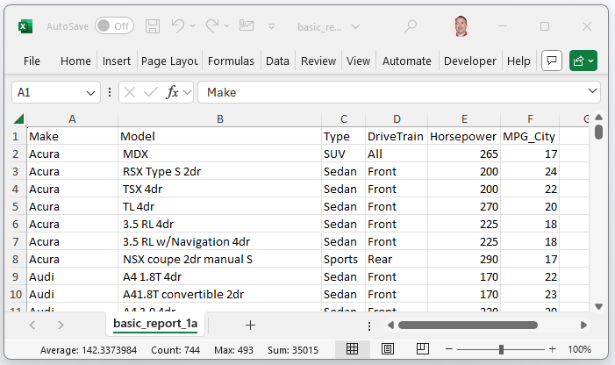
Report example—1a
Output:

Slide 18
1b). Printing the Variable Labels
To show the variable labels rather than the variable names, use the “LABEL” option in PROC EXPORT:
proc export data = work.cars_few_vars
dbms = xlsx
outfile = "C:\SASexamples\Reports\basic_report_1b.xlsx"
label
replace ;
run; quit;

Slide 19
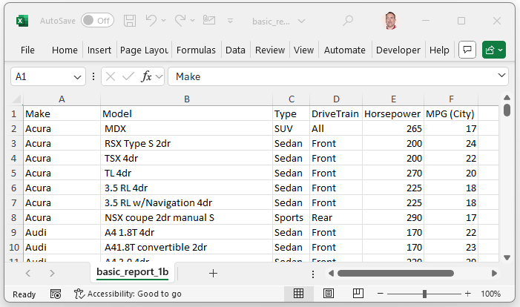
Report example—1b
Output:

Slide 20
1c). Changing the Worksheet Name
To change the worksheet name, use a SHEET statement in PROC EXPORT:
proc export data = work.cars_few_vars
dbms = xlsx
outfile = "C:\SASexamples\Reports\basic_report_1c.xlsx"
label
replace ;
sheet = "Luxury 2004" ;
run; quit;

Slide 21
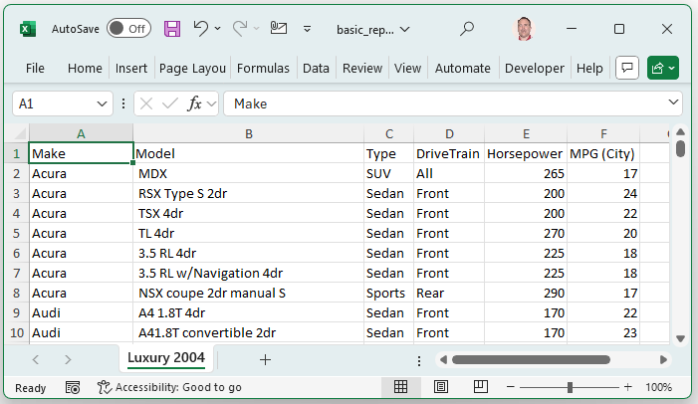
Report example—1c
Output:

Slide 22
Reports in Excel—Method 2
The Excel Libname Engine approach

Slide 23
2a). Default XLSX Libname & Data Step output
Use the XLSX (Excel) libname:
libname lxrepb1 xlsx "C:\SASexamples\Reports\basic_report_2a.xlsx" ;
data lxrepb1.cars_fewer_variables ;
set work.cars_few_vars ;
run;
libname lxrepb1 clear ;
The XLSX libname engine works across platforms and does not rely on Microsoft software or the PC Files Server
The worksheet name will be the name of the data set.
By default, the XLSX libname engine exports the variable names.

Slide 24
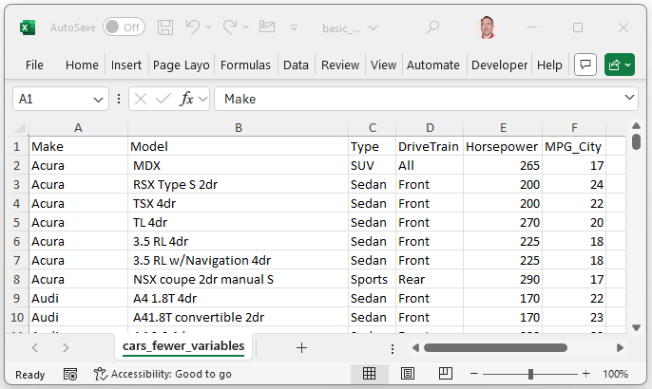
Report example—2a
Output:

Slide 25
2b). Printing the Variable Labels
To show the variable labels rather than the variable names, use the “DBLABEL=YES” option:
libname lxrepb2 xlsx "C:\SASexamples\Reports\basic_report_2b.xlsx" ;
data lxrepb2.cars_fewer_variables (DBLABEL=YES) ;
set work.cars_few_vars ;
run;
libname lxrepb2 clear ;

Slide 26
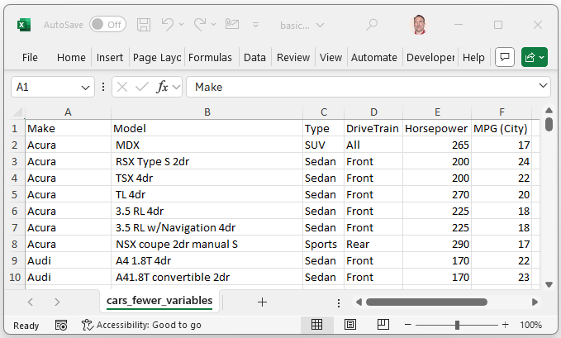
Report example—2b
Output:

Slide 27
2c). Changing the Worksheet Name
To alter the worksheet name, you can use a name literal (or n-literal)
A name literal is just a character string enclosed in quotes with a single “n” placed outside of the final quotation mark at the end:
libname lxrepb3 xlsx "C:\SASexamples\Reports\basic_report_2c.xlsx" ;
data lxrepb3.'Luxury 2004'n (DBLABEL=YES) ;
set work.cars_few_vars ;
run;
libname lxrepb3 clear ;

Slide 28
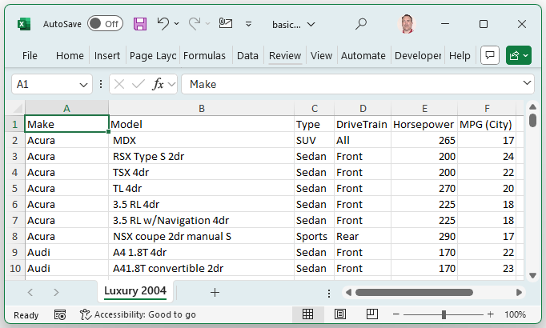
Report example—2c
Output:

Slide 29
Reports in Excel—Method 3
The Output Data System approach with PROC PRINT

Slide 30
3a). Default ODS & PROC PRINT output
Use the Output Data System (ODS):
ods excel file = "C:\SASexamples\Reports\basic_report_3a.xlsx" ;
proc print data = work.cars_few_vars ;
run;
ods excel close ;
The ODS system by default creates a generic sheet name: “Print 1 - Data Set WORK.CARS”
PROC PRINT by default produces the variable names (not the variable labels) at the top of the output.

Slide 31
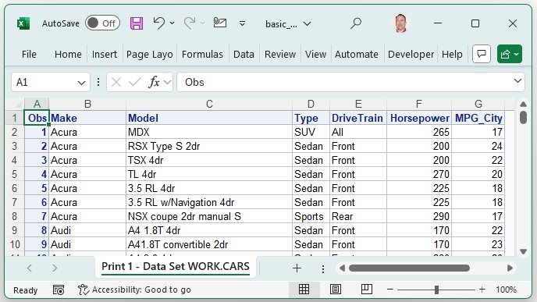
Report example—3a
Output:

Slide 32
3b). Printing the Variable Labels
To show the variable labels rather than the variable names, use the “LABEL” option for PROC PRINT:
ods excel file = "C:\SASexamples\Reports\basic_report_3b.xlsx" ;
proc print data = work.cars_few_vars label ;
run;
ods excel close ;

Slide 33
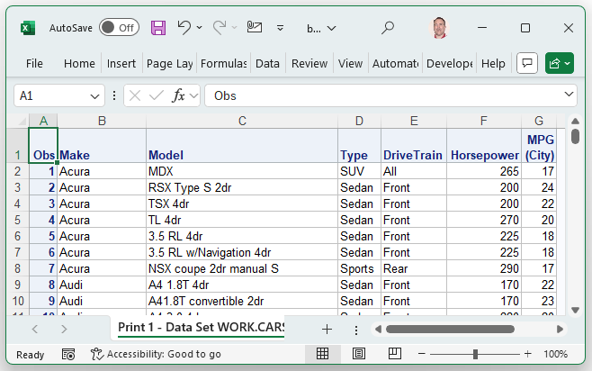
Report example—3b
Output:

Slide 34
3c). Changing the Worksheet Name
To change the worksheet name, use the OPTIONS available with ODS to change the SHEET_NAME:
ods excel file = "C:\SASexamples\Reports\basic_report_3c.xlsx"
options(sheet_name="Luxury 2004") ;
proc print data = work.cars_few_vars label ;
run;
ods excel close ;

Slide 35
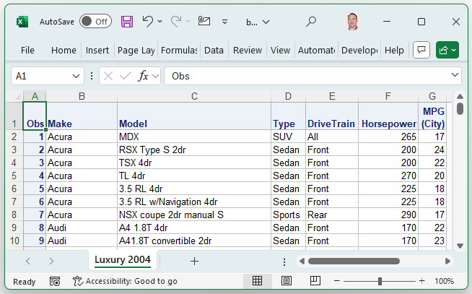
Report example—3c
Output:

Slide 36
Reports in Excel—Method 4
The Output Data System approach with PROC REPORT

Slide 37
4a). Default ODS & PROC REPORT output
Use the ODS and PROC REPORT:
ods excel file = "C:\SASexamples\Reports\basic_report_4a.xlsx" ;
proc report data = work.cars_few_vars ;
column Make Model Type DriveTrain MPG_City Horsepower ;
run;
ods excel close ;
As before, the ODS system by default creates a generic sheet name. Unlike PROC PRINT and some other procedures, PROC REPORT produces the variable labels—not the variable names—by default at the top of the output.

Slide 38
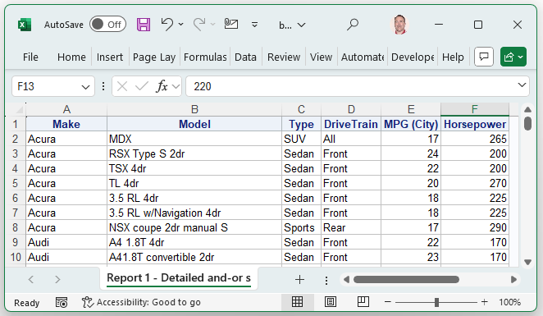
Report example—4a
Output:

Slide 39
4b). Printing the Variable Names
To show the variable names rather than PROC REPORT’s default (variable labels), use the “NOLABEL” option for PROC REPORT; it is typically a good idea to return settings to their original state (i.e., OPTIONS LABEL) once you are finished using them in their modified version:
ods excel file = "C:\SASexamples\Reports\basic_report_4b.xlsx" ;
options nolabel ;
proc report data = work.cars_few_vars ;
column Make Model Type DriveTrain MPG_City Horsepower ;
run;
options label ;
ods excel close ;

Slide 40
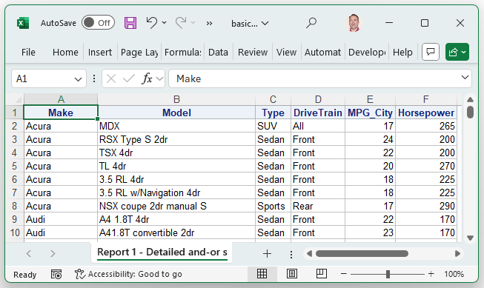
Report example—4b
Output:

Slide 41
4c). Changing the Worksheet Name
As before with PROC PRINT, to change the worksheet name, use the OPTIONS available with ODS to change the SHEET_NAME:
ods excel file = "C:\SASexamples\Reports\basic_report_4c.xlsx"
options( sheet_name = "Luxury 2004" ) ;
proc report data = work.cars_few_vars ;
column Make Model Type DriveTrain MPG_City Horsepower ;
run;
ods excel close ;
Note: the default behavior (with variable labels) is kept above because that what users usually want.

Slide 42
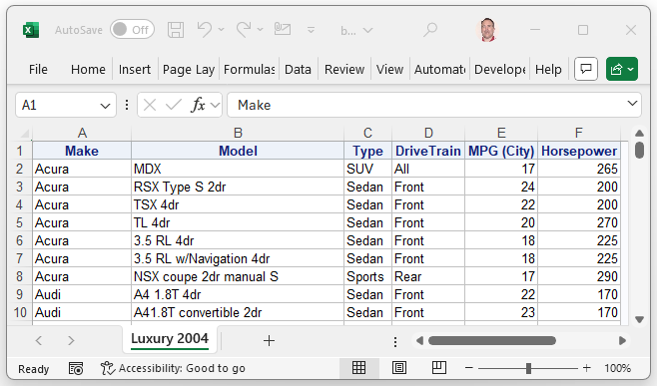
Report example—4c
Output:

Slide 43
A More Dynamic Report
Like Sands Through the Hourglass, So Are the Spec Changes of our Lives

Slide 44
Business Problem: “I need a report!”
“These are great!”
“BUT, could you put each Make on a separate worksheet?”

Slide 45
Fancier Reports in Excel—Method 1
ODS and PROC REPORT with a BY statement

Slide 46
A Simple Solution—Use a BY Statement
An easy way to get a separate worksheet for each Make is to use a BY statement.
It is usually a good idea to sort the data before using a BY statement.
proc sort data = work.cars_few_vars out = work.cars_few_vars_sort ;
by Make Model Type DriveTrain MPG_City Horsepower ;
run;
ods excel file = "C:\SASexamples\Reports\basic_report_5a.xlsx" ;
proc report data = work.cars_few_vars_sort ;
by Make ;
column Make Model Type DriveTrain MPG_City Horsepower ;
run;
ods excel close ;

Slide 47
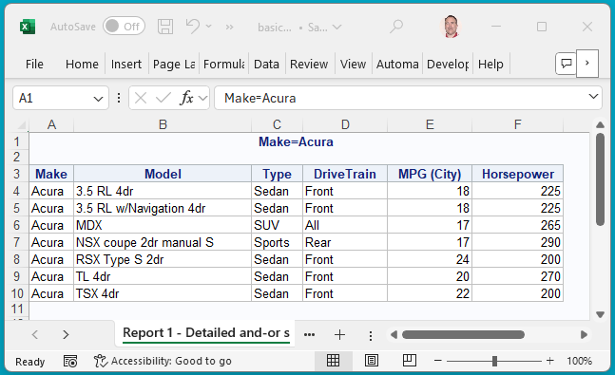
Report example—5a
Output:

Slide 48
Business Problem: “I need a report!”
“These are also great!”
“BUT, could you put the name of each Make as the name of the worksheet?”

Slide 49
Fancier Reports in Excel—Method 2
ODS and PROC REPORT
with a BY statement & #BYVALn Option

Slide 50
A Simple Solution—Use #BYVALn Option
To get the Excel worksheet names to match the car makes, use the #BYVALn syntax to indicate which by value to use for each worksheet name.
proc sort data = work.cars_few_vars out = work.cars_few_vars_sort ;
by Make Model Type DriveTrain MPG_City Horsepower ;
run;
ods excel file = "C:\SASexamples\Reports\basic_report_5b.xlsx"
options( sheet_name = "#byval1" ) ;
proc report data = work.cars_few_vars_sort ;
by Make ;
column Make Model Type DriveTrain MPG_City Horsepower ;
run;
ods excel close ;

Slide 51
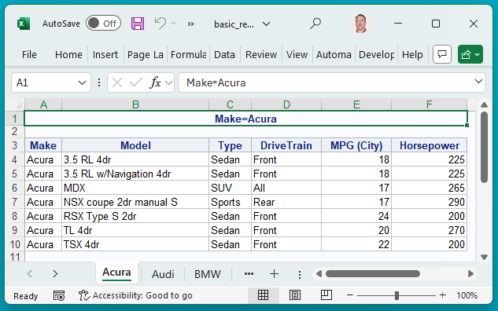
Report example—5b
Output:

Slide 52
Business Problem: “I need a report!”
“Again, these are great!”
“BUT, could we make the titles simpler and only show the Make of the vehicle?”

Slide 53
Fancier Reports in Excel—Method 3
ODS and PROC REPORT with a macro variables

Slide 54
Starting Small—A Report for One Make Only
When building dynamic reports, it is often easiest to make a static version first:
ods excel file = "C:\SASexamples\Reports\basic_report_5c.xlsx"
options( sheet_name = "Porsche" sheet_interval = "none" ) ;
proc odstext ;
p "Porsche" ;
run;
proc report data = work.cars_few_vars_sort ;
where Make = "Porsche" ;
column Make Model Type DriveTrain MPG_City Horsepower ;
run;
ods excel close ;

Slide 55
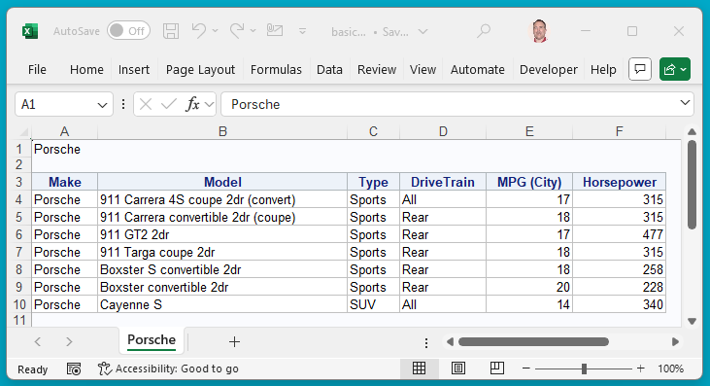
Report example—5c
Output:

Slide 56
Growing Your Program Without Copying
The SAS programming for the first static report would have to be copied and altered for each Make in the data set—so 11 chunks of code, one for each luxury Make!
ods excel file = "C:\SASexamples\Reports\basic_report_5c.xlsx"
options(sheet_name="Porsche 2004" sheet_interval = "none" ) ;
proc report data = work.cars_few_vars ;
where Make = "Porsche" ;
column Make Model Type DriveTrain MPG_City Horsepower ;
run;
ods excel options(sheet_name="Audi 2004" sheet_interval = "now" ) ;
proc report data = work.cars_few_vars ;
where Make = "Audi" ;
column Make Model Type DriveTrain MPG_City Horsepower ;
run;
…et cetera…
ods excel close ;

Slide 57
Needing a Macro? Some Clues
Coping and pasting chunks of the same SAS programming repeatedly means that you might need a macro variable and/or macro function.
Needing flexible code that can accommodate new data without much additional programming is also a sign you might need a macro variable and/or macro function
For example, if you receive additional data for other calendar years, you may have to retype your SAS programming to account for new luxury car Makes.

Slide 58
Creating a Macro Variable List
To create a dynamic list of luxury car Makes that are based on whatever is in the data set, you could create a macro variable to hold a list of Makes.
One of the easiest, most straightforward ways to do this in SAS software is with PROC SQL.
Here’s a generic pattern for creating a macro variable:
proc sql noprint ;
select distinct VariableOfInterest into: m_VariableList separated by "^"
from work.YourDataSet ;
quit; run;

Slide 59
Creating a Macro Variable List
m_VariableList will be a list of items separated by carets (^).
For the luxury car example, you can use the following:
proc sql noprint ;
select distinct Make into: m_Make_lst separated by "^"
from work.cars_few_vars ;
quit; run;
This produces a macro variable, m_Make_lst, which contains the following:
m_Make_lst = Acura^Audi^BMW^Cadillac^Hummer^Jaguar^Land Rover^Lexus^Lincoln^Mercedes-Benz^Porsche

Slide 60
Creating a Macro Counter Variable
When generating multiple reports using values stored in macro variables, you will often need a counter variable for looping through those stored values:
proc sql noprint ;
select count( distinct VariableOfInterest ) into: m_VariableList
from work.YourDataSet ;
quit; run;
For luxury car example, you can use the following:
proc sql noprint ;
select count( distinct Make ) into: m_Make_cnt
from work.cars_few_vars ;
quit; run;

Slide 61
Macro Variable List & Macro Counter Variable
You can create two macro variables in the same PROC SQL statement, like the following:
proc sql noprint ;
select count( distinct Make ) into: m_Make_cnt from work.cars_few_vars ;
select distinct Make into: m_Make_lst separated by "^" from work.cars_few_vars ;
quit; run;
The following will write your macro variable results to the log:
%put m_Make_cnt = &m_Make_cnt ;
%put m_Make_lst = &m_Make_lst ;
A shorter way to get the same information is…
%put &=m_Make_cnt ;
%put &=m_Make_lst ;

Slide 62
A Dynamic Report with Macros—Version 1
This macro function uses both macro variables:
%macro mcars_5d() ;
ods excel file = "C:\SASexamples\Reports\basic_report_5d.xlsx" options( sheet_interval = 'none' ) ;
%do i = 1 %to &m_Make_cnt ;
%let m_car_make = %scan("&m_Make_lst", &i., "^");
ods excel options( sheet_name = "&m_car_make" ) ;
proc odstext ;
p "&m_car_make Information for 2024" ;
run;
proc report data = work.cars_few_vars_sort ;
where Make = "&m_car_make" ;
column Make Model Type DriveTrain MPG_City Horsepower ;
run;
ods excel options( sheet_interval = "now" ) ;
%end ;
ods excel close ;
%mend mcars_5d ;
%mcars_5d() ;

Slide 63
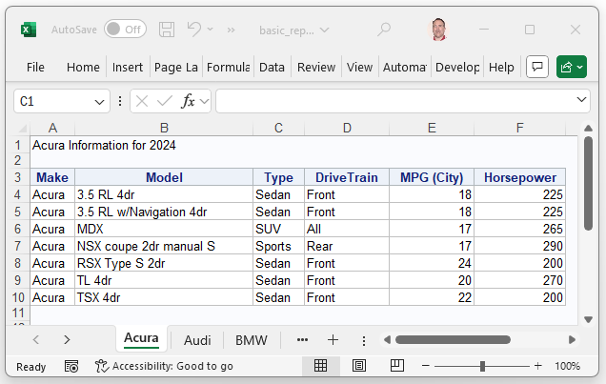
Report example—5d
Output:

Slide 64
Business Problem: “I need a report!”
“Once again, these are great!”
“BUT, could we make the titles bigger, change their color to maroon, and then add some more spacing between the report’s title and the report’s table?”

Slide 65
Fancier Reports in Excel—Method 4
ODS and PROC REPORT
with a macro variables and fancier titles

Slide 66
A Dynamic Report with Macros—Version 2
This macro function modifies the text from the defaults:
%macro mcars_5e() ;
ods excel file = "C:\SASexamples\Reports\basic_report_5e.xlsx" options( sheet_interval = 'none' ) ;
%do i = 1 %to &m_Make_cnt ;
%let m_car_make = %scan("&m_Make_lst", &i., "^");
ods excel options( sheet_name = "&m_car_make" ) ;
proc odstext ;
p "&m_car_make Information for 2024" /
style={ font_weight = bold font_size = 14pt color = STR }; /* strong red */
p " " / style={ font_weight = bold font_size = 14pt };
run;
proc report data = work.cars_few_vars_sort ;
where Make = "&m_car_make" ;
column Make Model Type DriveTrain MPG_City Horsepower ;
run;
ods excel options( sheet_interval = "now" ) ;
%end ;
ods excel close ;
%mend mcars_5e ;
%mcars_5e() ;

Slide 67
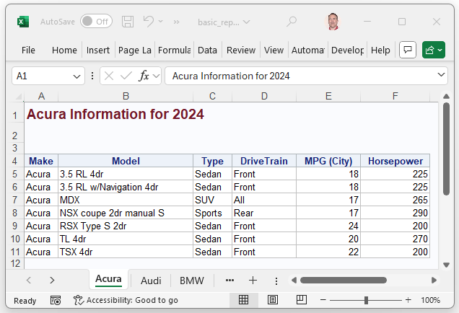
Report example—5e
Output:

Slide 68
References
Like Sands Through the Hourglass, So Are the Spec Changes of our Lives

Slide 69
References
SAS Help Data Sets
https://support.sas.com/documentation/tools/sashelpug.pdf
Using the Output Delivery System to Create and Customize Excel Workbooks
https://www.lexjansen.com/wuss/2023/WUSS-2023-Paper-196.pdf
ODS List and Text Block Tip Sheet
https://support.sas.com/content/dam/SAS/support/en/products-solutions/base-sas/tip-sheets/Tipsheet_ListTextBlks.pdf
Working with the ODSTEXT Procedure :: Getting Started with the SAS(R) 9.4 Output Delivery System
https://support.sas.com/documentation/cdl/en/odsgs/66634/HTML/default/viewer.htm#n1gjfa8h98goken1902k56odwm9m.htm
More Than Just a Pretty Face: Using the SAS® Output Delivery System to Create Microsoft Excel Worksheets That Answer Those Difficult Questions
https://support.sas.com/resources/papers/using-sas-ods-create-excel-worksheets.pdf
Excel with the ODS EXCEL Destination and PROC Report
https://www.lexjansen.com/sesug/2022/SESUG2022_Paper_232_Final_PDF.pdf

