Slide 2
Automate in a Dash with SAS®: Time-Saving Techniques for Building Quality Improvement Dashboards
Shavonne J. Standifer, Truman Medical Center

Slide 3
Shavonne J. Standifer
Statistical Business Analyst, has worked in healthcare for 17 years. She uses SAS® to create data insights that assist clinicians, doctors, and administrators in understanding health outcomes and population data.

Slide 4
Automate in a Dash with SAS®
Overview
Data Preparation
Dynamic data sourcing
Save time and increase accuracy in performing routine tasks
Reporting
Report Structure
Report Distribution
Automation
SAS Enterprise Guide
Windows Task Scheduler
Notes:
This paper highlights by example how you can use SAS Enterprise Guide to optimize your routine reporting processes
This paper demonstrates by business case example.
Data Preparation
We’ll review some SAS statements and routines that you can use in your programs to read data from multiple sources into your project.
We’ll also look at some handy SAS routines that you can use in your programs.
Reporting
We look at ways to structure your report output so that reviewers can quickly identify key data points for decision
So we will look at some quick ways you can produce graphs an frequency visualizations to help support your data.
Automation
We’ll discuss how SAS Enterprise Guide works together with Windows Task Scheduler to automate your entire project so that you can set it to run independently.
Reducing the data prep time gives you more time to actually analyze the data and make better strategic recommendations to teams.
Lets dive in.

Slide 5
On Your Mark, Get Set

Slide 6
Your Environment
Key Technical Details to Consider
Local Administrative Privileges
Windows Task Scheduler
VBScript
Metadata Credentials
Local Environment
Notes:
Local Administrative rights on your workspace.
Windows Task Scheduler –
-you can access it and run a simple VBScript program independently.
Metadata credentials –
Are cached so that your automated program can run indepently.

Slide 7
Finding the Most Current File in a Directory
Business Case 1

Slide 8
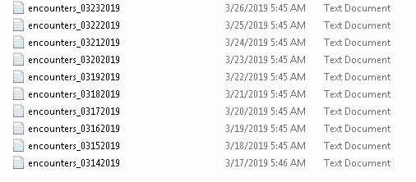
About
Data Source File Structure
About the data:
Fictitious dataset that contains admission data at the encounter level.
Notes:
This example looks at how to find the most current file in a directory based on the file name,
KEY Takeaways
-The format of the file
MONTH/DAY/YEAR Format
48 Hour lag – Can’t use the system date

Slide 9
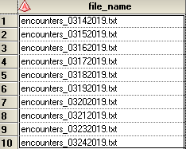
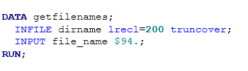
Bringing the Data Into Your Project
Techniques to Bring Data in Quickly
Use the Filename statement with a PIPE and an asterisk wildcard (*) and windows command features to output the name of each file in your directory
Notes:
FILENAME – we use this to create a ref to our source data
Unamed PIPE – to act as our virtual folder that holds information needed to processes the code.
DIR-Windows command that returns a list of files.
ASTERISK Wildcard – Used in the directory name so that we only return filenames that reach our specifications.
/B p This is a command parameter that only returns the “NAMES of the files in a directory. This difference between DIR and/b
DIR can returns all of the file information with each file in a directory.
Adding the /B parameter helps you to only return the file names.

Slide 10
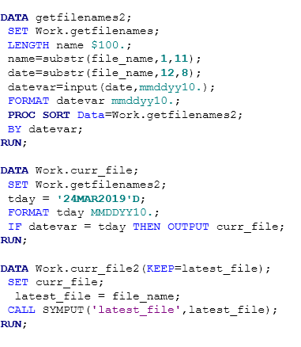

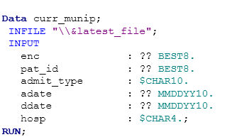
Bringing the Data Into Your Project
Techniques to Bring Data in Quickly
Use SAS code to identify the most current file in the dataset.
Notes:
You can replace the date variable with the today() function
Key Takeaway : Storing the name of the latest data file in a macro variable helps to make your project dynamic and runs independently.

Slide 11
Bring the Contents of all Files in a directory into a SAS® Dataset
Business Case 2

Slide 12
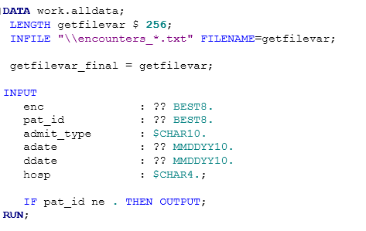
Reading in all of the Contents of a Directory
The Dynamic FILENAME Statement
You can include a FILENAME statement in your pathname to quickly read in the contents of all files in a directory.
Notes:
Using the FILENAME statement with INFILE will attach the name of the source file per each observation row.

Slide 13

Reading in all of the Contents of a Directory
Results
Here is the Output:
Notes:
This action will read in your titles and header information from a document. If this method is used, remember to add an additional data step that removes those observations.

Slide 14
Automatically Distribute Daily Volume by E-Mail
Business Case 3

Slide 15
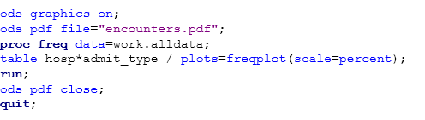
Auto Distribute a Daily Volume Report By E-Mail
Business Case 3
Add a PLOT option to PROC FREQ

Slide 16
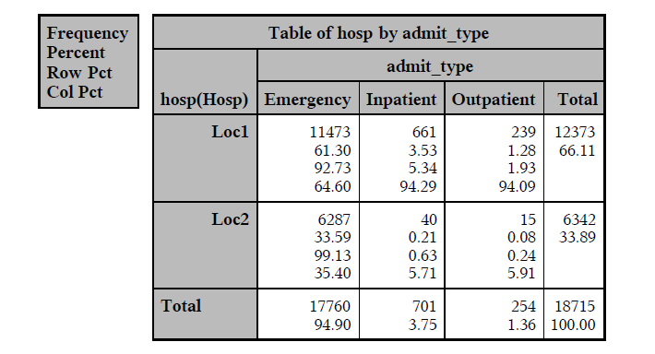
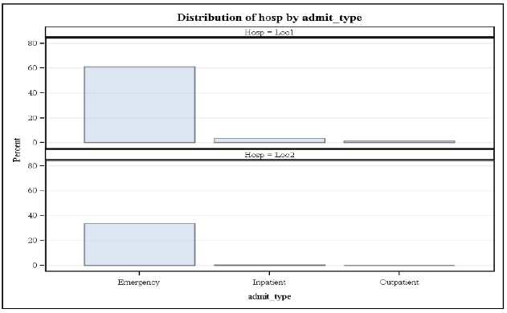
Auto Distribute a Daily Volume Report By E-Mail
Results

Slide 17
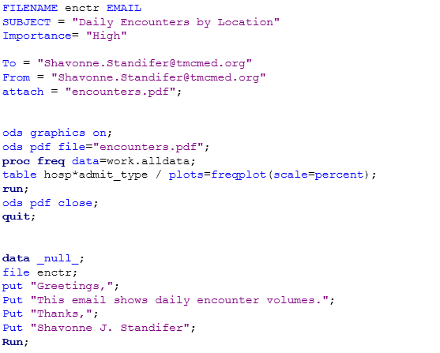

Report Distribution
E-Mailing From SAS
Ensure that you have set up your communication configurations for your e-mail server.

Slide 18
Auto Distribute a Report that Shows Performance Over Time Business Case 4

Slide 19
Showing Measures over Time
Key Performance Indicators (KPI’s)
Here is a snapshot of the source data:

Slide 20
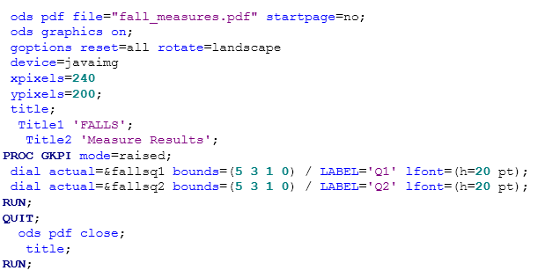
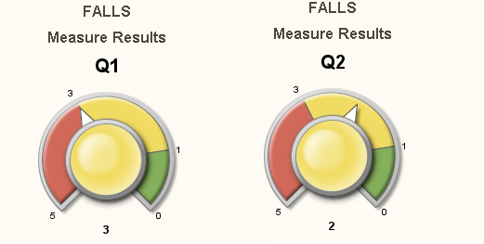
Showing Measures over Time
Results
Use Proc GKPI to create a visualization of performance.
Notes:
From here you can set an option to automatically distribute this by email

Slide 21
Project Automation
Notes:
This paper doesn’t outline the step by step process of setting up your project automation.
This is because the POINT AND click interface of SAS is pretty intuitive.

Slide 22
Project Automation
Automation with SAS® Enterprise Guide
Be sure that your system options are set so that your project runs when you are not logged in.
Create an AUTOEXEC process flow and set your system options to automatically execute when opened
Notes:
Intuitive Interface
Easy project set up
Once you create your programs and execute. SAS EG will automatically ceates a VBScript file that contains instructions for launching your project.
Point in Click Interface of SAS is pretty intuitive, and sometimes the most challenging part of automating a project is adapting to your technical environment. The tips on the slide help.

Slide 23
Conclusion
This paper discussed useful techniques in data reporting automation that you can include in your reports and dashboards. The examples in this paper were created to help business analysts utilize the automation features of SAS® Enterprise Guide. The examples will give some ideas to use in your own custom reporting.

Slide 24
Thank you!
Contact Information Shavonne.Standifer@tmcmed.org
Reminder: Complete your session survey in the conference mobile app.

