Slide 1
What Are You Bringing To the Table? Leveraging SQL and SAS for Analysis Ready Data
Shavonne J. Standifer
With over 15 years of experience in data science, statistical business analysis, and web development, Shavonne is a results-oriented professional specializing in SAS programming and data management. My background as a certified data scientist and analyst has equipped me with a deep understanding of leveraging data-driven insights to support business objectives and drive organizational success.

Slide 2
What Are You Bringing To The Table?
Leveraging SQL and SAS for Analysis Ready Data
Shavonne J. Standifer, University Health, Kansas City, Mo

Slide 3
Overview

Slide 4
Database/Table and Why

Slide 5
What Is An Analysis Ready Dataset?
An analysis ready dataset is a dataset where an analysis can be performed with minimal programming. Its data that has been reviewed, cleaned, validated, and structured so it can be used immediately for statistical analysis, modeling, reporting, and more. Creating your own “Analysis Ready” framework can help you have data elements that are consistent and error free to support the various needs of your organization.

Slide 6
Data Cleaning Process

Slide 7
Data Cleaning Pain Points
GGrGfr
Filter data based on conditions

Slide 8
Data Cleaning Pain Points
Filter data based on conditions
Join multiple tables
Update inefficient table joins
Aggregate data using functions like COUNT, SUM, and AVG
Set predefined rules
Standardize formats
Handle missing values
Combine data from different sources

Slide 9
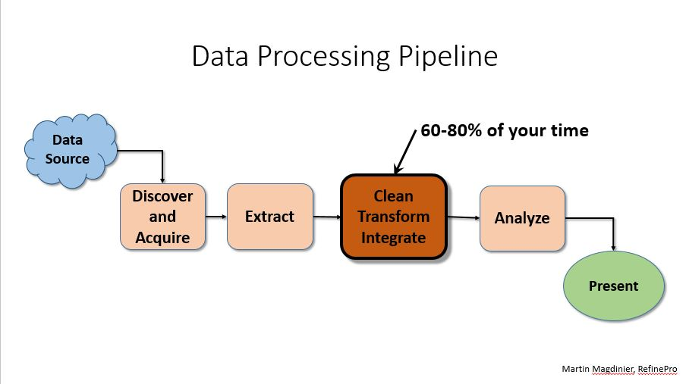
Why You Need ARD

Slide 10
Streamlining The Process
Raw Data File
ETL
SAS Tables
SQL Queries
Analysis Ready Data
Reports

Slide 11
Part 1
A Brief Overview of the technical concepts used

Slide 12
The SAS Data Step

Slide 13
Set Up Your SAS Library

Slide 14
SQL - A General Overview

Slide 15
The SQL Procedure

Slide 16
Set-Based vs. Iterative

Slide 17
Implicit vs. Explicit Looping

Slide 18
Part 2
The data used for the exercises.

Slide 19
The DATA used

Slide 20

Decide What To Bring To The Table

Slide 21

Set The Table

Slide 22

Add The Ingredients

Slide 23
CREATE VIEW

Slide 24
Merging Data
DATA step
PROC SQL

Slide 25
Grouping Data
DATA step
PROC SQL

Slide 26
Filtering Data
DATA step
PROC SQL

Slide 27
Sorting Data
DATA step
PROC SQL

Slide 28
Aggregating Data
DATA step
PROC SQL

Slide 29

Serve & Share

Slide 30
PROC REPORT

Slide 31
Conclusion

Slide 32
Thank You (or) Contact Information
Name
Company
Address
Phone
Email
Social Media

