Slide 1
How Did That Python Code get into my SAS Program?
Jim Box, SAS Institute
MWSUG 2025 BB-066

Slide 2
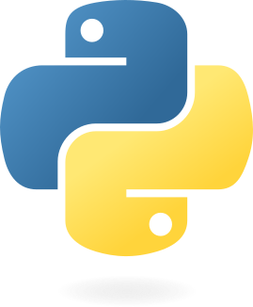
PROC Python
Exploring the new SAS Methods

Slide 3
PROC PYTHON
SAS Viya Procedure
PROC PYTHON allows you to execute Python code inside any SAS program
Macro variables and datasets can be passed between the two languages
SAS functions can be called in the Python block
SAS code can be submitted in the Python block
Matplotlib.pyplot objects can be printed

Slide 4
PROC PYTHON
SAS Methods for Python Interactions
SAS.pyplot() – writes out PNG file
SAS.sasfnc() – call a SAS program
SAS.submit() – submit SAS code
SAS.symget() – return the value of a SAS macro variable
SAS.symput() – assign a value to a SAS macro that will persist

Slide 5
PROC PYTHON
SAS Methods for Data Transfer
SAS.df2ds() – transfers data from a Pandas dataframe to a SAS dataset. This will overwrite the SAS dataset
SAS.sd2df() – transfers data from a SAS dataset to a Pandas dataframe

Slide 6
PROC PYTHON
SAS Methods for Log Output
SAS.hideLOG(True|False) – True directs the Python output to a file in the work directory called sas2py.log. False sends it back to the SAS log. Default behavior is False.
SAS.printLOG() – displays all accumulated Python output since the SAS.hideLOG() method was called

Slide 7
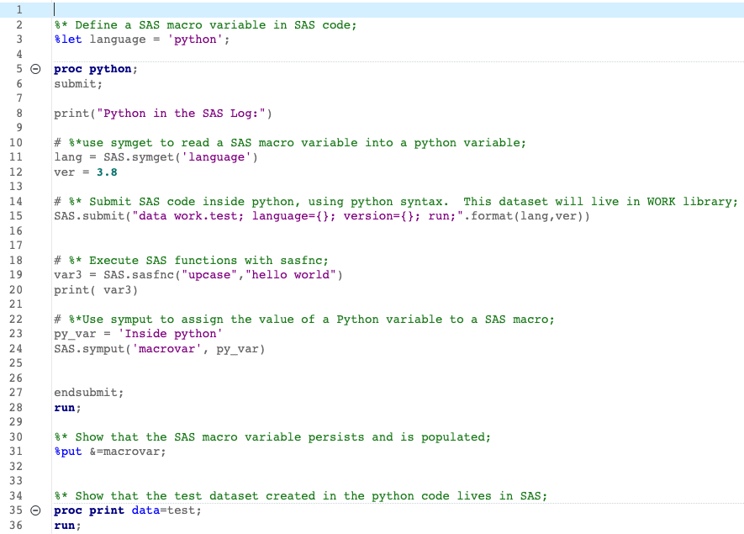
PROC PYTHON
Example Code

Slide 8

PROC PYTHON
Code Results – Python Initialized

Slide 9
PROC PYTHON
Example Code

Slide 10

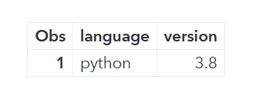

PROC PYTHON
Code Results – SAS.symget() and SAS.submit()

Slide 11
PROC PYTHON
Example Code

Slide 12
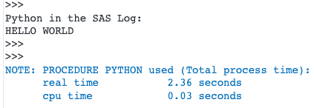
PROC PYTHON
Code Results – SAS.sasfcn()

Slide 13
PROC PYTHON
Example Code

Slide 14
PROC PYTHON
Code Results – SAS.symput()

Slide 15
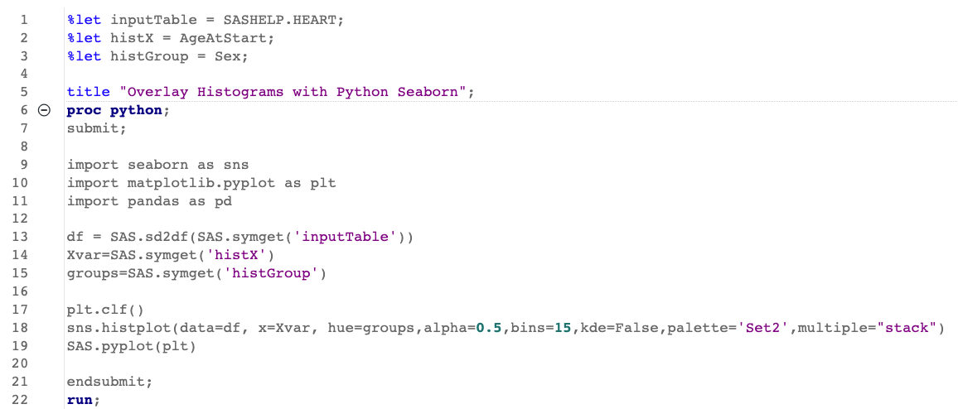
PROC PYTHON
Example Code

Slide 16
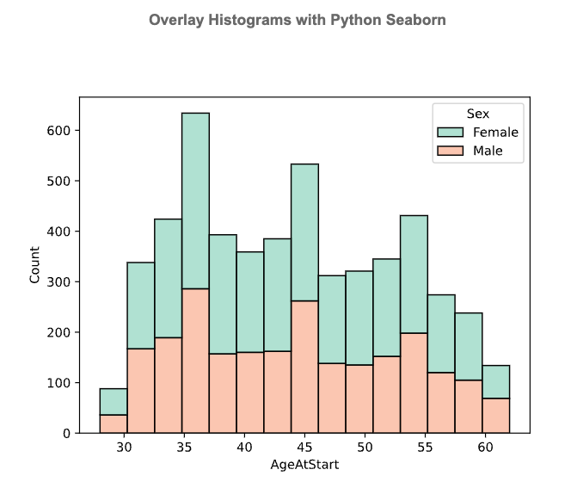
PROC PYTHON
Code Results – SAS.pyplot()

Slide 17
PROC PYTHON in Action
Lab Data Import

Slide 18
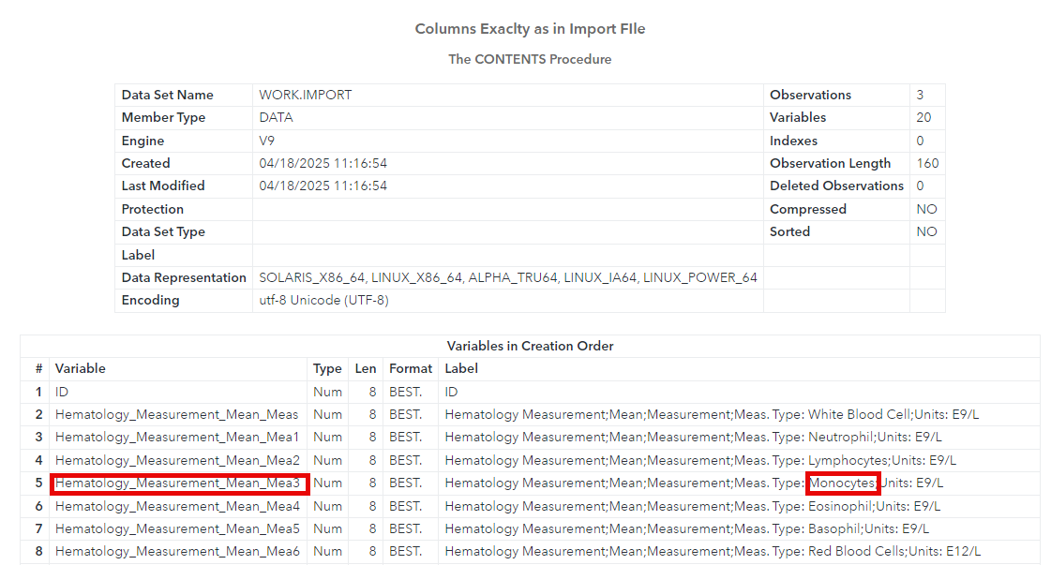
Importing From LabExtract.xlsx

Slide 19
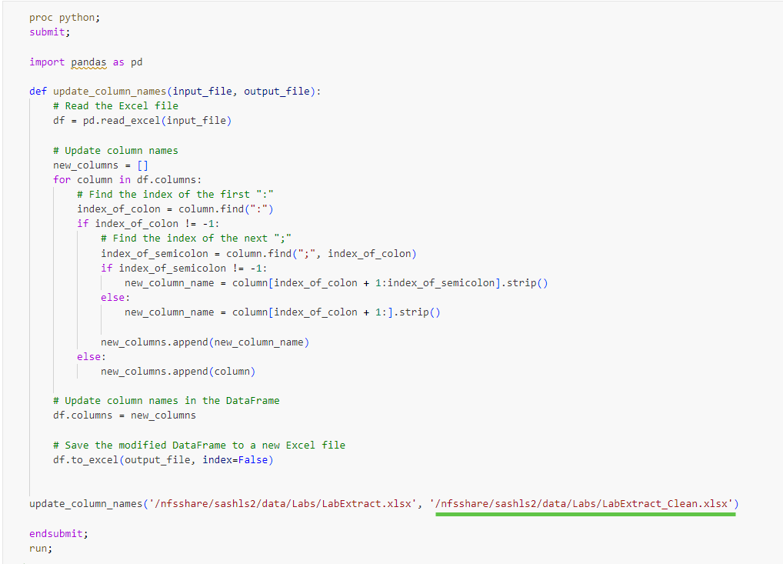
Summon the Python

Slide 20
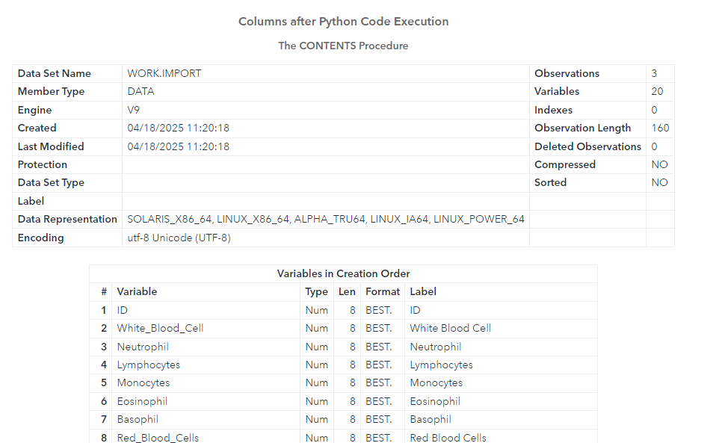
Magic Achieved

Slide 21

Coming Soon ……
PROC R

Slide 22
Thanks!
Jim Box
SAS Institute
Jim.Box@sas.com

