Slide 1
Enhance your Coding Experience with the SAS Extension for VS Code
Jim Box
MWSUG 2025 BB-065

Slide 2
Microsoft Visual Studio Code
More than just a text editor

Slide 3
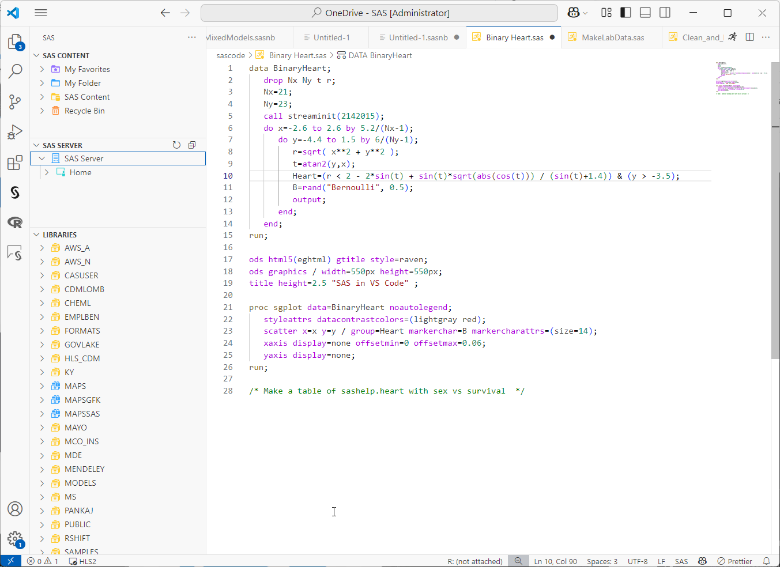
VS Code Features
Free, lightweight, and highly extensible
Cross-platform Compatibility
Integrated Git Support
Highly Customizable through extensions and themes
Multiple coding language support, including R, Python, and SAS

Slide 4
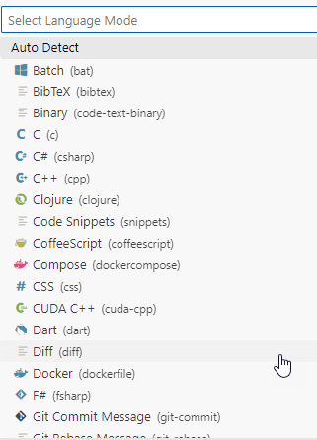
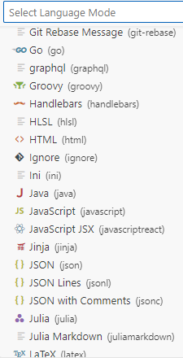
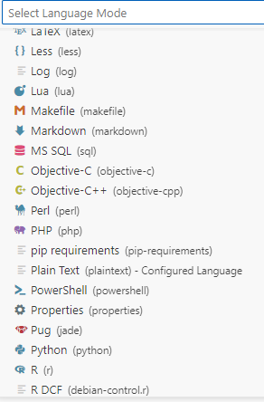
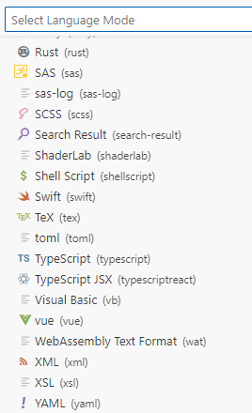
VS Code Features
Language Support

Slide 5
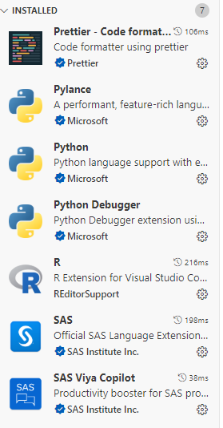
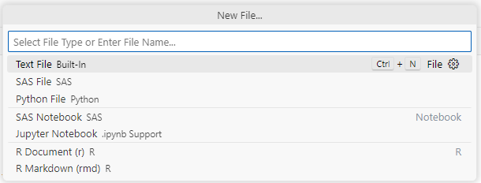
VS Code Features
Extensions

Slide 6
SAS Extension
Connect to multiple SAS compute environments

Slide 7
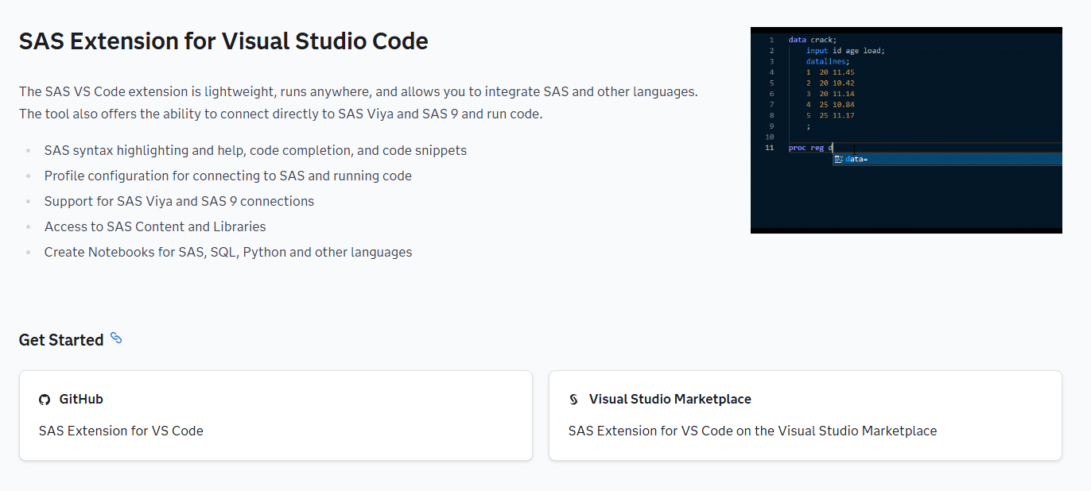
SAS Extension
Details on SAS Developers Page
https://developer.sas.com/programming/vs_code_extension

Slide 8
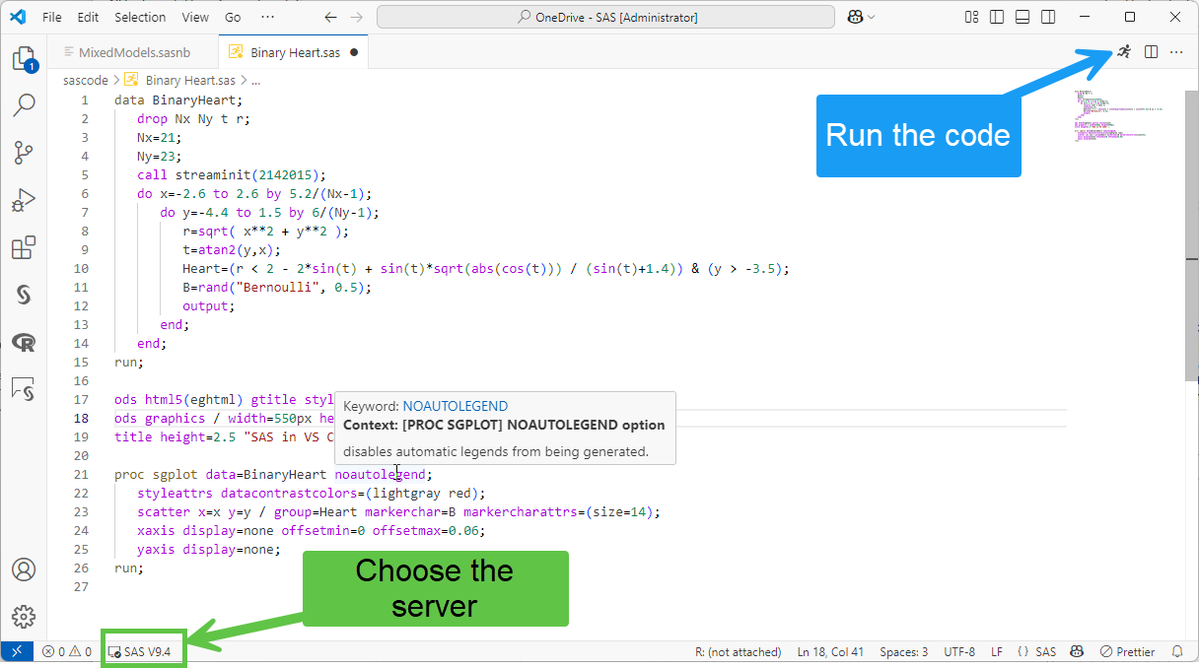
SAS Extension
Coding Window
Syntax Highlighting
Syntax Help
Auto complete
Color Themes
Keyword Explanations
Code Folding and Outlines
Multiple Compute Options
Code Snippets

Slide 9
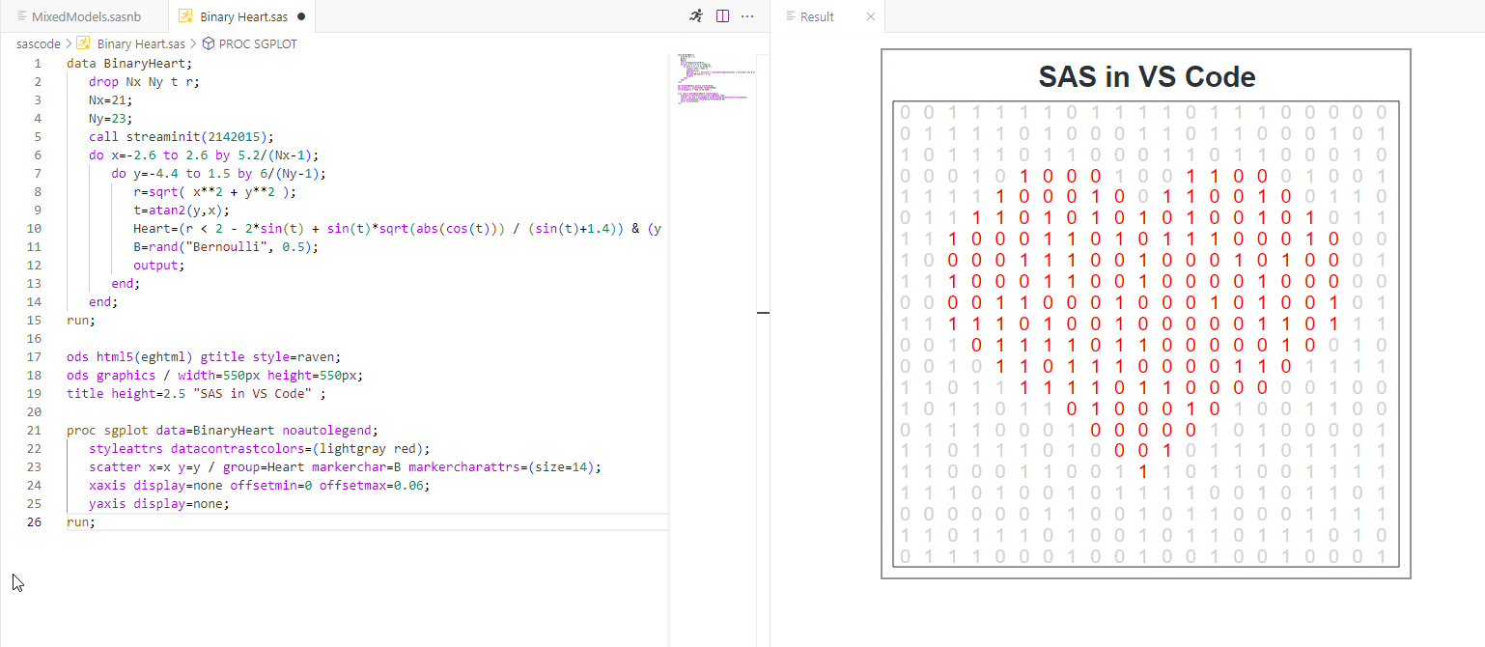
SAS Extension
Program Results

Slide 10
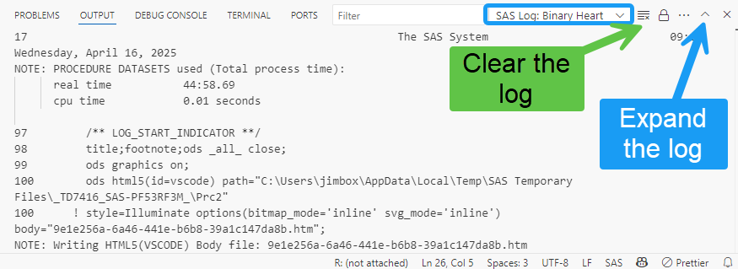
SAS Extension
Log Viewer

Slide 11
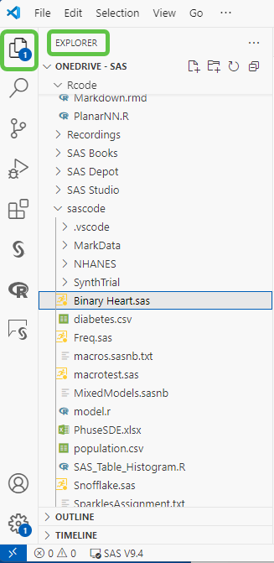
SAS Extension
Content Browser - Files

Slide 12
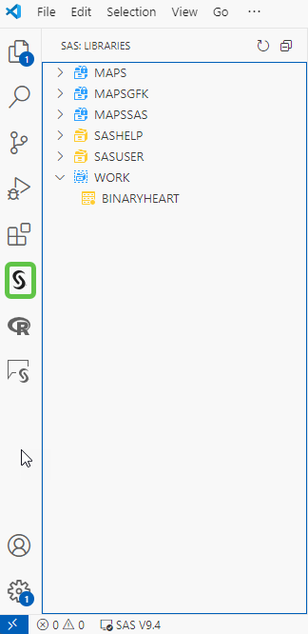
SAS Extension
Content Browser –SAS 9

Slide 13
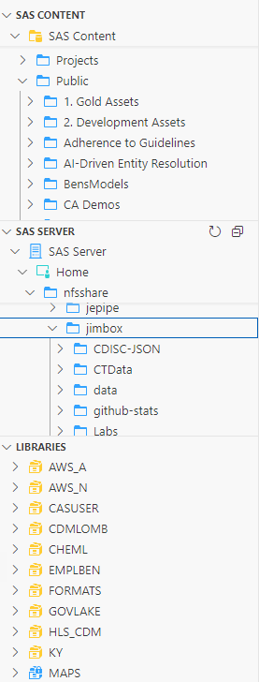
SAS Extension
Content Browser –Viya

Slide 14
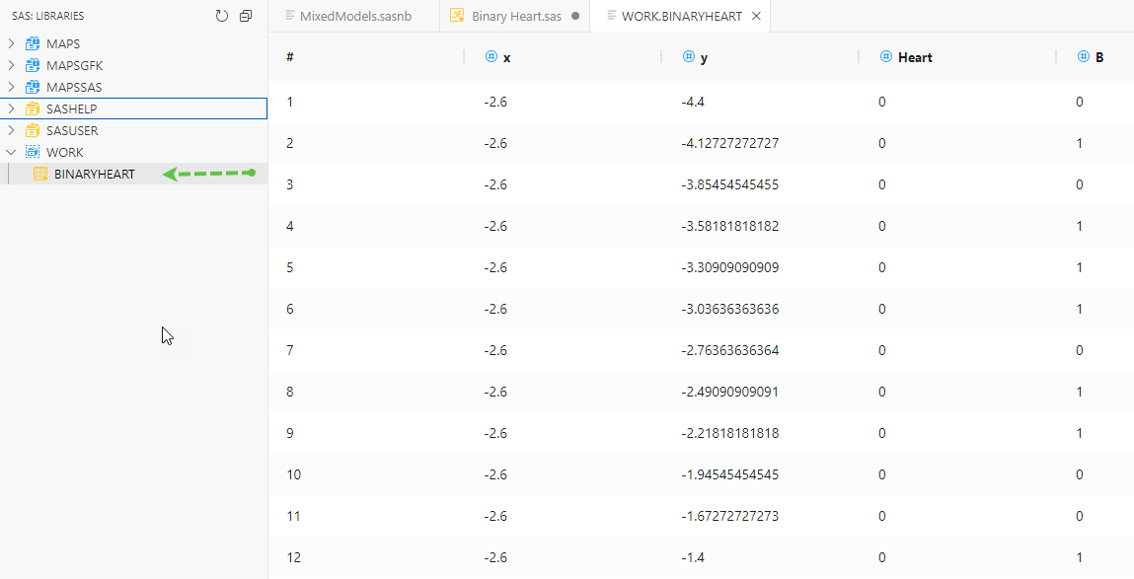
SAS Extension
Dataset Viewer

Slide 15
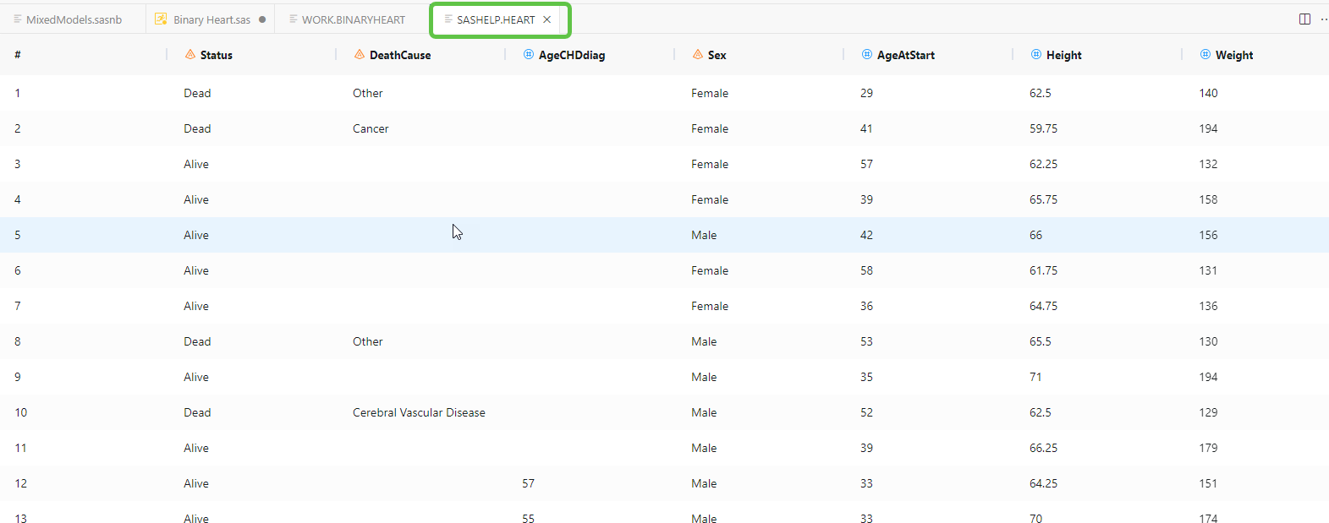
SAS Extension
Dataset Viewer

Slide 16
SAS Extension
SAS Notebooks
Interactive notebooks that combine text, code, logs, and results in one document
Excellent for telling stories with data and programming
Similar to Jupyter notebooks and R Markdown files
Sharable with other users of VS code with the plugin

Slide 17
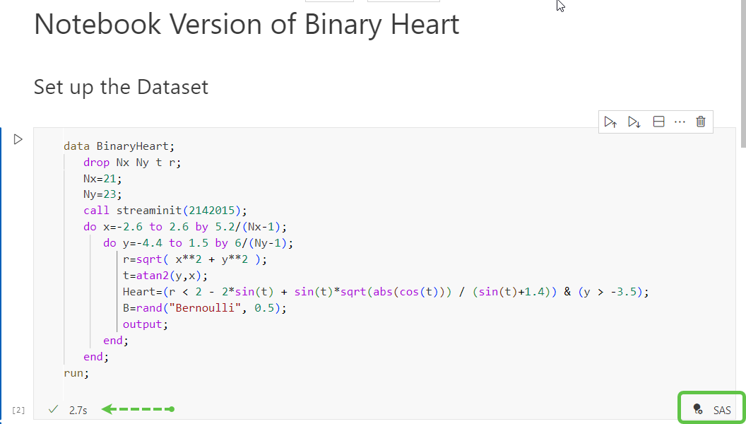
SAS Extension
SAS Notebooks

Slide 18
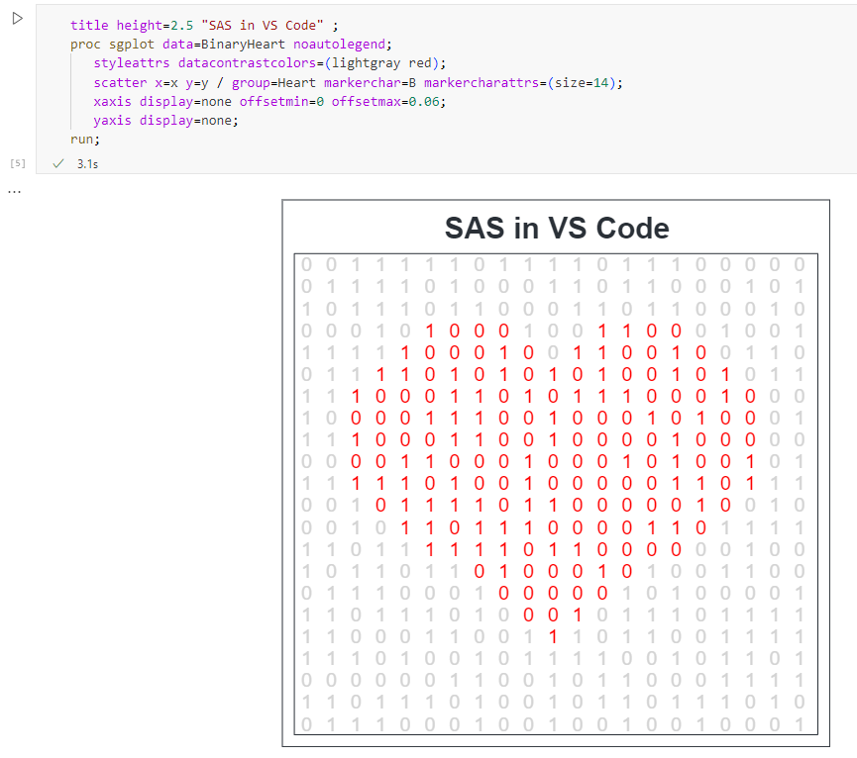
SAS Extension
SAS Notebooks

Slide 19
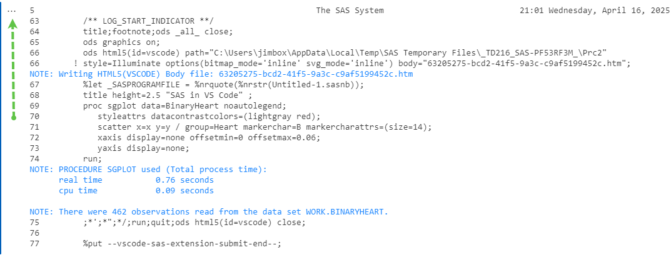
SAS Extension
SAS Notebooks

Slide 20
SAS Extension
Final Thoughts & Resources

Slide 21
Final Thoughts
My Pros and Cons
Connect to multiple SAS compute engines
Very nice formatting and code viewing
Can run other languages from the same application
SAS Notebooks in general are awesome
Can use on any OS
Dataset viewer is currently pretty basic
Placement of logs is a little hard to get used to
Must manually clear log
No background submit

Slide 22
References
Links to get you Started
Community | Link
SAS Developers | https://developer.sas.com/programming/vs_code_extension
SAS Community | https://communities.sas.com/t5/SAS-Communities-Library/SAS-Extension-for-Visual-Studio-Code/ta-p/819490
GitHub Project | https://github.com/sassoftware/vscode-sas-extension

Slide 23
Thanks!
MWSUG 2025 BB-065

