Slide 1
What is Machine Learning, Anyway?
Jim Box
MWSUG 2025 BB-063

Slide 2
Machine Learning Defined
Algorithms that train computer systems to improve their performance on specific tasks without being given explicit rules on how to do that
The “computer systems” up there is an Artificial Intelligence
ML is a branch of AI, but can also be used outside an AI application

Slide 3
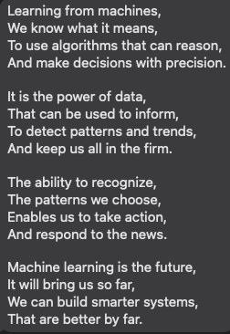
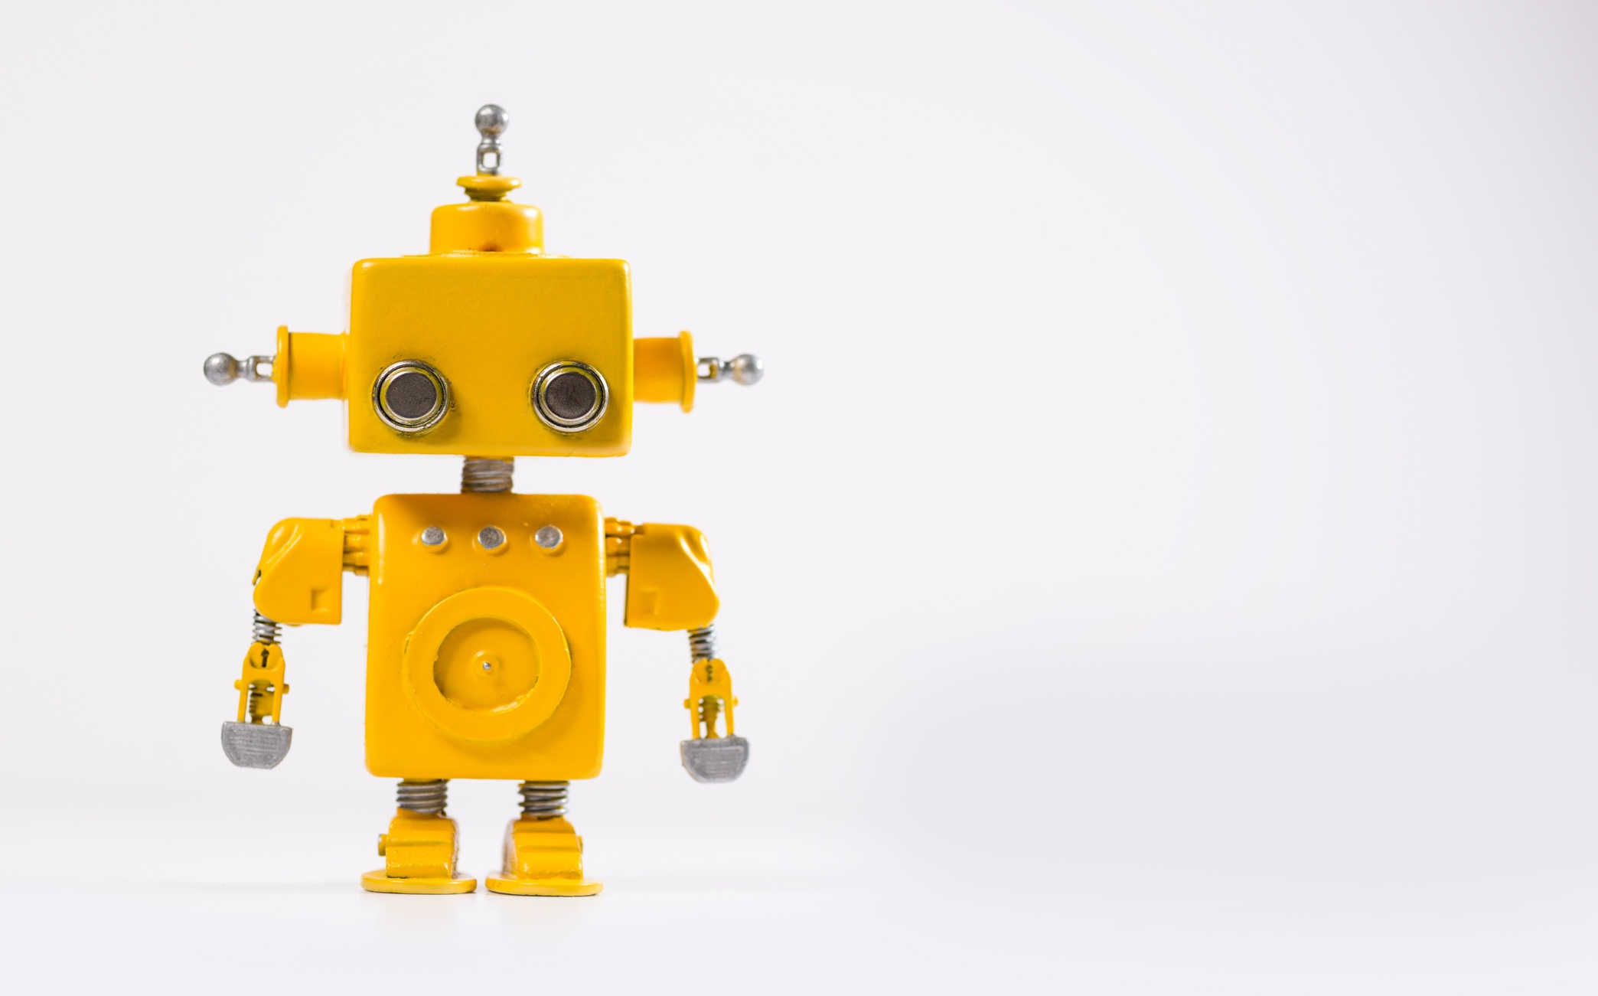
Machine Learning Defined

Slide 4
ML vs Statistical Inference
 | Statistical Inference | Machine Learning
Data | Data has some underlying probability distribution | Wide range of data types

Slide 5
ML vs Statistical Inference
 | Statistical Inference | Machine Learning
Data | Data has some underlying probability distribution | Wide range of data types
Goals | Test hypotheses / explore relationships | Make predictions / decisions

Slide 6
ML vs Statistical Inference
 | Statistical Inference | Machine Learning
Data | Data has some underlying probability distribution | Wide range of data types
Goals | Test hypotheses / explore relationships | Make predictions / decisions
Approach | Specify a model and estimate parameters | Learn patterns by itself

Slide 7
ML vs Statistical Inference
 | Statistical Inference | Machine Learning
Data | Data has some underlying probability distribution | Wide range of data types
Goals | Test hypotheses / explore relationships | Make predictions / decisions
Approach | Specify a model and estimate parameters | Learn patterns by itself
Scope | Smaller data with a specific question | Large, complex data with many variables

Slide 8
ML vs Statistical Inference
 | Statistical Inference | Machine Learning
Data | Data has some underlying probability distribution | Wide range of data types
Goals | Test hypotheses / explore relationships | Make predictions / decisions
Approach | Specify a model and estimate parameters | Learn patterns by itself
Scope | Smaller data with a specific question | Large, complex data with many variables
Validation | Check the underlying assumptions about the data | See how the model does on data from a hold-out sample

Slide 9
Machine Learning Methods
Supervised Learning – Algorithms are trained on a labeled dataset and work to predict outcomes
Unsupervised Learning – Techniques where data is not labeled or classified, so there is no target to predict
Deep Learning – ML techniques that use multiple layers of nonlinear processing to analyze data and create predictions

Slide 10
Supervised Learning
There is a Known Answer

Slide 11
Supervised Learning: Use Cases
Generally used for predictive models, mostly binary (Yes/No) predictions
Can be used for continuous variable predictions
Data is partitioned into a Training Set (~70%) and a Validation set (~30%) to see how the model does on data it was not exposed to in training -- this is to minimize overfitting the model.

Slide 12
Logistic Regression
Similar to Linear Regression, except you are predicting the probability of an outcome
Produces an equation to predict that probability of success
Hypothesis tests for each variable’s significance
You must specify a cutoff point that determines if the prediction is a success or failure
Cutoff point selection is critical, but often overlooked
Case complete model

Slide 13
Decision Trees
Find the values of variables that can split the data into branches that lead to leaves where there are a high number of success or failures
Algorithm searches through all values of all variables
Handles missing values like any other value
Very easy to interpret and use
Can limit the numbers of splits in a branch, the number of levels possible and the smallest leaf size

Slide 14
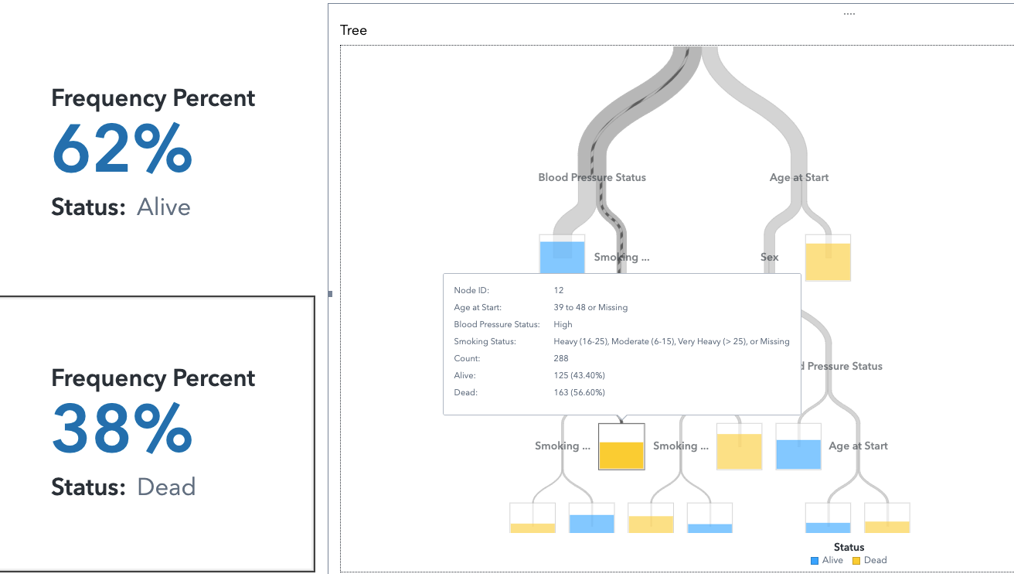
Decision Trees

Slide 15
Random Forests
Data is sampled (with replacement) to create multiple subsets of observations (bootstrapped samples)
Make a decision tree for each bootstrapped sample, using a random selection of variables
Once all trees are trained, predictions are made by running new data through each tree. Final prediction is based on majority vote
Essentially crowdsourcing predictions
Less prone to overfitting than a single tree

Slide 16
Gradient Boosting
Train a tree to make predictions
Calculate errors between predicted and actual value
Build a new model to predict errors in step 2
Combine the base model and error model to make new predictions and calculate new error rates
Repeat 2-4 until error rate stops improving
Final version gives prediction
Good for complex relationships between features and targets

Slide 17


Supervised Learning

Slide 18
Unsupervised Learning
Exploration and Pattern Detection

Slide 19
Unsupervised Learning
Goal: Discover patterns, relationships, and structures in the data
Most Common use cases:
Customer Segmentation
Anomaly Reduction
Variable Reduction
Recommendation Systems
Fraud Detection
Network Analysis

Slide 20
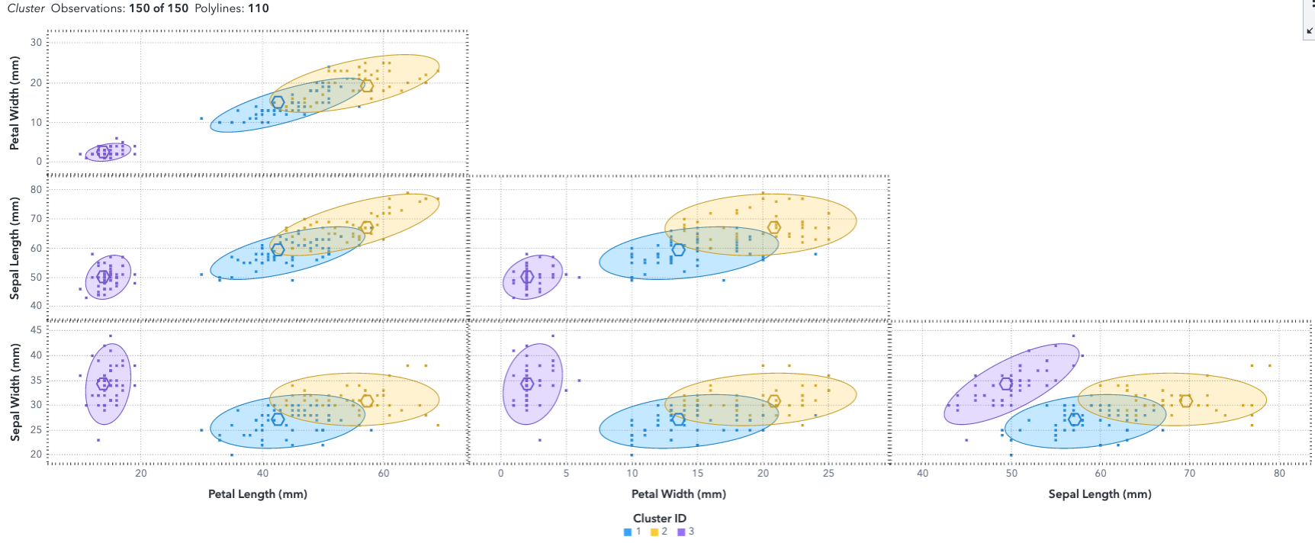
Clustering

Slide 21
Clustering
Pick a starting number of clusters
Randomly assign center points (centroids)
Determine the distance from each point to each centroid
Assign each point to the closest cluster
Find the new centroid of points assigned to each cluster
Repeat 3-5 until no observations move
Repeat the whole process with a different number of clusters

Slide 22
Principal Components Analysis
Reduce the number of variables (features) in a dataset to make modeling smoother (reducing dimensionality)
Basically, instead of needing 12 variables to explain the variance in the data, make a new set of coordinates and only need 3 features

Slide 23
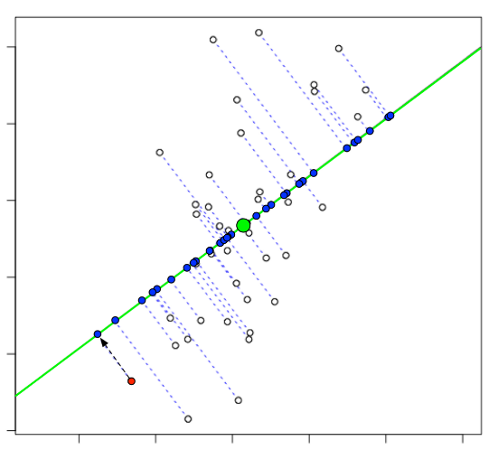
Principal Components Analysis

Slide 24
Association Analysis
Identifies sets of items that are frequently obtained together (Beer and pretzels, milk and cereal, similar types of movies streamed, that sort of thing)
Generates a bunch of association rules
Ranks the rules based on how often things are consumed together
Besides market basket analysis, also used in fraud detection and supply chain optimization

Slide 25


Unsupervised Learning

Slide 26
Deep Learning
The Mystery Begins

Slide 27
Deep Learning
Neural Networks – complex networks of neurons that make many steps of models to get from inputs to predictions
Computationally intensive and very hard to understand what’s happening (black box models)
Common Use cases:
Computer vision & pattern recognition
Natural language translation and sentiment analysis
Generating new data, such as images or videos

Slide 28
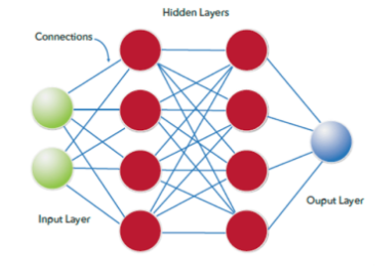
Neural Networks

Slide 29
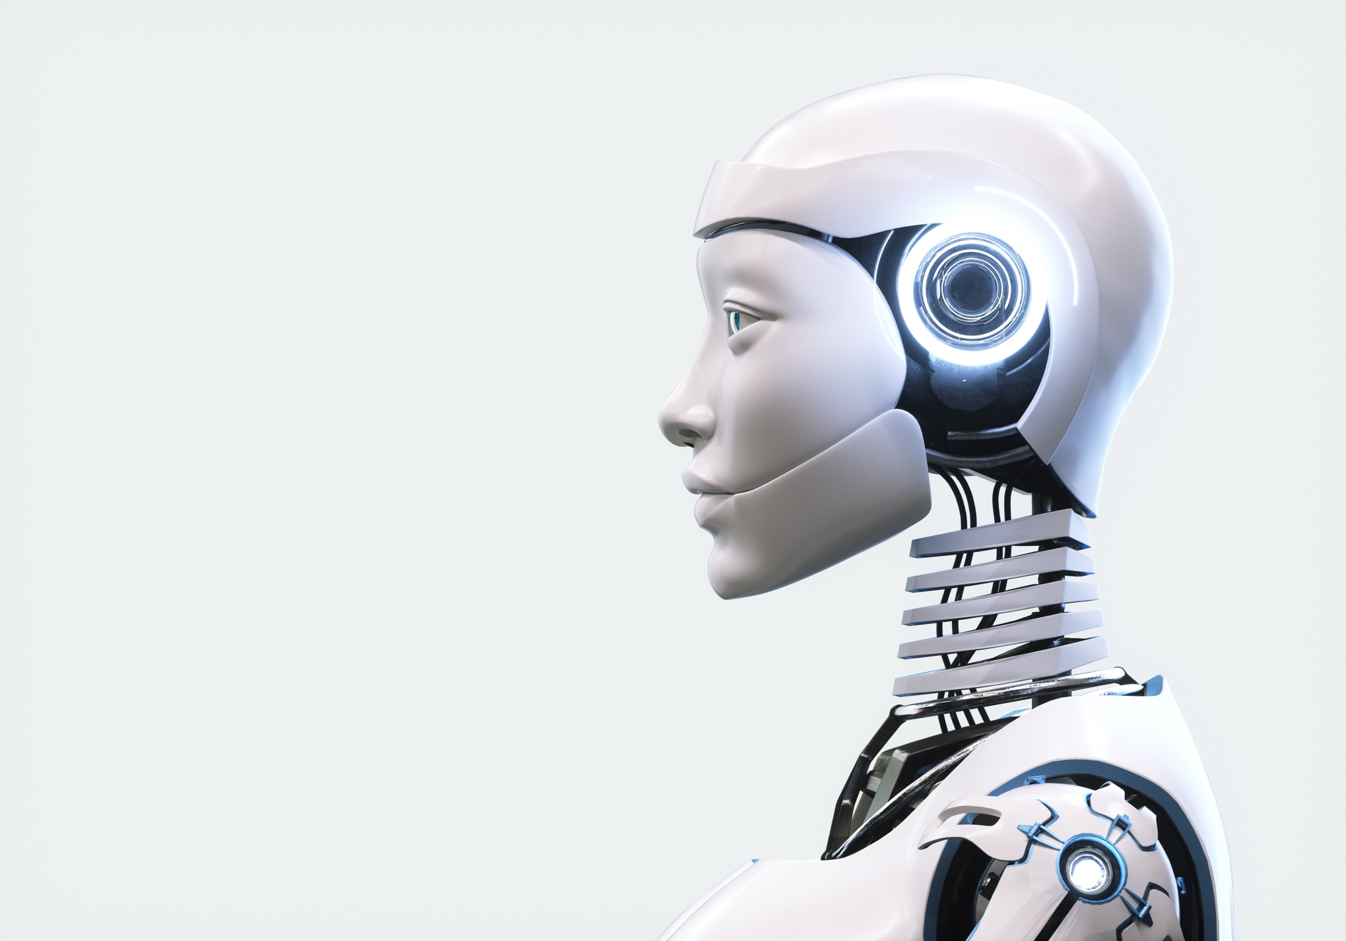
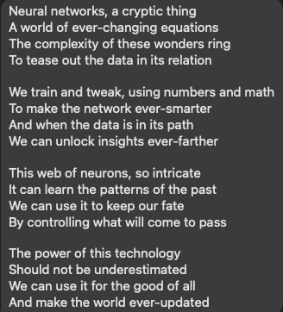
Neural Networks

Slide 30
Model Selection
How do I Pick a Winner?

Slide 31
Model Process
Partition the data into Training and Validation
Train a bunch of models in the Training data
Use the model to generate predictions on the Validation data
Compare the Predicted values to the Actual Values in the Validation partition
Use different methods to decide which is the “best” model

Slide 32
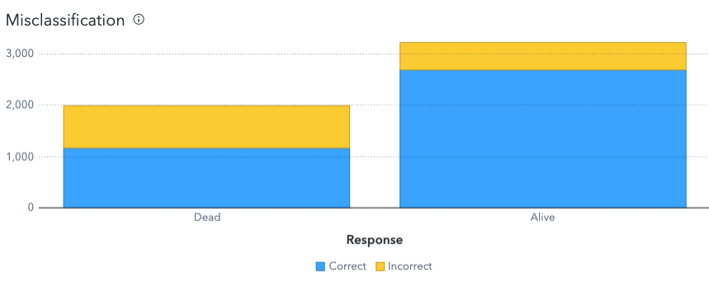
Misclassification Rate
Dependent on that Cutoff Point!

Slide 33
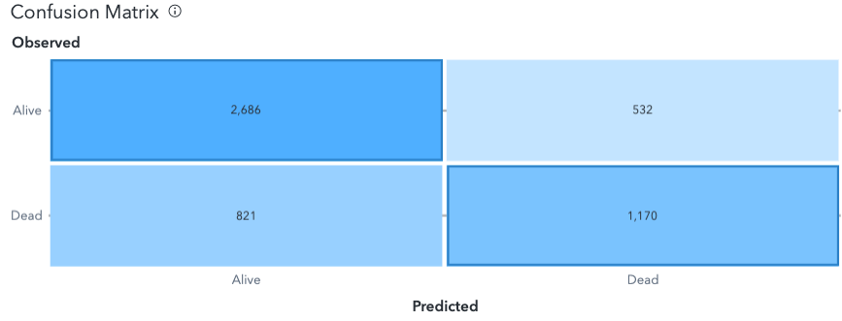
Confusion Matrix
True
Positive
False
Negative
False
Positive
True
Negative
Sensitivity: True Positive / Actually Positive = .8347
Specificity: True Negative / Actually Negative = .5876
Dependent on that Cutoff Point!

Slide 34
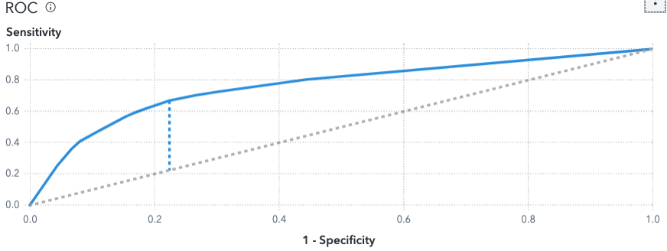
ROC Curve
AUC = Area Under Curve
AKA c-statistic (if binary)
Looks across all possible cutoff points
Identifies candidate cutoff point

Slide 35
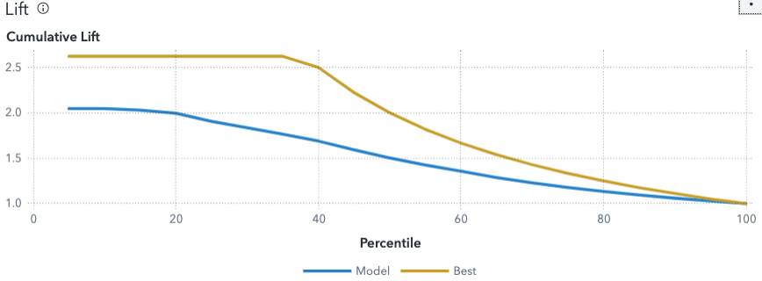
Lift Curves
Independent of cutoff points – uses predictions

Slide 36

Machine Learning Summary

Slide 37
Thanks!
MWSUG BB-063

