Slide 1
Cutting Edge Regression Methods: RIDGE, LASSO, LOESS, and GAM
David J Corliss, PhD
Midwest SAS User Group
October 7, 2025
Copyright: Grafham Analytics 2025
All Rights Reserved

Slide 2
Penalized Regression: Ridge Regression
Regression Type: linear, penalized regression
Contributions from predictor variables reduced by the square of the magnitude of the coefficients, favoring models with many strong contributors
Supports measurement and analysis of the amount of collinearity and parameterization of the ridge factor
SAS = REG with RIDGE option, R = glmnet

Slide 3
Special Model Types: Ridge Regression
Source Code and Options
proc reg data=rm.homelessstudents ridge=0 to .04 by .005;
outvif outest=ridgests plots(only)=ridge(unpack VIFaxis=log);
model hs_pct_10 = GINI_10 GINI_pct_change Pov_Change_09_11
aa_pct hisp_latino_pct indian_alaskan_pct
high_school_grad_pct_10 mhi_09 mfi_acs_10; run;
REG Statement Options
ridge – ridge parameter limits and step size
outvif – output variance inflation factor => severity of multicol.
outseb – output standard errors and parameter estimates
PLOT Statement Options
all – lots of plots but many are seldom used
ridge – shrinking by ridge parameter as the model converges

Slide 4
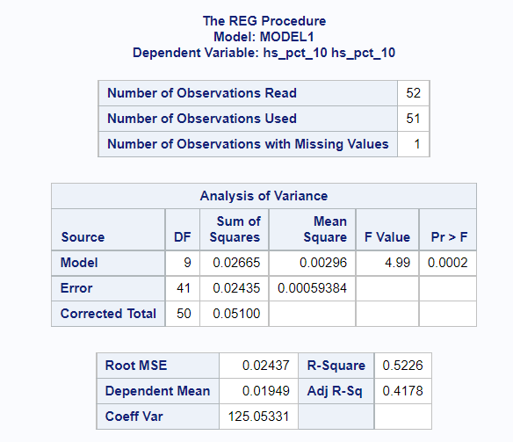
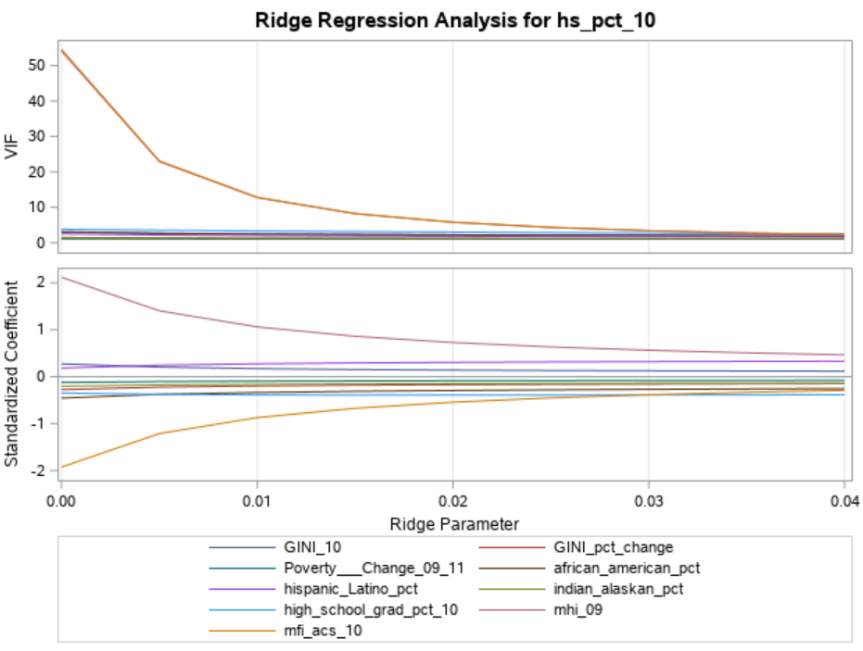
Special Model Types: Ridge Regression
Output and Plots

Slide 5
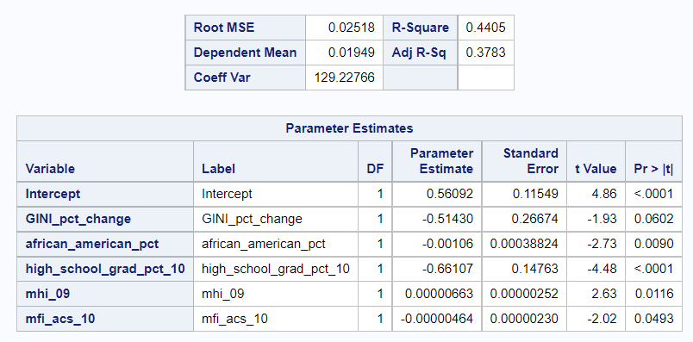
Special Model Types: Ridge Regression
Example 2: OUTSEB for model parameters
proc reg data=rm.homelessstudents ridge=0 to .04 by .005 outseb;
outvif outest=ridgests plots(only)=ridge(unpack VIFaxis=log);
model hs_pct_10 = GINI_pct_change african_american_pct
high_school_grad_pct_10 mhi_09 mfi_acs_10;
run;
In this example, a final run with the strongest variables from earlier runs performs well

Slide 6
Special Model Types: LASSO Regression
Regression Type: linear, penalized regression
Contributions from predictors reduced by the sum of the absolute values of the magnitude of the coeffi-cients, favoring models with a few strong contributors
Supports multiple cross validation, a variety of methods for choosing variables for the model with the CHOOSE statement, and Bayesian analysis
SAS = GLMSELECT with LASSO option, R = glmnet

Slide 7
Special Model Types: LASSO Regression
Source Code and Options
proc glmselect data=rm.sas_baseball plots=all;
partition fraction(validate=.3);
model logSalary = nAtBat nHits nHome nRuns nRBI nBB
yrMajor crAtBat crHits crHome crRuns
crRbi crBB nOuts nAssts nError
/ selection=lasso(stop=none choose=validate);
run;
MODEL Statement Options
selection – must = lasso to use this method
stop – sets the criteria for when to stop variable selection, stop=none examines all variables in the MODEL statement
choose – sets criteria for choosing the model; default is AICC, sbc is Schwarz Bayesian information criterion
PARTITION Statement Options
validate – states the fraction for the validation sample

Slide 8
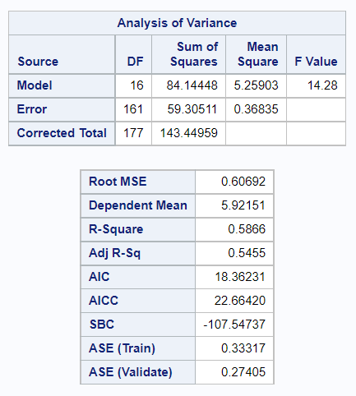
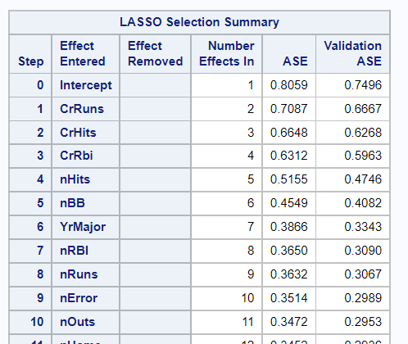
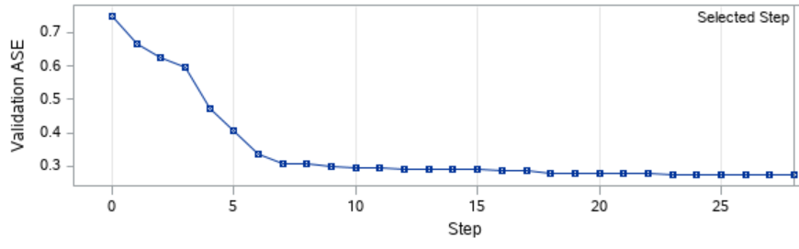
Special Model Types: LASSO Regression
Output and Plots

Slide 9
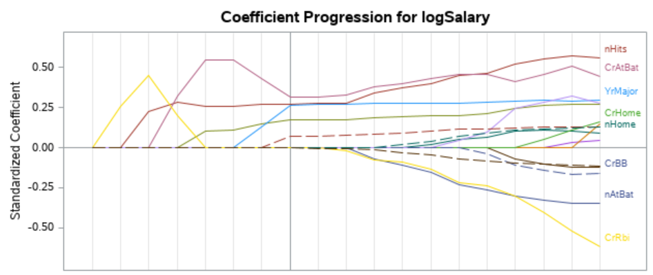
Special Model Types: LASSO Regression
Example 2: Adaptive LASSO w/ Bayesian
proc glmselect data=rm.sas_baseball plots=all;
partition fraction(validate=.3);
model logSalary = nAtBat nHits nHome nRuns nRBI nBB
yrMajor crAtBat crHits crHome crRuns
crRbi crBB nOuts nAssts nError / selection=lasso(adaptive stop=none choose=sbc);
run;
Adaptive LASSO improves the ability to select just the strongest predictors and Bayesian analysis is specified using choose=sbc

Slide 10
Non-Parametric Models: Localized
Local Regression
Regression Type: linear, non-parametric
Develops a model using non-parametric regression to segments of data and calculates confidence limits for
the outcome; computationally intensive
Supports multiple dependent variables, multidimensional predictors and interpolation using kd trees
SAS = LOESS, R = locfit

Slide 11
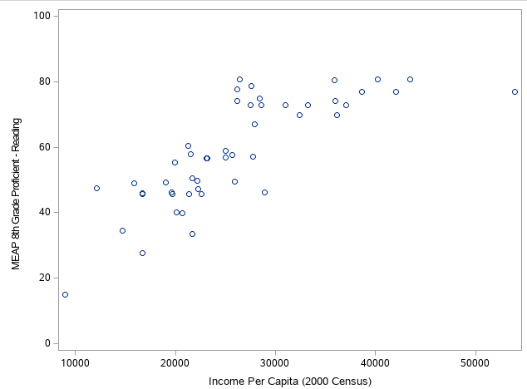
Non-Parametric Models: Local Regression
Source Code and Options
ods graphics on;
proc loess data=rm.sem_eduction;
ods output OutputStatistics=GasFit
FitSummary=Summary;
model MEAP8_Read = PCI_2000;
run;
ods graphics off;
MODEL Statement Options
degree – degree of the local polynomials (either 1 or 2)
select= – specifies a smoothing method: AICC, AICC1,
GCV, DF1, DF2, or DF3
direct – requires direct fitting at every point
std – outputs the standard of the mean predicted values
SCORE Statement Options
clm – output confidence limits with the score

Slide 12
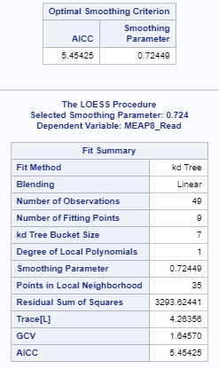
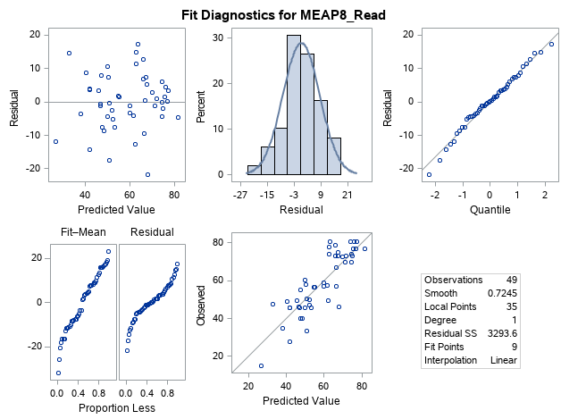
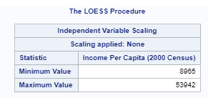
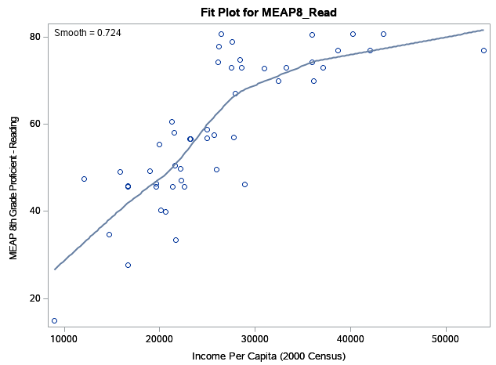
Non-Parametric Models: Local Regression
Output and Plots
Local Regression is an option for complex functional forms –
here it fits the same data as one example for PROC NLIN

Slide 13
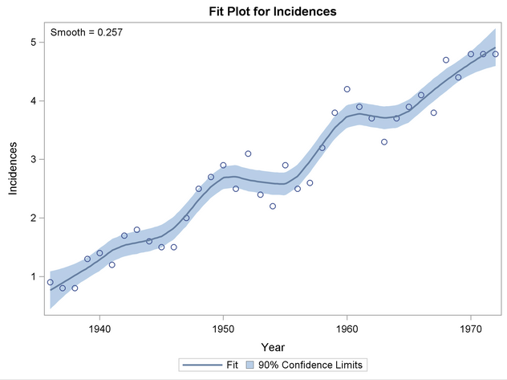
Local Regression
Example 2: Smoothing Data with PROC LOESS
proc loess data=Melanoma;
model Incidences=Year/clm alpha=0.1
run;
SAS Figure 50.13 Loess Fit of Melanoma Data with 90% Confidence Limits
In this example, Local Regression is used with a smoothing
factor to model a complex form without overfitting

Slide 14
Non-Parametric Models: Additive
Generalized Additive Models
Regression Type: linear, non-parametric
Generalized Additive Models, with multiple independent non-parametric predictors; univariate smoothing provides finer details than is possible with the piece-wise LOESS procedure
Supports non-parametric and semi-parametric models, multidimensional predictors
SAS = GAM, R = gam

Slide 15
Non-Parametric Models: Generalized Additive Models
Source Code and Options
proc gam data=rm.baseball plots(unpack)=all;
model term_2017 = spline(RateApril) spline(RateMay)
spline(RateJune / method=gcv;
output out=PredGAM p=Gam_p_;
run;
GAM Statement Options
descending – reverses the sort order of the class variable
plot= – plotting options: all, unpack
MODEL Statement Options
anodev – smoothing options: refit, norefit, none
maxiter – maximum number of estimation iterations
method=gcv – smoothing parameter uses the generalized cross
validation method

Slide 16
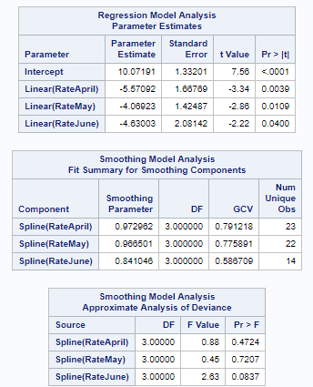
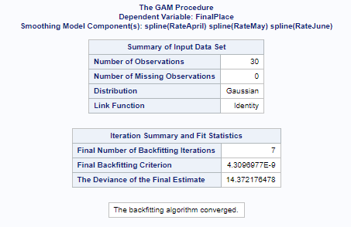
Non-Parametric Models: Generalized Additive Models
Output and Plots

Slide 17
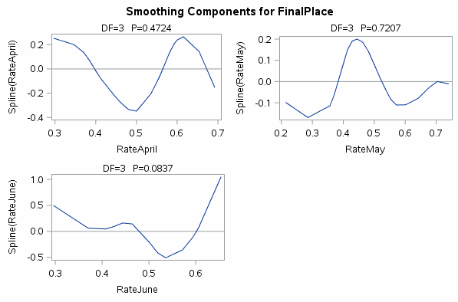
Non-Parametric Models: Generalized Additive Models
Output and Plots

Slide 18
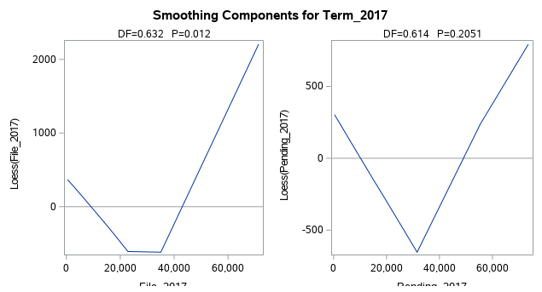
Additive Model
Example 2: Segmented Response Surface
ods graphics on;
proc gam data=rm.bankruptcy plots(unpack)=all;
model term_2017 = loess(file_2017) loess(pending_2017) /
method=gcv;
output out=PredGAM p=Gam_p_;
run;
ods graphics off;
An Additive Model used to fit a complex response surface
without loss of detail to due piece-wise fitting in local regression

Slide 19
Cutting Edge Regression Methods:
LASSO, RIDGE, LOESS, GAM
David J Corliss, PhD
Grafham Analytics
davidjcorliss@gmail.com

