Slide 1
SAS Macros and PROC FCMP
A comparative inquiry
Vijay Govindarajan
Principal Systems Engineer, Customer Advisory,
SAS Institute Inc
Vijay Govindarajan has spent over 15 years at SAS Institute, serving in a variety of roles including developer in SAS R&D, architect in SAS Services, and Systems Engineer in the Global Technology Practice. He is passionate about SAS programming, data architecture, and analytics. Vijay holds master’s degrees in Biomedical Engineering (Marquette University) and Data Analytics (Georgia Institute of Technology).

Slide 2
Agenda
Conditional Macro Programs
Functional style macros
Proc FCMP Functions and Subroutines
When do you use Macro and PROC FCMP?

Slide 3
Problem Statement
SAS Macro is a powerful tool in SAS, but is it the best option for every use case?
Would PROC FCMP be better in certain scenarios over using SAS Macros?
We’ll get into these questions but first some basics.

Slide 4
SAS Macro Programming
Top use cases
Automating repetitive code
  Code that is repeatedly executed by changing parameters
  Eg: Create standard reports for different trials or departments etc.
Dynamic code generation based on conditional logic
  Different code is executed based values passed to macro parameters
  Eg: Data load for Sales would use different columns compared to data load for inventory
  Eg: if value is REPORT, create a report; if value is ANALYZE, run analysis etc.
Standard data validation macros
  These are very popular to evaluate datasets and make sure they have the right columns and data.
Using macros as functions
  Create macros as functions to “return” values to the calling program/code.

Slide 5
Conditional Macros

Slide 6
Conditional Macro Programming
Example
%myUtilityMacro(
action= REPORT, /* Required: (e.g., 'summarize', 'report', 'analyze') */
dataset=sashelp.cars, /* Required: Input dataset */
var= make model origin mpg_city mpg_highway, /* Optional: Variables */
groupvar= make, /* Optional: Grouping variable */
outputds=cars_out, /* Optional: Output dataset name */
where_clause= mpg_city>=25 /* Optional: WHERE clause for filtering data */
);
In this macro call, based on the value passed to the action parameter, different code is executed.
The values for the optional parameters are evaluated and code is compiled accordingly.
For example, if a value is provided for the where_clause, it will be included in the action to subset the data.

Slide 7
Macro Programs
Define the Macro
%macro carinfo (action=REPORT);
%if %upcase(&action.) = REPORT %then %do;
proc print data=sashelp.cars (obs=&obs);
title "Report for Vehicles from &origin (Rows Displayed: &obs)";
var Make Model Type DriveTrain MSRP Invoice;
where Origin="&origin";
run;
%end;
%else %if %upcase(&action.) = SUMMARIZE %then %do;
proc means data=sashelp.cars;
title "Summary for Vehicles from &origin";
var MSRP Invoice Horsepower MPG_City MPG_Highway;
where Origin="&origin";
run;
%end;
%mend;
Notes:
Demo conditionalMacroExample.sas in EG.

Slide 8
Functional Style Macros

Slide 9
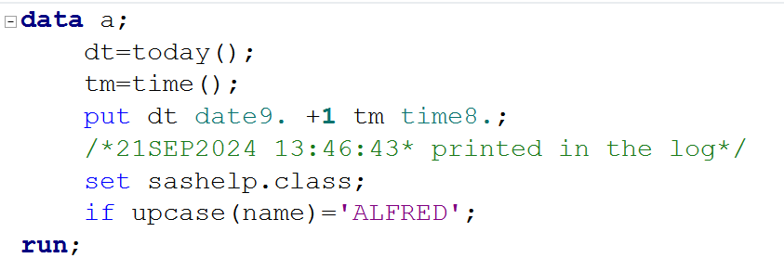
Functions
Functions are usually used to manipulate or transform a set of inputs to return a derived value back to the executing program.⁴
Function make it easy to reuse code with simple calls to the function.
There are many data step and macro functions available in SAS.
Here is simple data step using some functions.
Notes:
Note today() and time() functions don’t take any inputs but returns a value.
Upcase() function takes a string as input and returns the string back in upper case.
There are hundreds of datastep functions available in SAS.
Lot of times your assign the value returned from a function to a variable but functions can also be used INLINE within a statement like the upcase() function shown here.

Slide 10
Functional Style Macros
Function-style macros are SAS macros that take one or more parameters as input and “returns” a value that is substituted back in the calling statement.
The following ways to implement Functional-style macros in SAS will be discussed in the upcoming slides.
  SCL (SAS Component Language)
  DOSUBL()
A SCL style functional macro has 3 ingredients.
  Macro (duh!)
  SCL function(s)
  %sysfunc()

Slide 11
Creating SAS Macro Functions Using SCL
About SCL – Ingredient 2
SCL or SAS Component Language has a few useful functions.
SCL functions allows access to dataset metadata and to manipulate SAS datasets.
Using these function in SAS macros, we can create functional style macros.
Notes:
OPEN (dataset name, dataset access method)
Returns a dataset identifier as a numeric value
Returns a zero if the dataset cannot be opened (e.g. because another user has an exclusive lock on the dataset)
The dataset identifier returned by the function can be used by other SCL functions to reference the OPEN dataset when they perform their actions
In most case you will use ‘I’ as the dataset access method as this denotes a read-only access method that can help prevent the locking of a dataset to other users
Example syntax: DSID = OPEN(“SASHELP.CLASS”,”I”);
CLOSE (dataset identifier)
Closes the dataset referenced by the dataset identifier and releases it for use
Must be called when you have finished with the dataset otherwise your program will still have a handle (or reference) to the open dataset
Example syntax: RC=CLOSE(DSID);
ATTRN – returns a number of different numeric metadata items about a dataset including the number of observations and the number of variables. N.B. There are a number of different ways to return the number of observations from this function (different counts may include deleted observations etc.) so make sure you select the right one.
ATTRC – returns character information about a dataset but is generally less useful that ATTRN.
VARNAME – returns the name of a dataset variable based on its index number (position in the dataset).
VARNUM – returns the variable index based on the variable name. Returns a zero if the variable does not exist.
VARTYPE – returns the variable type (character or numeric).

Slide 12
Creating SAS Macro Functions Using SCL
Commonly used SCL functions (there are over 50)
Function | Purpose
DSID=OPEN (dataset name, dataset access method) | opens dataset and returns a dataset identifier as a numeric value.
CLOSE (DSID) | Closes the dataset referenced by the dataset identifier
ATTRN() | returns a number of different numeric metadata items about a dataset
ATTRC() | returns character information about a dataset
VARNAME() | returns the name of a dataset variable based on its index number
VARNUM() | returns the variable index based on the variable name
VARTYPE() | returns the variable type (character or numeric)
Notes:
OPEN (dataset name, dataset access method)
Returns a dataset identifier as a numeric value
Returns a zero if the dataset cannot be opened (e.g. because another user has an exclusive lock on the dataset)
The dataset identifier returned by the function can be used by other SCL functions to reference the OPEN dataset when they perform their actions
In most case you will use ‘I’ as the dataset access method as this denotes a read-only access method that can help prevent the locking of a dataset to other users
Example syntax: DSID = OPEN(“SASHELP.CLASS”,”I”);
CLOSE (dataset identifier)
Closes the dataset referenced by the dataset identifier and releases it for use
Must be called when you have finished with the dataset otherwise your program will still have a handle (or reference) to the open dataset
Example syntax: RC=CLOSE(DSID);
ATTRN – returns a number of different numeric metadata items about a dataset including the number of observations and the number of variables. N.B. There are a number of different ways to return the number of observations from this function (different counts may include deleted observations etc.) so make sure you select the right one.
ATTRC – returns character information about a dataset but is generally less useful that ATTRN.
VARNAME – returns the name of a dataset variable based on its index number (position in the dataset).
VARNUM – returns the variable index based on the variable name. Returns a zero if the variable does not exist.
VARTYPE – returns the variable type (character or numeric).

Slide 13
Creating SAS Macro Functions Using SCL
About %SYSFUNC – Ingredient 3
%sysfunc() is a SAS Macro Function that allows us to use datastep and SCL functions in the context of SAS Macro language.
Example
%macro sysfunc1;
  %let aa1=10;
  %let bb1=20;
  %let meanab1=%sysfunc(mean(&aa1,&bb1));
  %put Mean of aa1 and bb1 = &meanab1;
%mend sysfunc1;
%sysfunc1
&meanab1 resolves to the value 15.
Notes:
Before we proceed further with using SCL to create macro functions, there is one more topic we need to understand %sysfunc.
%sysfunc allows us to use datastep functions and SCL function in the context of SAS Macro language.

Slide 14
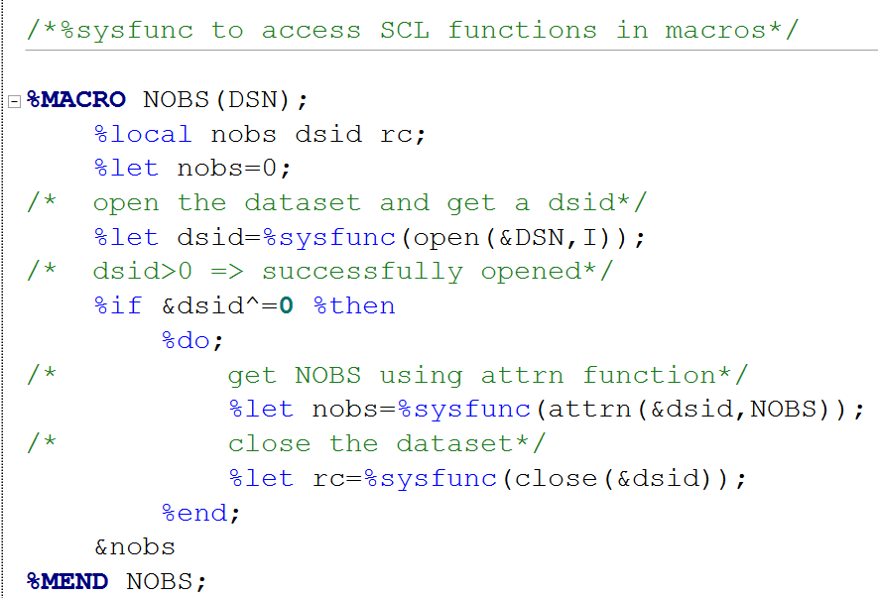
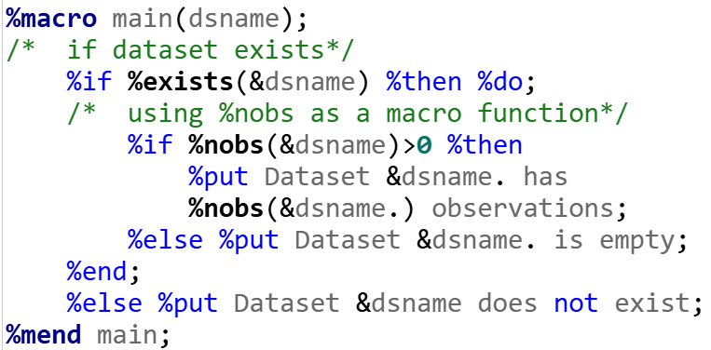
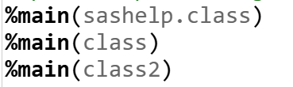
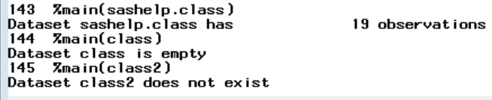
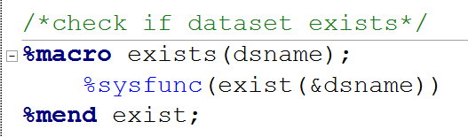
Creating SAS Macro Functions Using SCL
SCL recipe - Putting it together!
Notes:
Demo this code: 19_SCL_Functional_macro_example.sas
‘I’ as the dataset access method as this denotes a read-only access method that can help prevent the locking of a dataset to other users

Slide 15
Creating SAS Macro Functions Using DOSUBL()
Dosubl() basics
The DOSUBL function enables the immediate execution of SAS code after a text string is passed.
The function imports macro variables from the calling environment, and macro variables that are created or updated during the execution of the submitted code are exported back to the calling environment.
DOSUBL should be used in a DATA step. The function can also be used with %SYSFUNC outside a step boundary.
DOSUBL executes code in a different SAS executive (known as a side session).

Slide 16
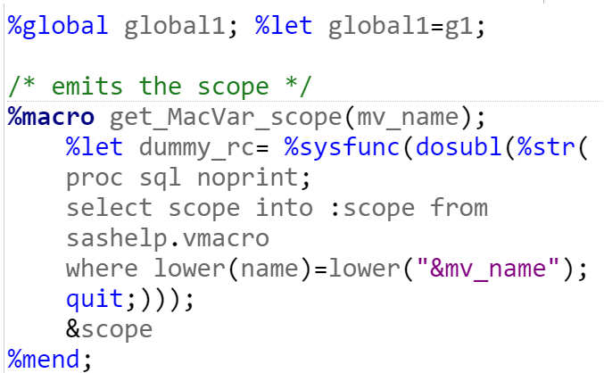
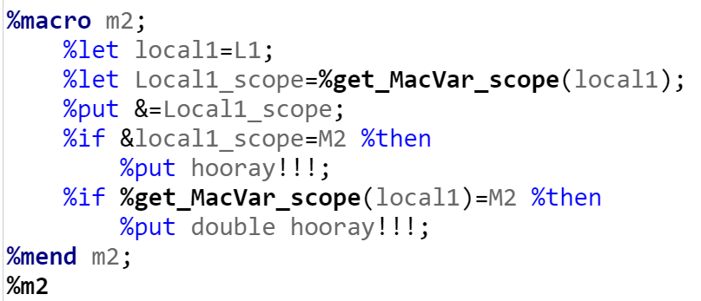




Creating SAS Macro Functions Using DOSUBL()
Dosubl() usage
Notes:
Demo: 20_DOSUBL_Functional_macro.sas

Slide 17
PROC FCMP
Function and SubRoutines

Slide 18
PROC FCMP
What and Why
What is PROC FCMP?
  FCMP stands for Function Compiler
  Enables you to write custom functions and subroutines in SAS
  Like how functions work in other languages like Python or R
Why should you use it?
  Reusable logic — define once, use across multiple steps or programs
  Encapsulated and local — no risk of global macro variable conflicts
  Type-aware — enforces numeric/character types, reducing errors
  Integrates natively — callable from DATA steps, PROC SQL, IML, DS2, and more
  Built for computation — supports arrays, loops, and math functions natively
  Clean code — easier to test, debug, and maintain

Slide 19
PROC FCMP
Example
/* Define the function using PROC FCMP */
proc fcmp outlib=work.funcs.financial;
function calc_rar(return, riskfree, volatility); /*function params */
if volatility = 0 then do; /* Check for division by zero */
put "ERROR: Volatility cannot be zero.";
return (.);
end;
/* Calculate risk-adjusted return */
return ((return - riskfree) / volatility); /* RETURN STMT !!!! */
endsub;
run;
/* Make the function available */
options cmplib=work.funcs;
Notes:
The primary purpose of OUTLIB= is to specify the library, dataset, and package where your PROC FCMP compiled functions and subroutines will be stored. When you run PROC FCMP with this option, SAS doesn't just execute the functions in memory; it compiles them into a special SAS file that can be reused in subsequent SAS sessions or by other programs.
Does a calculation and returns a value.

Slide 20
PROC FCMP Function
Usage
data investments; /* Sample dataset */
input Return RiskFreeRate Volatility;
datalines;
0.12 0.02 0.15
0.08 0.015 0.10
0.15 0.025 0.20
;
run;
/* Usage – PROC FCMP function in DATA step */
data investments_fcmp;
set investments;
RiskAdjustedReturn = calc_rar(Return, RiskFreeRate, Volatility);
run;
Notes:
Useful for complex logic implementation

Slide 21
PROC FCMP
Function Vs SubRoutine
Feature | FUNCTION | SUBROUTINE
Purpose | To calculate and return a single value. | To perform an action or calculate and return multiple values (or modify inputs).
Return | Uses the RETURN() statement to explicitly send back a single value. | Does not have a RETURN() statement for a value. Values are "returned" by modifying parameters passed by reference.
Output | All parameters are passed by value by default. | Parameters intended for output must be explicitly declared using the OUTARGS statement.
Invocation | Called as part of an expression or an assignment statement. | Called using a CALL statement in a DATA step.

Slide 22
When do you use Macro and PROC FCMP?

Slide 23
The Important Question
When do you use Macro and PROC FCMP
PROC FCMP and SAS macros serve different purposes, though they can sometimes overlap in functionality.
PROC FCMP is for creating user-defined functions and subroutines to use in DATA steps or other SAS procedures and offers a more structured and reusable approach for computations.
Macros are primarily for code generation and automation, substituting text to simplify repetitive tasks or parameterize code.
Macros are typically resolved and used during compile time whereas functions are executed during run time.
Due to familiarity with programmers, Macros are often overused for creating functions and PROC FCMP provides a more efficient alternative in such cases.

Slide 24
Contact Information
Name: Vijay Govindarajan
Organization: SAS Institute Inc, Cary NC
E-mail: vijay.Govindarajan@sas.com
Web: LinkedIn

