Slide 1
Accelerating Your SAS Data Step
Tips and Best Practices for SAS Viya Migration
Vijay Govindarajan
Principal Systems Engineer, Customer Advisory,
SAS Institute Inc
Vijay Govindarajan has spent over 15 years at SAS Institute, serving in a variety of roles including developer in SAS R&D, architect in SAS Services, and Systems Engineer in the Global Technology Practice. He is passionate about SAS programming, data architecture, and analytics. Vijay holds master’s degrees in Biomedical Engineering (Marquette University) and Data Analytics (Georgia Institute of Technology).

Slide 2
Agenda
SAS Viya Migration Vs Modernization
FAQs
Six Steps in CAS lifecycle
The Basic Setup
Data Step Considerations for CAS
Resources

Slide 3
SAS Viya Migration Vs Modernization
Compute Vs CAS Engine

Slide 4
Migration Vs Modernization
SAS Viya Engines
Migration - Compute
SAS 9 code executes as-is in SAS Viya Compute Server
Single threaded execution of data step code
No overhead to load data
Can be faster for smaller data sets
All SAS 9 data step functionality supported in the Compute server.
No new concepts are required to run SAS 9 code in SAS Compute.
Best suited for the Crawl-Walk Phase of SAS Viya migration
Modernization - CAS
Changes are required to process SAS 9 code in Viya CAS Server.
Data is loaded in-memory across CAS nodes and executed in parallel
Overhead to load data to CAS
Much faster for large datasets
Most but not all SAS 9 functionality is supported in the CAS Server
Need to understand CAS Session, CASLibs and the CAS lifecycle
Best suited for the Walk-Run phase of the SAS Viya migration

Slide 5
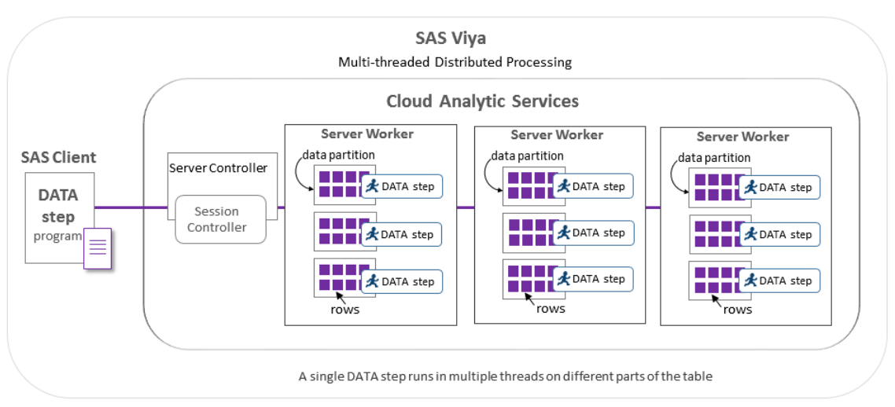
CAS Distributed Processing
Notes:
CAS partitions and distributes data across multiple physical machines. The DATA step runs by default in multiple threads on every available node. When the DATA step runs in multiple threads in a distributed CAS server, CAS partitions and distributes the table data across the cluster. Then, the DATA step runs in multiple threads on each node, allocating one DATA step thread per partition. Thus, each thread processes only a portion of the table. If your data is big, your big data is distributed and simultaneously processed.

Slide 6
FAQs

Slide 7
FAQs
Do I have to update data step code for it work in SAS Viya?
  No, you don’t. The code works as-is in the SAS Compute Server.
What’s the use of the CAS Server?
  CAS Server is an in-memory, distributed, parallel processing server which provides great performance improvements especially when dealing with large data.
Is CAS Server always faster than the SAS Compute Server?
  No. There are guidelines for identifying use cases to run in the CAS Server. Large datasets, long running processes, high computations are some good use cases to move to CAS.
Is it a significant effort to move code to CAS?
  In my experience, for the most part it has been simple. In some cases, there might be a need to find CAS enabled functions, loading formats or supported options.

Slide 8
FAQs
Should I care about CAS?
  YES! The performance improvement for the right use cases can be manifold.
Are there specific steps to take to gain performance improvement in CAS?
  No. Just executing the right use cases in CAS results in better performance because of the in-memory, distributed, parallel processing capability in CAS.
Does all the code need to be migrated to CAS?
  Absolutely NOT. In fact, most of the code will likely run on the Compute Server and only a small percentage of the code will be updated to run in the CAS Server.
Notes:
Should I care about CAS?
YES! The performance improvement for the right use cases can be manifold. Example: One of my data steps went from running in 3 hours 30 minutes to 6 minutes, simply by going to CAS processing. The overall process time went from 110 hours in SAS 9 / compute to 10.5 hours with CAS processing of multiple data steps and procs.

Slide 9
Six Steps in CAS lifecycle
Notes:
Presenter: Brian

Slide 10
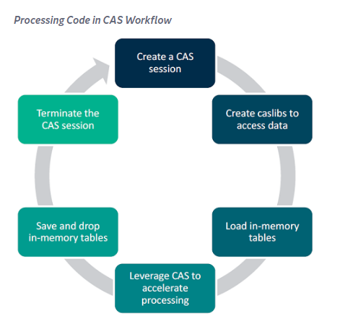
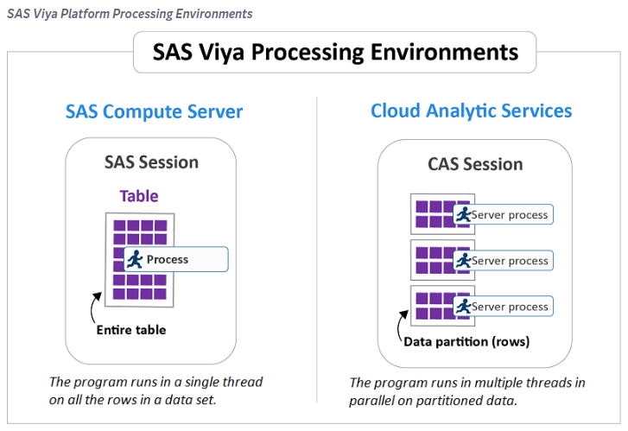
Processing Code in CAS
Notes:
Presenter: Brian
The following steps are recommended to execute SAS code in CAS:
Create a CAS session.
Create a caslib to access your data.
Load data into in-memory tables.
Use CAS where appropriate to improve processing speed.
Save and drop in-memory tables.
End your CAS session.
The SAS Viya platform programs and jobs that are not run on the CAS server run on the SAS Compute Server.
CAS writes a note to the log to indicate where the program or job ran:
Log
NOTE: Could not execute DATA step code in Cloud Analytic Services. Running DATA step in the SAS client. NOTE: Running DATA step in Cloud Analytic Services.

Slide 11
The Basic Setup
CAS Session and CASLibs

Slide 12

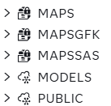
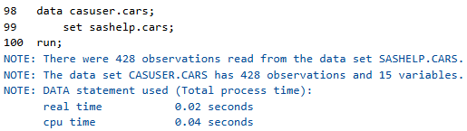
The Basics
CAS Session and CASLibs
/*create a SAS Session */
cas mysession;
/* assign Cas librefs */
caslib _all_ assign;
/* load data into cas in-
memory table */
data casuser.cars;
set sashelp.cars;
run;
Notes:
Note how CAS libraries have a cloud icon Vs File cabinet icon for Compute folders
CAS Libraries can be local or global scope.
Tables saved in CAS libraries can be local or global scope.

Slide 13
Caslibs
Caslib has 2 parts
In-memory tables
Data store (path based, NFS database etc)
Caslib can be global or session scope
Global scope caslibs persist beyond the current session.
In-memory Tables in global caslibs can be session scope or “promoted” to global scope.
Local or session scope caslibs do not persist beyond the current session.
In-memory Tables in session scope caslibs can only be session scope.

Slide 14
Data Step Considerations
CAS Processing

Slide 15
Executing Data Step in CAS
Requirements
Input(s) and Output data must be in CAS memory
Use CAS supported functions
Output data step should at least have 1 column
Set msglevel=i for more in information in the log
Check the log to see if step ran in CAS or Compute Server

Slide 16
Executing Data Step in CAS
Turn on logging
88 options msglevel=i;
89 data casuser.class; /* load to CAS */
90 set sashelp.class;
91 run;
NOTE: To run DATA step in Cloud Analytic
Services a CAS engine libref must be used with
all data sets and all librefs in the program
must refer to the same session.
NOTE: Could not execute DATA step code in
Cloud Analytic Services. Running DATA step in
the SAS client.
NOTE: There were 19 observations read from the
data set SASHELP.CLASS.
88 options msglevel=i;
89
90 data casuser.cars1;
91 set casuser.cars;
92 run;
NOTE: Running DATA step in Cloud Analytic
Services.
NOTE: The DATA step will run in multiple threads.

Slide 17
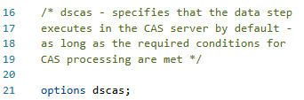
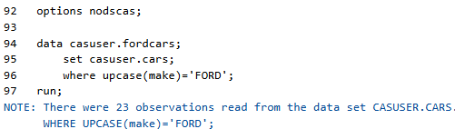
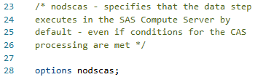
Specify Server for Data Step Execution
Specify default servers
Note: Although the data step had all requirements to execute in CAS, it ran in the compute server due to the nodscas option.
Notes:
Options dscas is more of a directive than a command. For example, if dscas option is set (it is by default) but the data step cannot be executed in CAS, the code will be executed in compute.

Slide 18
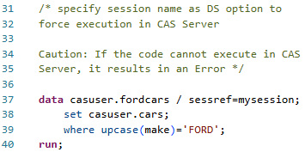
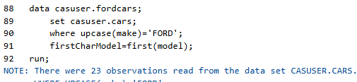
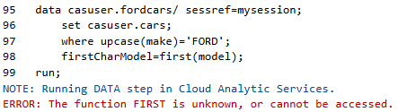

Specify Server for Data Step Execution
Force execution in CAS using sessref option
Note: The sessref option will cause the data step to fail if cannot execute in the CAS Server
Notes:
If sessref is not specified and an unsupported function is used in the datastep, the step is executed in Compute server. This means the CAS in-memory data is transferred to the Compute server to execute the code.
The sessref data step option forces the data step to run in CAS. If for any reason, the data step can’t execute in CAS, it creates an Error.
This option should be used if you expect the data step to run in CAS, especially when involving large datasets.
First() function is not supported in CAS, so in the first case the step runs in Compute.
In the second instance, due to the sessref option, the unsupported CAS function causes an Error.

Slide 19
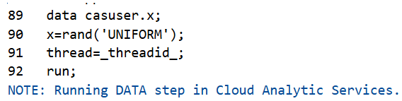
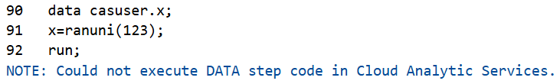
Using supported functions in CAS
Find alternate functions supported in CAS
/* unsupported function */
data casuser.x;
x=ranuni(123);
run;
/* supported function */
data casuser.x;
x=rand('UNIFORM’);
run;
Note: When unsupported functions are used, the code will not execute in CAS.

Slide 20
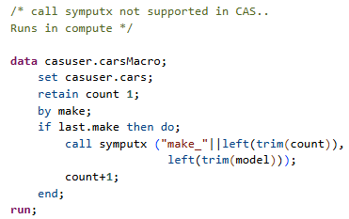
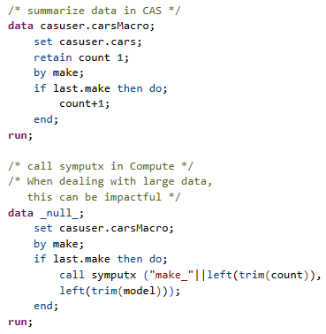
Unsupported Call Routines/ Function in CAS
Alternate strategy
Notes:
On the left, the entire table is transferred to Compute for processing.
On the right, the summarization happens in CAS and only the summarized data is transferred to compute to create the macro variables. This is a much better approach when dealing with large tables.

Slide 21
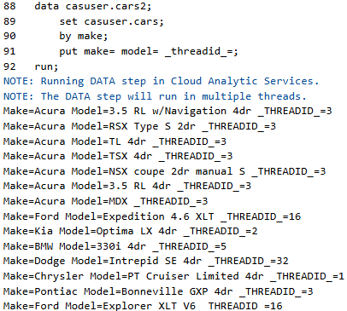
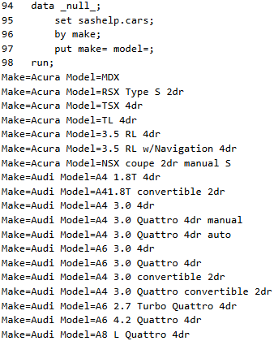
Data Step Processing – Order of records
CAS Vs Compute – Threaded processing and preserving the order
Notes:
Note: _threadid_ is an automatic macro variable in CAS, others are _hostname_, _nthreads_ etc.
In CAS, all the same values of the first BY variables are always processed in the same thread. For example, all Make=Acura records will be processed in Thread 3. All Ford records will be processed in Thread 16 and so on.
The order of the records within the thread is not guaranteed in CAS.
Whereas in the Compute code on the right, the order is always the same order from the data set.

Slide 22
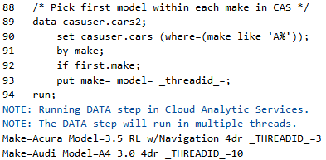
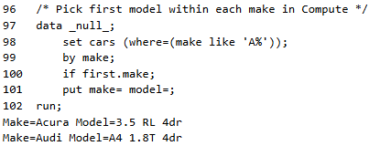
Data Step Processing – Order of records
CAS Vs Compute
Note: Different records are returned by CAS compared to the Compute server. Order of data is not preserved in CAS.
Strong BY variables are needed to preserve the order in some cases.

Slide 23
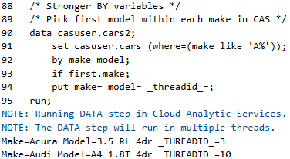
Importance of Strong BY Variables
By design, data is distributed in random order in CAS (in multiple threads) versus exact order in SAS Compute (in a single thread).
To ensure repeatable order in CAS, strong BY Variables that guarantee the order of the data becomes important.
Adding model to the BY variable in the previous example, reinforces the order of the rows in CAS.

Slide 24
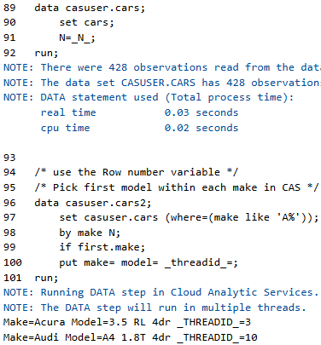
Preserving the order of the records
Explore if making the BY variables stronger can make the order of the data repeatable.
In some instances, even strong BY variables don’t preserve the order of the SAS Compute dataset in CAS.
Adding a row number while loading data into CAS can be used in this instance to preserve the order.

Slide 25
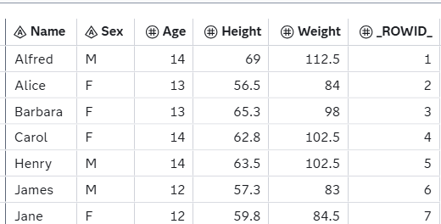
Data Step Options in CAS
/* AddRowID DS option */
data casuser.class (AddRowID=yes);
set sashelp.class;
run;
AddRowID=yes
Helps preserve the original order of the data in CAS by adding a _ROWID_ column to the CAS table.
Add the _ROWID_ column to the BY Statement to preserve order of the data in CAS

Slide 26
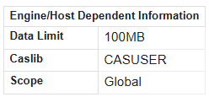
Data Step Options in CAS
Promote
Promoting a table changes the scope from session scope to global scope.
Only tables in global caslibs can be promoted.
Promoted tables persist beyond the current CAS session.
Proc contents output shows the scope.
/* Promote a table */
data casuser.class2 (promote=yes);
set sashelp.class;
run;

Slide 27
Data Step Options in CAS
Datalimit to transfer data from CAS to Compute
/* transferring huge data set from
CAS to Compute -
default limit - 100 MB */
data hmeq3;
set casuser.hmeq;
run;
NOTE: One or more variables were
converted because the data type is not
supported by the V9 engine. For more
details, run with options MSGLEVEL=I.
ERROR: The maximum allowed bytes (1024)
of data have been fetched from Cloud
Analytic Services. Use the DATALIMIT
option to increase the maximum value.
NOTE: The DATA step has been abnormally
terminated.
/* increase datalimit -
Be cautious with this option */
data hmeq3;
set casuser.hmeq3 (datalimit=500M);
run;
NOTE: There were 172840 observations
read from the data set CASUSER.HMEQ3.
NOTE: The data set WORK.HMEQ3 has
172840 observations and 18 variables.
NOTE: DATA statement used (Total
process time):
real time 0.93 seconds
cpu time 0.25 seconds
Notes:
Can be set at the global level.
/* set data limit for transfer */
options casdatalimit=100M;

Slide 28
Performance Options
/* Append to a CAS table */
data casuser.hmeq4 (append=yes);
set hmeq3;
run;
/* MAXTABLEMEM option */
/* maximum amount of memory in bytes
that each
thread should allocate for in-memory
blocks */
data casuser.hmeq4 (MAXTABLEMEM=10k);
set hmeq3;
run;
/* Copies option */
/* Specifies the number of redundant
copies */
data casuser.hmeq4 (copies=0);
set hmeq3;
run;
Tip:
Set copies to 0 for intermediate CAS tables.
Set to 1 for important CAS tables
Notes:
Note; Copies can be controlled at a global level using the cas statement option called defaulttablereplication.
cas mysession sessopts=(defaulttablereplication=0) ;

Slide 29
Key Takeaways
Use CAS processing for large datasets and long running steps
Processing in CAS is the magic bullet for performance for the right use cases
Use supported functions
Understand BY group processing, strong BY variables and preserving record order
Use available data step and system options for processing and performance

Slide 30
References
SAS CALL Routines and Functions That Are Not Supported in CAS
CASLIB Statement
Caslibs and librefs in SAS Viya
Data Set options by Category
A New Option to Manage CAS Table Replications (or Copies)

Slide 31
Contact Information
Name: Vijay Govindarajan
Organization: SAS Institute Inc, Cary NC
E-mail: vijay.Govindarajan@sas.com
Web: LinkedIn

