Slide 1
Going from PROC SQL to PROC FedSQL for CAS Processing: Common mistakes to avoid
Vijay Govindarajan
Principal Systems Engineer
Customer Advisory, SAS Institute Inc
Vijay Govindarajan has spent over 15 years at SAS Institute, serving in a variety of roles including developer in SAS R&D, architect in SAS Services, and Systems Engineer in the Global Technology Practice. He is passionate about SAS programming, data architecture, and analytics. Vijay holds master’s degrees in Biomedical Engineering (Marquette University) and Data Analytics (Georgia Institute of Technology).

Slide 2
Agenda
SQL – FedSQL Basic differences
The lay of the land - Where do they work?
Proc FedSQL for CAS - useful statement options
Proc FedSQL for CAS - Statements
FedSQL Data types for CAS
Type Conversion and Applying Formats
Some common conversion issues in FedSQL
Performance options
Conclusion

Slide 3
SQL – FedSQL Basic differences
PROC SQL | PROC FedSQL
PROC SQL is partially compliant with ANSI-1992 plus SAS additions. | PROC FEDSQL is fully ANSI-1999-compliant, and it is vendor-neutral.
Runs on Compute server. | Can run on CAS / Compute server.
No Federated Queries: Supports single DB connection per query. | Allows Federated Queries: Supports multiple DB connection per query.
Multi-threading for sorting and indexing | Fully multi-threaded, scalable and parallel processing.
Char and Numeric datatypes | Expanded data types for both Compute and CAS.
Notes:
PROC FEDSQL in SAS is considered vendor neutral because it allows users to write SQL queries using a standardized dialect (FedSQL) which is based on ANSI SQL standards, meaning the same query can be executed against different data sources without needing to modify the syntax to match each vendor's specific SQL dialect; essentially, it acts as a common language across various databases, eliminating the need to write unique queries for each data source.

Slide 4
Where do they work?
Source table | Target table | SQL | FedSQL Compute | FedSQL CAS
Compute | Compute | Yes | Yes* | No
Compute | CAS | Yes | No | No
CAS | CAS | No | No | Yes
CAS | Compute | Yes⁺ | No | No
Select from Compute |  | Yes | Yes | No
Select from CAS |  | Yes | No | Yes
* Cannot use concatenated libraries in library references such as sashelp
⁺ The entire CAS table is sent back to the client for processing when using PROC SQL to query a CAS table

Slide 5
Proc FedSQL for CAS - useful statement options
Proc FedSQL <options> ;
sessref = CAS-session-reference - runs the FedSQL statements in the CAS session.
noerrorstop - the procedure continues executing even if it encounters an error.
noprint - suppresses the normal display of results.
stimer - writes a subset of system performance statistics
_METHOD - prints a brief text description of the FedSQL query plan

Slide 6
Proc FedSQL for CAS - Statements
Create Table as:
Can drop and recreate the table.
Can create CAS output tables from CAS input tables and DBMS input tables.
Drop Table:
Drops in memory CAS table.
Syntax:
drop table <tablename>;
drop table <caslib.tablename>;
drop table <tablename> force; /* force suppresses error if the table does not exist */

Slide 7
Proc FedSQL for CAS - Statements
Select Statement options
Limit Clause:
Offset Clause:
Union Operator:
Joins:
Inner, left, right, full joins are supported.
Cartesian join (cross joins) are supported.
Connection to external datasources using the pass-through facility is supported.

Slide 8
FedSQL Data types for CAS
CAS Data Type | Description
INT64 | large signed, exact whole number, with a precision of 19 digits.
CHAR() | fixed-length character string, where n is the maximum number of characters to store
DOUBLE | 64-bit double precision, floating-point number.
INT32 | regular size signed, exact whole number, with a precision of 10 digits.
VARBINARY | used to store image data, audio, documents, and other unstructured data
VARCHAR(n) | varying-length character string, where n is the maximum number of characters to store. Max characters size based on the actual data is allocated for the column irrespective of the value of n.
Note: Date, time, and datetime values are stored as DOUBLE with a format applied.

Slide 9
Common Conversion Issues
Converting code from PROC SQL to PROC FedSQL for CAS

Slide 10
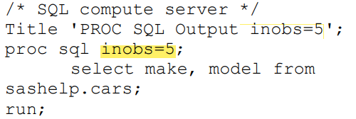
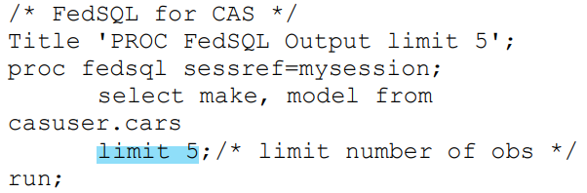
SELECTING FIRST N ROWS
Select first N columns in Proc SQL using inobs statement option
Use limit clause in select statement in PROC FedSQL instead of inobs statement option in PROC SQL.

Slide 11
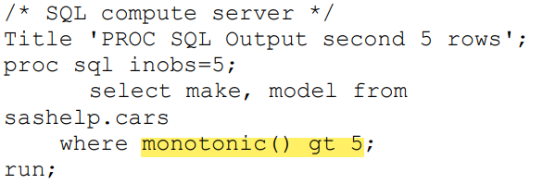
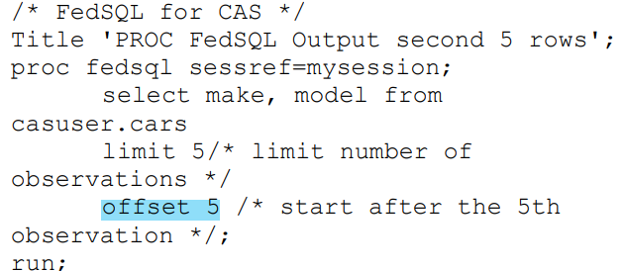
SKIP FIRST N ROWS
The undocumented function monotonic() can be used in SAS 9 to skip rows
OFFSET clause in PROC FedSQL specifies the number of rows to skip before the SELECT statement starts to return rows.

Slide 12
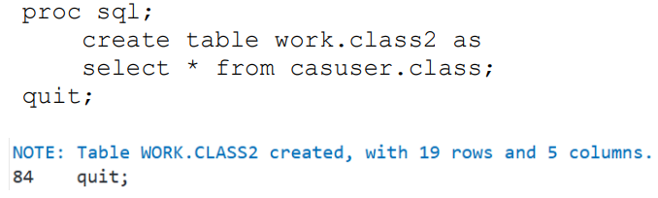
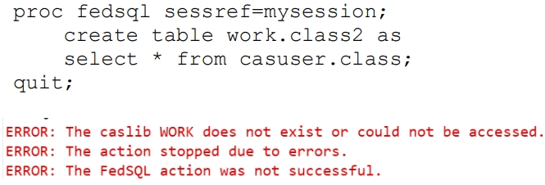
USING COMPUTE LIBRARY INPUT TABLES TO CREATE CAS OUTPUT TABLES
If there is a need to read from a Compute library and write to a CAS library or vice versa, use PROC SQL.
PROC FedSQL for CAS doesn’t understand Compute libraries. An error occurs when you attempt to execute statements that reference Compute libraries in PROC FedSQL for CAS.

Slide 13
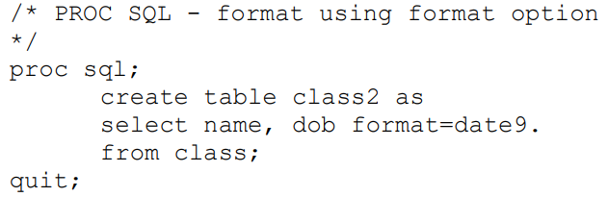
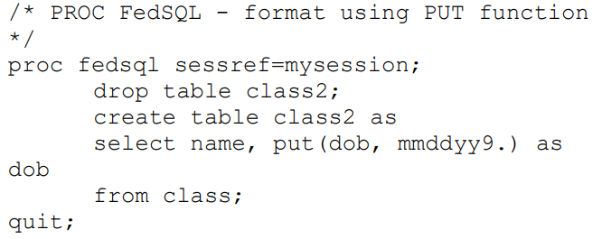
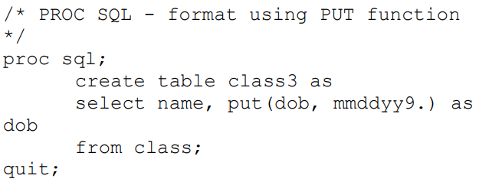
APPLYING FORMATS
In PROC SQL, 2 of the popular ways to apply formats are using the format option and the PUT function. The format option adds a format without changing the underlying data type, whereas the PUT option changes the data type to char.
In PROC FedSQL, formats are applied using the PUT statement and this changes the datatype of the variable to varchar. Format option is not available in PROC FedSQL.

Slide 14
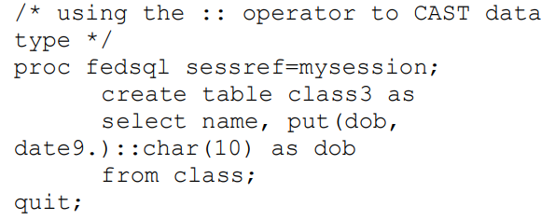
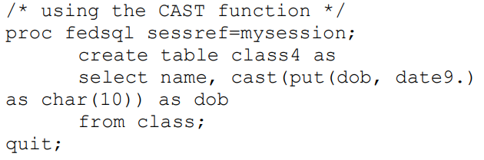
CASTING VARIABLE DATATYPE
PROC FedSQL performs implicit type conversions as needed for data source support.
Sometimes, it might be necessary to specify the datatype for specific variables in the table.
The CAST function is used for performing explicit type conversions.
Note that the ‘::’ operator is synonymous with the cast function.

Slide 15
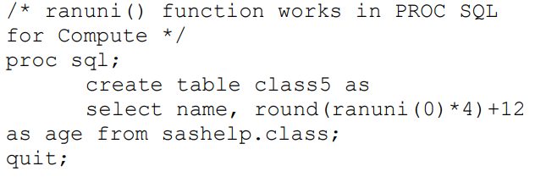
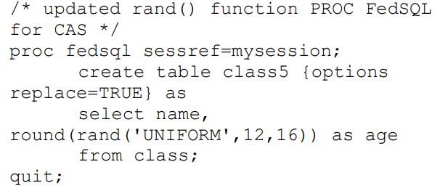
USING UNSUPPORTED FUNCTIONS
A few functions in SAS 9 are not available in the CAS engine but there are alternate functions that provide the same functionality.
This requires updating the SQL program with new/ different functions for CAS.

Slide 16
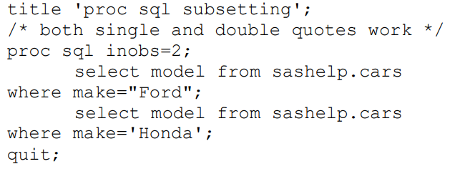
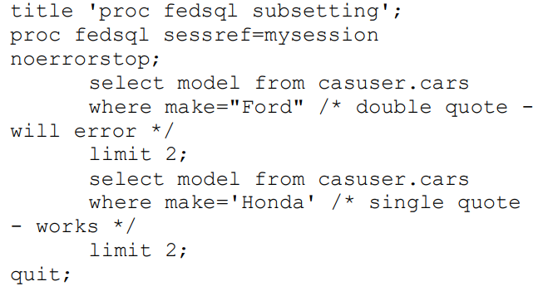
FILTERING USING STRING VALUES
In PROC SQL, when filtering data using string values contained in a column, the string can be enclosed in either single or double quotes.
Single quotes MUST BE used in PROC FedSQL. Using double quotes causes it to be interpreted as a variable name and causes an error.

Slide 17
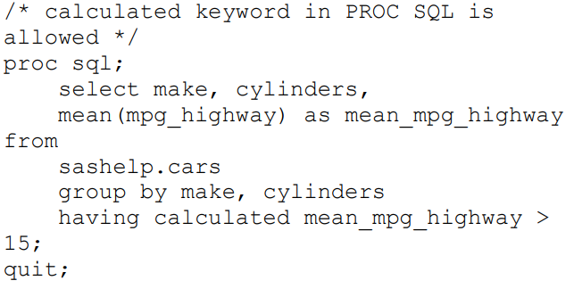
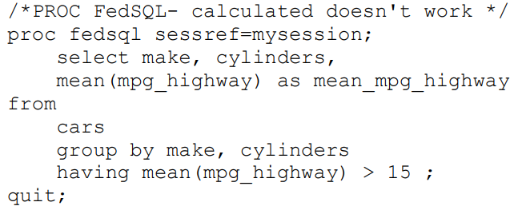
USING CALCULATED COLUMNS IN THE QUERY
The CALCULATED keyword, in PROC SQL, allows the use of a calculated column in the HAVING clause without repeating the underlying calculation again.
The CALCULATED keyword doesn’t work in PROC FedSQL and needs to be rewritten as shown.

Slide 18
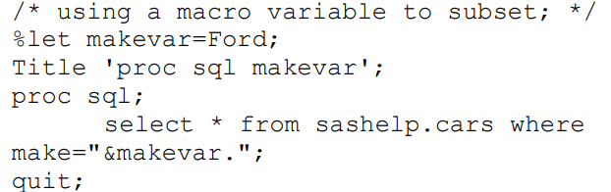
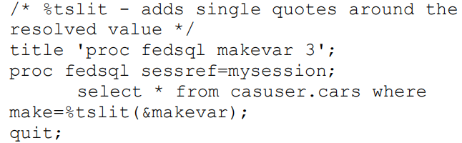
USING MACRO VARIABLE STRINGS IN WHERE CLAUSE PROCESSING
Double quotes are required to resolve macro variable values as a string. However, double quotes in PROC FedSQL causes them to be interpreted as variable name.
SAS provides a new macro function called %tslit that allows the use and resolution macro variables in PROC FedSQL. %tslit macro adds single quotes around resolved macro values which can be used for string comparisons in PROC FedSQL.

Slide 19
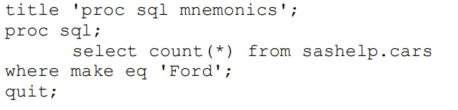
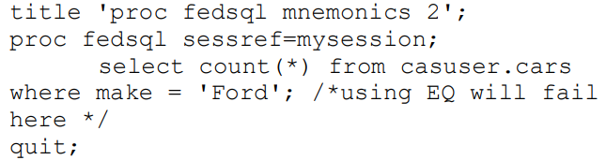
USING MNEMONICS FOR COMPARISON OPERATORS
A SAS addition to PROC SQL is the usage of mnemonic operators for comparison.
However, this is not available in PROC FedSQL due to its ANSI 99 compliance and therefore actual comparison operators must be used.

Slide 20
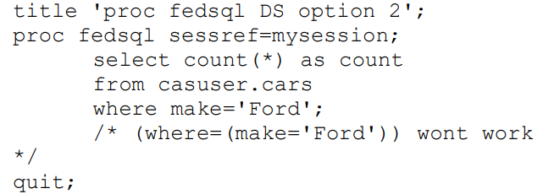
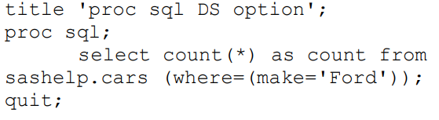
USING DATASET OPTIONS IN THE QUERY TABLES
SAS Dataset options can be used in PROC SQL tables as part of the query.
Dataset options are not available in PROC FedSQL and code needs to be updated to work in CAS Engine.

Slide 21
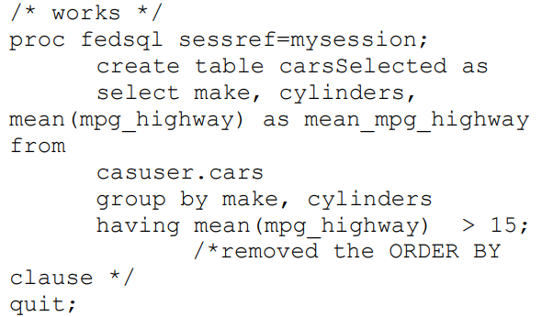
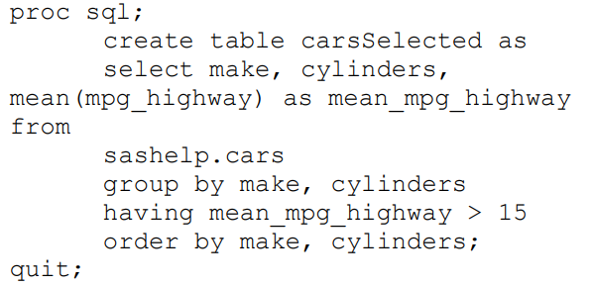
USING ORDER BY CLAUSE WHEN CREATING TABLES
ORDER BY clause is supported in PROC SQL when creating a table.
However, this option is not supported in PROC FedSQL for CAS and the ORDER BY clause must be removed from the CREATE TABLE statement.

Slide 22
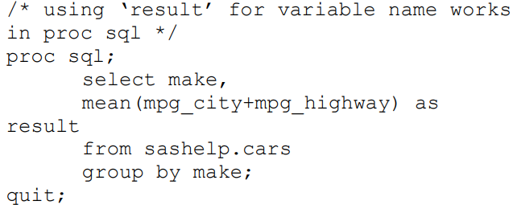
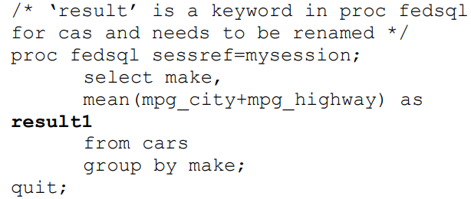
USING FEDSQL RESERVED WORD
PROC FedSQL for CAS introduces several reserved key words that cannot be used as variable names or in another way.
Review the SAS 9 code and rename variables that are using a reserved keyword and provide a new name so it can work with PROC FedSQL for CAS.

Slide 23
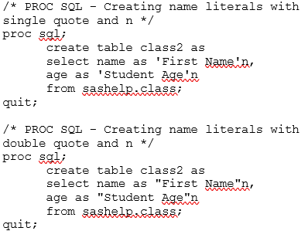
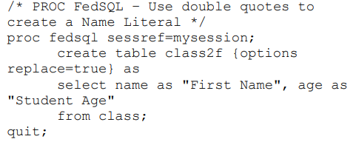
USING NAME LITERALS FOR VARIABLE NAMES
In PROC FedSQL for CAS, the variable name must be enclosed in a double quote to create a Name Literal. To use name literals for variable and table names, a couple of options need to be updated appropriately.
VALIDVARNAME=ANY and VALIDMEMNAME=EXTEND
To create Name Literals in PROC SQL, you can enclose the variable name with either single or double quotes immediately followed by the letter n
Notes:
In PROC FedSQL for CAS, the variable name must be enclosed in a double quote to create a Name Literal. To use name literals for variable and table names, a couple of options need to be updated appropriately.
VALIDVARNAME=ANY and VALIDMEMNAME=EXTEND

Slide 24
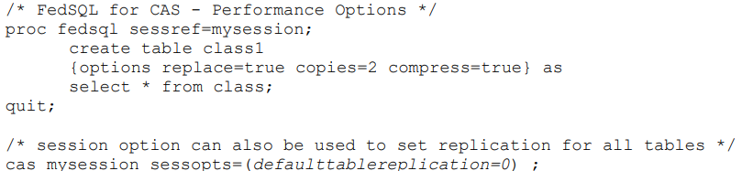
UNDERSTANDING AVAILABLE PERFORMANCE OPTIONS
CAS Engine, by default, keeps copies of every in-memory table, cached in 2 other CAS nodes for fault tolerance. Keeping 2 copies of every table has performance implications. It is advisable to keep copies of only the main tables and recreate the rest from the main tables if there is an interruption.
Compressing the data rows in a CAS output table reduces the number of bytes to represent each row. This reduces the storage requirements and I/O operations necessary to read and write data but requires additional CPU resources to process the compression. Compression usually helps with improved performance if the CPU is not overallocated. Test the CAS table processing with and without compression to evaluate performance

Slide 25
Conclusion
SAS Viya’s CAS Engine provides huge benefits due to its distributed, in-memory, parallel processing capabilities.
Modernization of SQL code from the SAS Viya Compute server to execute in the CAS Engine requires going from PROC SQL to PROC FedSQL for CAS.
Basic differences between the 2 such as datatypes, supported statements, where they work etc were discussed.
“Common mistakes to avoid” while converting code from PROC SQL to PROC FedSQL learnt from real customers during real code migration were reviewed with examples.

Slide 26
Contact Information
Name: Vijay Govindarajan
Organization: SAS Institute Inc, Cary NC
E-mail: vijay.Govindarajan@sas.com
Web: LinkedIn

