Slide 1
Kernel Bandwidth Selection for Maximum Mean Discrepancy
Hangcen Zou
Department of Statistics and Data Science, Washington University in St. Louis
MWSUG 2025, Cincinnati, OH

Slide 2


Acknowledgements
Arin Chaudhuri
SAS Institute, Inc.
Srikanth Patala
SAS Institute, Inc.

Slide 3
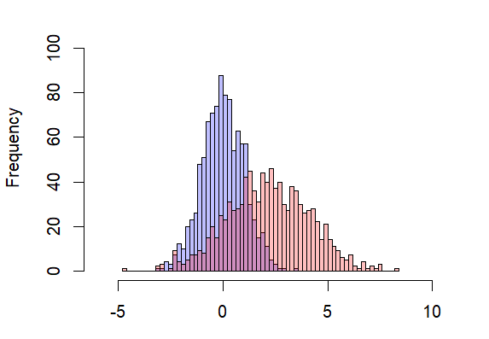

Distributional Shift Detection for Streaming Data
Univariate
Multivariate
Kolmogorov-Smirnoff (KS) test [Smirnov ‘48]
Wald-Wolfowitz runs test [Wald & Wolfowitz ‘40]
based on geometric graphs [Bhattacharya ‘19]
based on energy distance [Deb & Sen ‘21]
maximum mean discrepancy
[Gretton et al. ‘12, Chatterjee & Bhattacharya ‘25]

Slide 4
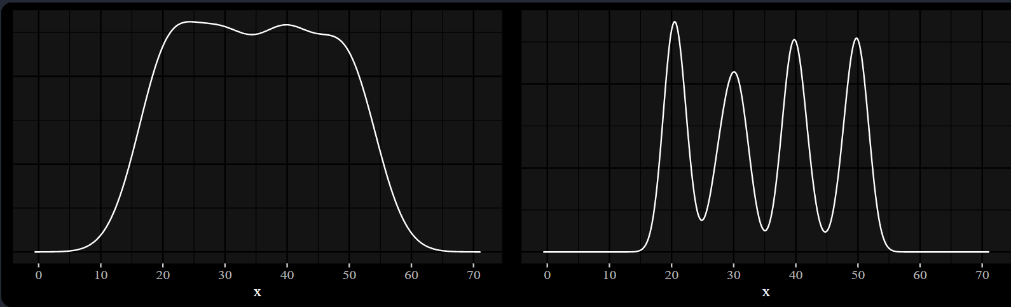
Maximum Mean Discrepancy (MMD)
Effectiveness Depends on Kernel Bandwidth Choice
a non-parametric kernel based statistical test
advantages
easy implementation, rich kernel-based theory,
non-tabular observations
disadvantages
bandwidth selection, computational cost
How To Efficiently Choose an Appropriate Bandwidth?
Notes:
Complex data structure: parametric models may not be sufficient

Slide 5
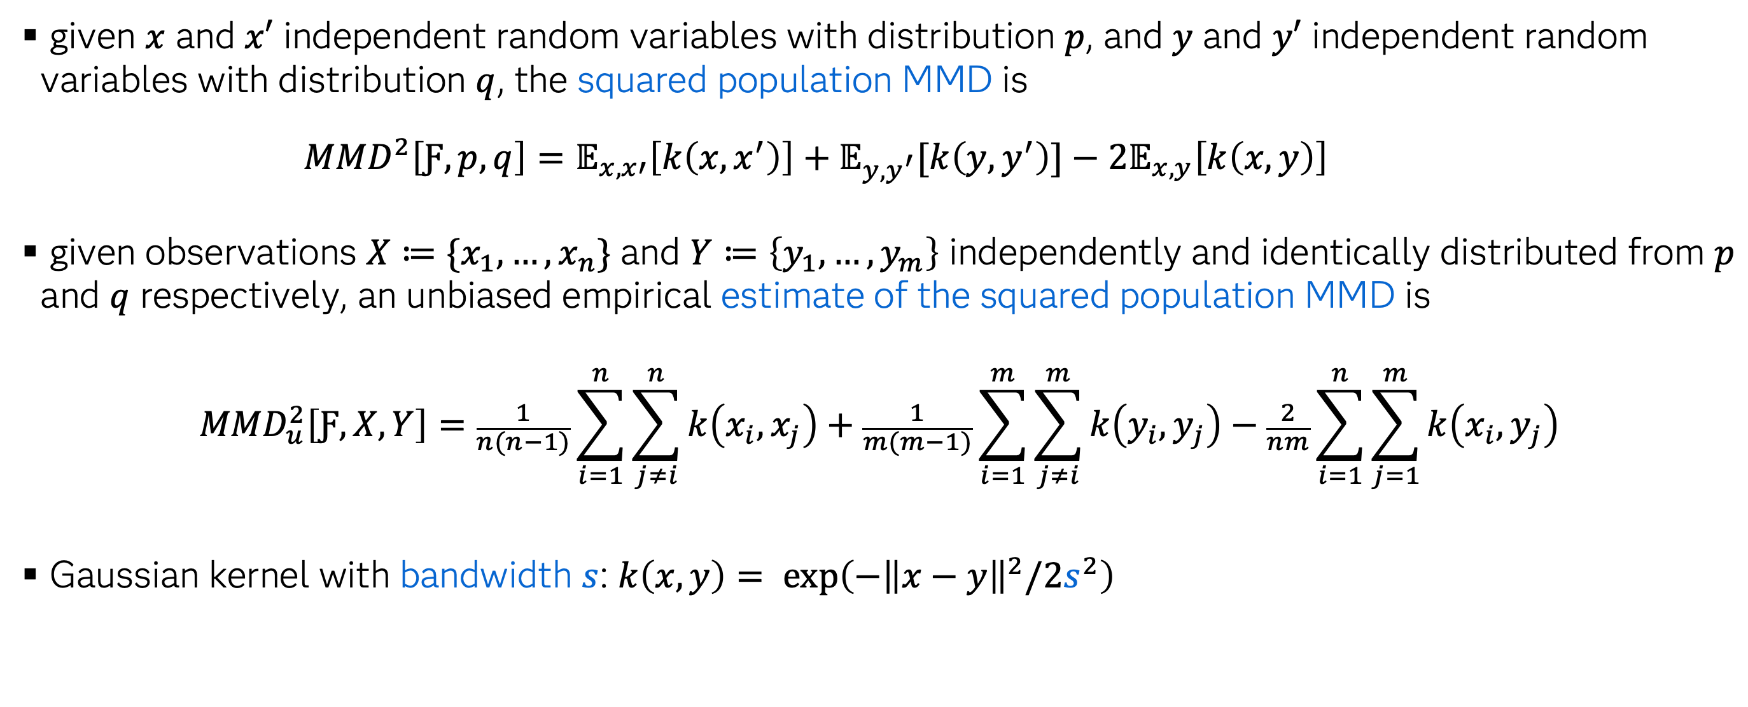
Definitions
given $x$ and $x′$ independent random variables with distribution $p$, and $y$ and $y′$ independent random variables with distribution $q$, the squared population MMD is
${MMD}^{2}\left[Ƒ,p,q\right]=𝔼_{x,x′}\left[k\left(x,x^{′}\right)\right]+𝔼_{y,y^{′}}[k\left(y,y^{′}\right)]−2𝔼_{x,y}\left[k\left(x,y\right)\right]$
given observations $X≔\{x_{1},…,x_{n}\}$ and $Y≔\left\{y_{1},…,y_{m}\right\}$ independently and identically distributed from $p$ and $q$ respectively, an unbiased empirical estimate of the squared population MMD is
$${MMD}_{u}^{2}\left[Ƒ,X,Y\right]=\frac{1}{n(n−1)}\sum_{i=1}^{n}{\sum_{j≠i}^{n}{k\left(x_{i},x_{j}\right)}}+\frac{1}{m(m−1)}\sum_{i=1}^{m}{\sum_{j≠i}^{m}{k\left(y_{i},y_{j}\right)}−\frac{2}{nm}\sum_{i=1}^{n}{\sum_{j=1}^{m}{k\left(x_{i},y_{j}\right)}}}$$
Gaussian kernel with bandwidth $s$: $k\left(x,y\right)= exp\left(−{\left\|x−y\right\|}^{2}/2s^{2}\right)$
Notes:
Reproducing kernel Hilbert space

Slide 6
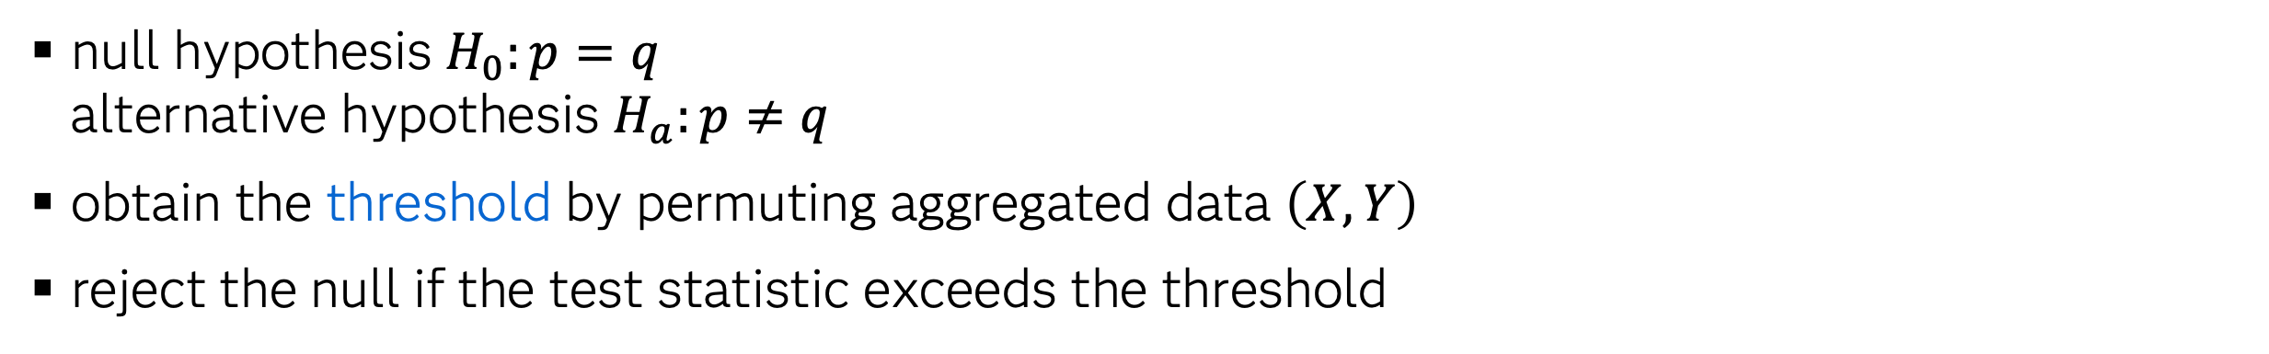
Statistical Hypothesis Testing
null hypothesis $H_{0}:p=q$
alternative hypothesis $H_{a}:p≠q$
obtain the threshold by permuting aggregated data $\left(X, Y\right)$
reject the null if the test statistic exceeds the threshold
[1] Gretton, Arthur, et al. "A kernel two-sample test." The journal of machine learning research 13.1 (2012): 723-773.

Slide 7
Statistical Hypothesis Testing
null hypothesis $H_{0}:p=q$
alternative hypothesis $H_{a}:p≠q$
obtain the threshold by permuting aggregated data $\left(X, Y\right)$
reject the null if the test statistic exceeds the threshold
Standard MMD^{[1]}
based on MMD estimate from a single kernel bandwidth
more relevant to streaming data
choosing an appropriate bandwidth is challenging
[1] Gretton, Arthur, et al. "A kernel two-sample test." The journal of machine learning research 13.1 (2012): 723-773.

Slide 8
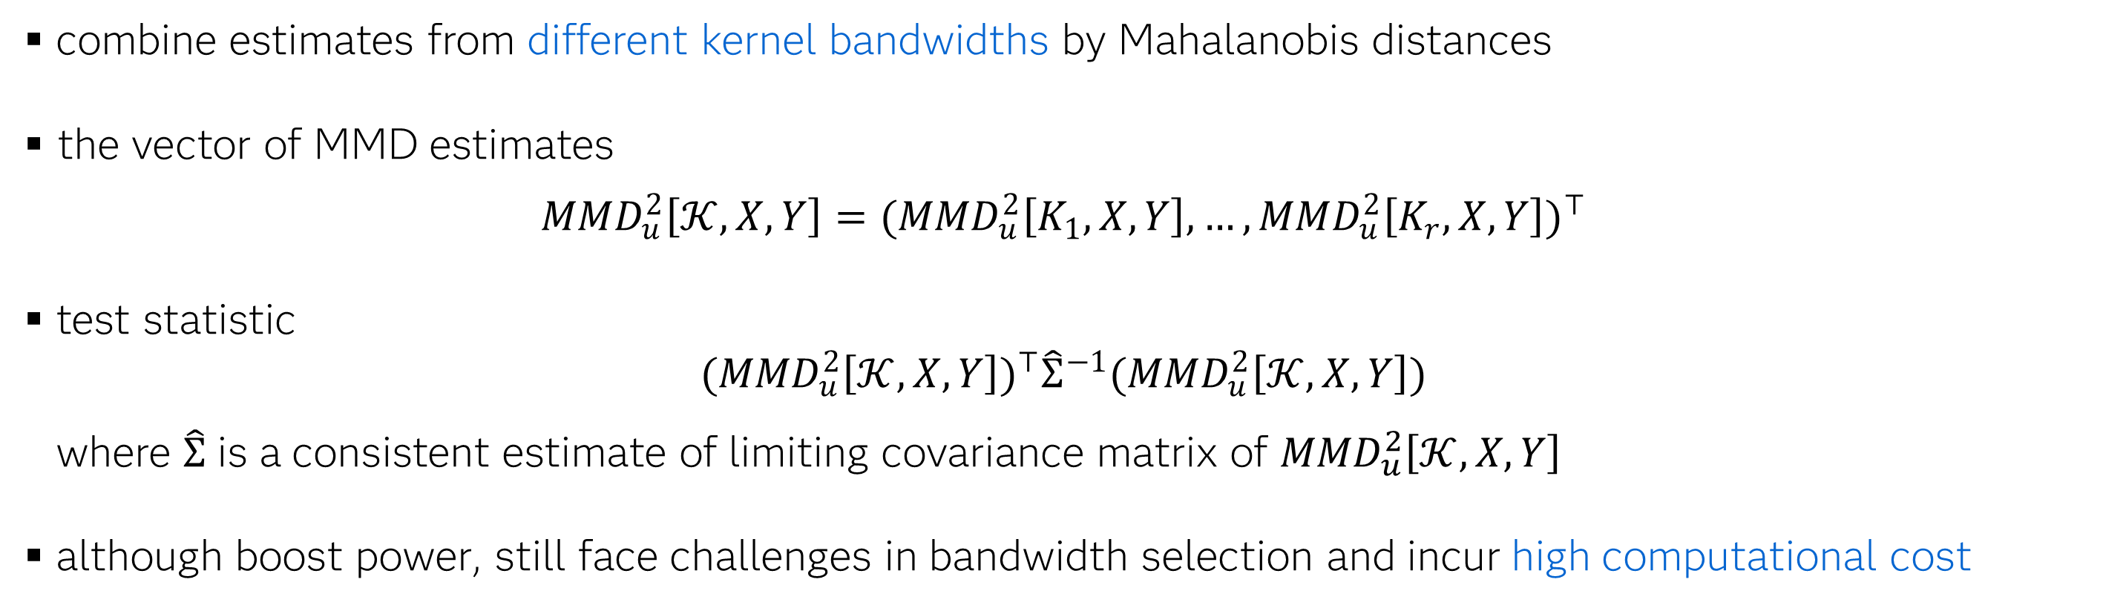
Mahalanobis Aggregated MMD (MMMD)^{[2]}
combine estimates from different kernel bandwidths by Mahalanobis distances
the vector of MMD estimates
$${MMD}_{u}^{2}\left[𝒦,X,Y\right]={({MMD}_{u}^{2}\left[K_{1},X,Y\right],…,{MMD}_{u}^{2}\left[K_{r},X,Y\right])}^{⊤}$$
test statistic
$${({MMD}_{u}^{2}\left[𝒦,X,Y\right])}^{⊤}{\hat{Σ}}^{−1}({MMD}_{u}^{2}\left[𝒦,X,Y\right])$$
where $\hat{Σ}$ is a consistent estimate of limiting covariance matrix of ${MMD}_{u}^{2}\left[𝒦,X,Y\right]$
although boost power, still face challenges in bandwidth selection and incur high computational cost
[2] Chatterjee, Anirban, and Bhaswar B. Bhattacharya. "Boosting the power of kernel two-sample tests." Biometrika 112.1 (2025): asae048.

Slide 9
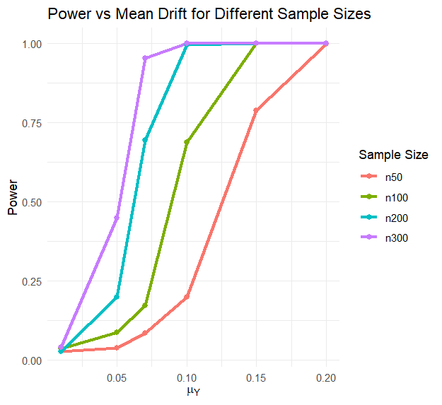
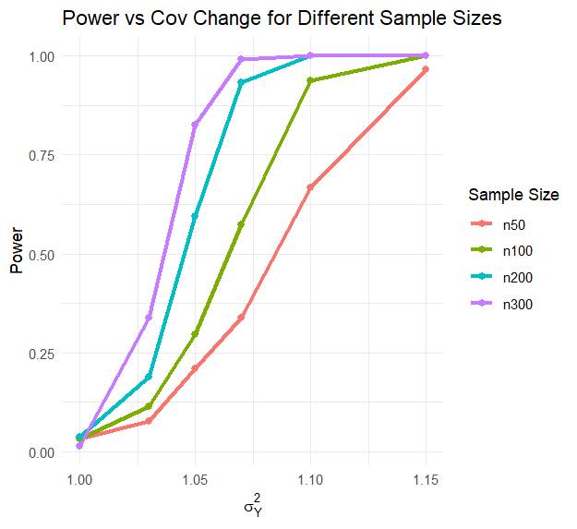
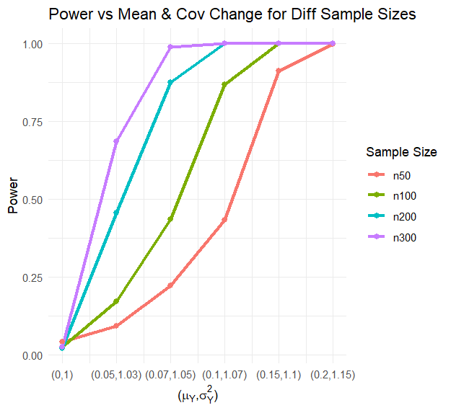
Performance of the State-of-the-Art: MMMD
Gaussian i.i.d. distribution:$X\sim N_{d}(0, I)$ and $Y\sim N_{d}(μ_{Y},σ_{Y}^{2} I)$
changes in EITHER mean or covariance can affect performance
changes in BOTH mean and covariance can affect performance

Slide 10
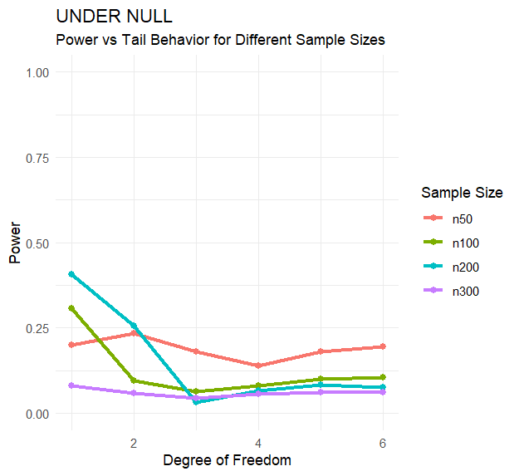
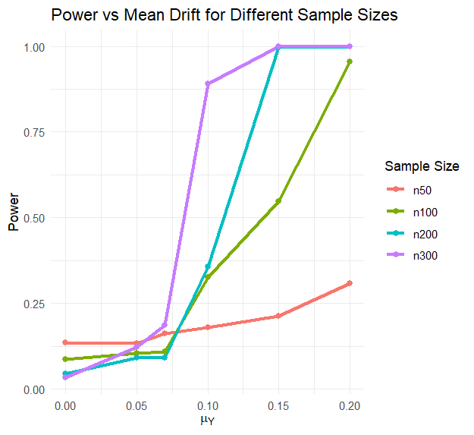
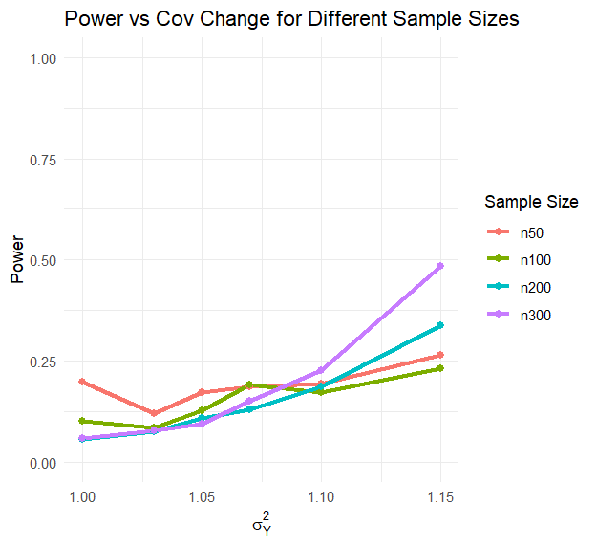


Robustness and Sensitivity Stress Testing Under Extreme Cases
heavy-tail i.i.d. distribution:$X\sim t_{ν}(0,\frac{ν}{ν−2}I)$ and $Y\sim t_{ν}(μ_{Y},σ_{Y}^{2} \frac{ν}{ν−2}I)$
$$υ=4$$
$$υ=4$$
valid with mild heavy-tailedness and moderate sample size
more challenging to detect changes in covariance

Slide 11
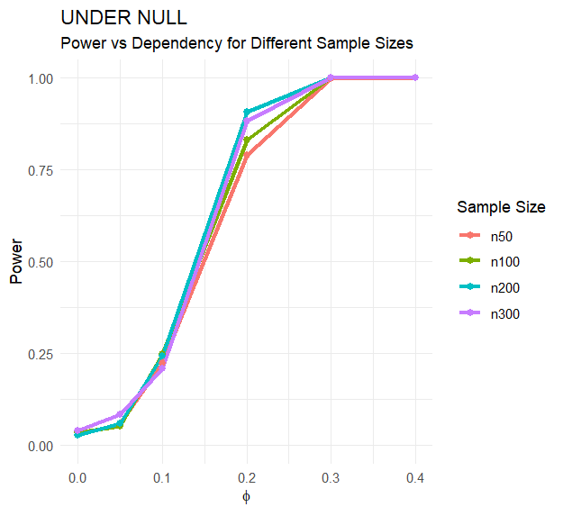
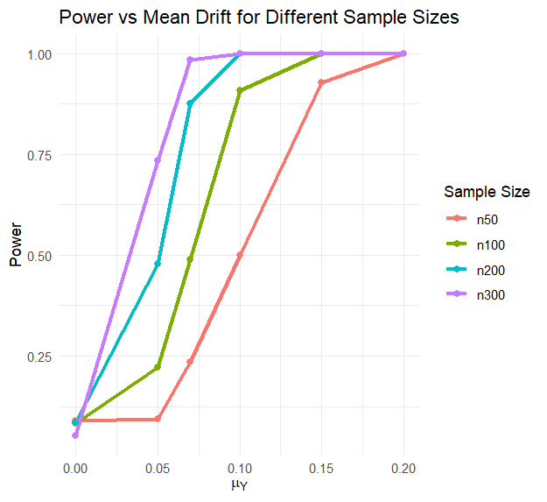
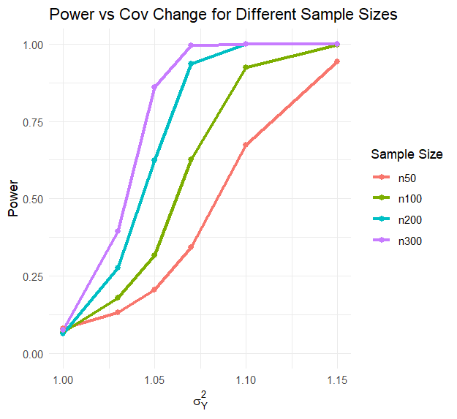


Robustness and Sensitivity Stress Testing Under Extreme Cases
autoregressive model:
${ x}_{t}=φ_{X}∙x_{t−1}+ε_{t}^{X}$ and $y_{t}−μ_{Y}=φ_{Y}(y_{t−1}−μ_{Y})+ε_{t}^{Y}$ where $ε_{t}^{X}\sim N\left(0,I\right)$, $ε_{t}^{Y}\sim N(0,σ_{Y}^{2}I)$
$$φ_{X}=φ_{Y}=0.05$$
$$φ_{X}=φ_{Y}=0.05$$
valid only under weak dependence
weak dependence yields performance similar to Gaussian i.i.d. case

Slide 12






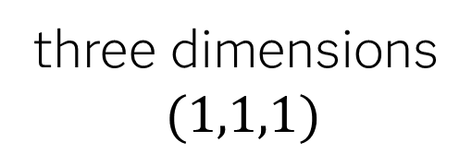

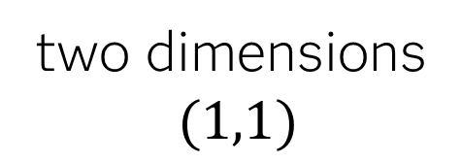
Impact of Mean Drift Orientation
$$x_{2}$$
$$x_{2}$$
$$x_{3}$$
$$x_{1}$$
$$x_{1}$$
$$x_{1}$$
one dimension
$$(1)$$
two dimensions
$$(1,1)$$
three dimensions
$$(1,1,1)$$

Slide 13


Impact of Mean Drift Orientation
$$x_{2}$$
$$x_{1}$$

Slide 14
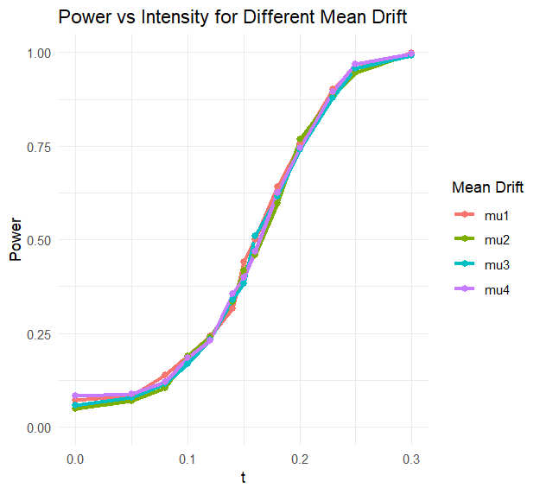
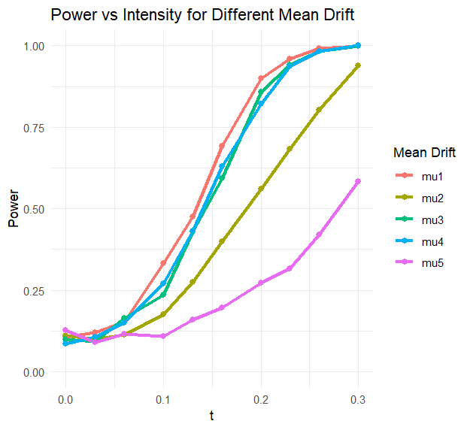

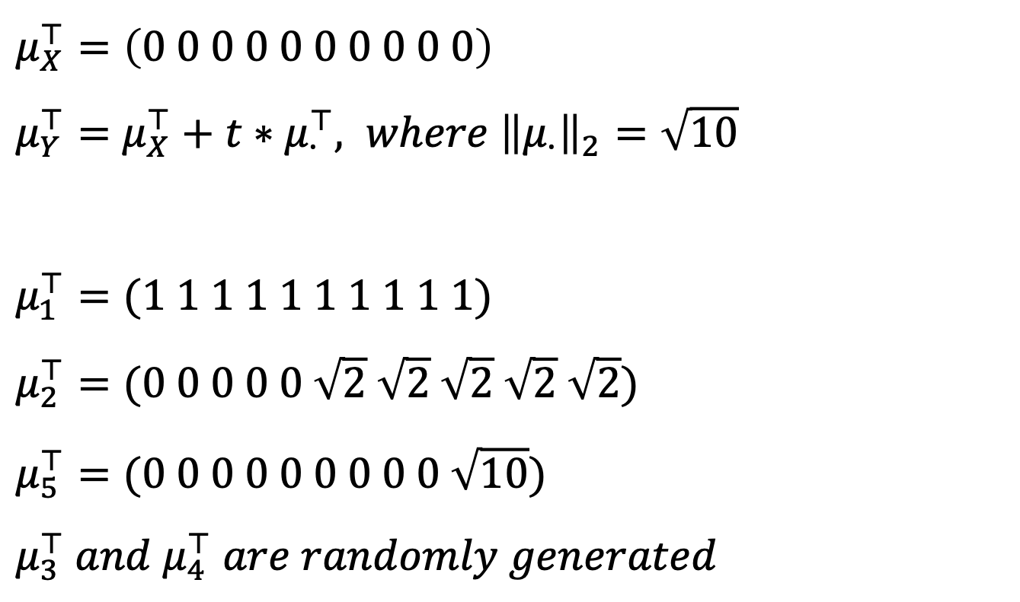
Impact of Mean Drift Orientation
$$μ_{X}^{⊤}=\left(0 0 0 0 0 0 0 0 0 0\right)$$
$μ_{Y}^{⊤}=$ $μ_{X}^{⊤}+t∗μ_{∙}^{⊤}, where {\left\|μ_{∙}\right\|}_{2}=\sqrt{10}$
$$μ_{1}^{⊤}=(1 1 1 1 1 1 1 1 1 1)$$
$$μ_{2}^{⊤}=(0 0 0 0 0 \sqrt{2} \sqrt{2} \sqrt{2} \sqrt{2} \sqrt{2})$$
$$μ_{5}^{⊤}=(0 0 0 0 0 0 0 0 0 \sqrt{10})$$
$$μ_{3}^{⊤} and μ_{4}^{⊤} are randomly generated$$
Gaussian i.i.d.
AR(1)
$$φ_{X}=φ_{Y}=0.1$$
with the mean drift magnitude fixed,
the orientation of the drift affects power for correlated samples but not for i.i.d. samples.

Slide 15
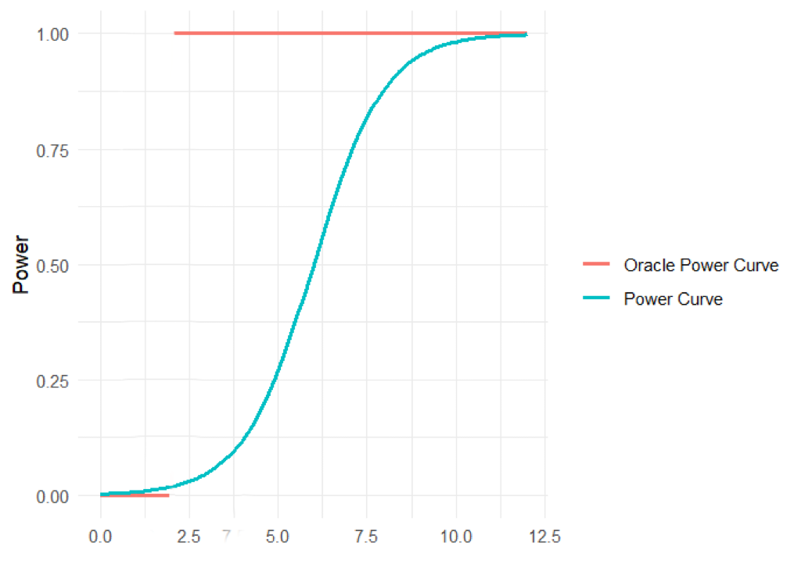
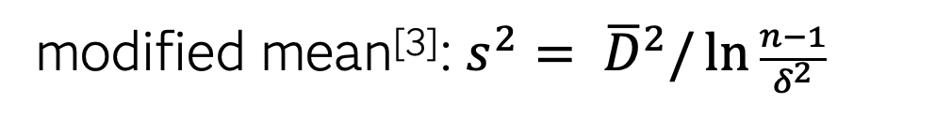
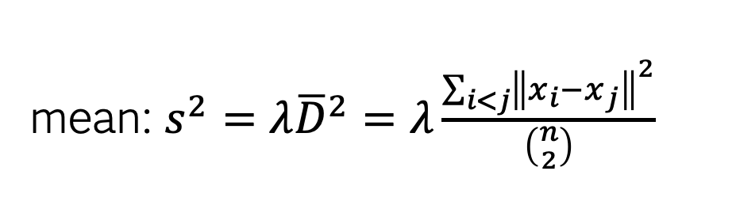
Potential Bandwidth Options
mean: ${s^{2}=λ\overline{D}}^{2}=λ\frac{\sum_{i<j}{{\left\|x_{i}−x_{j}\right\|}^{2}}}{\left({n \atop 2}\right)}$
modified mean^{[3]}: $s^{2}= {\overline{D}}^{2}/\ln{\frac{n−1}{δ^{2}}}$
median
Measuring Power Performance
distance from oracle power curve
oracle power curve
zero in the vicinity of the null and one elsewhere
[3] Chaudhuri, Arin, et al. "The mean and median criteria for kernel bandwidth selection for support vector data description." 2017 IEEE International Conference on Data Mining Workshops (ICDMW). IEEE, 2017.

Slide 16
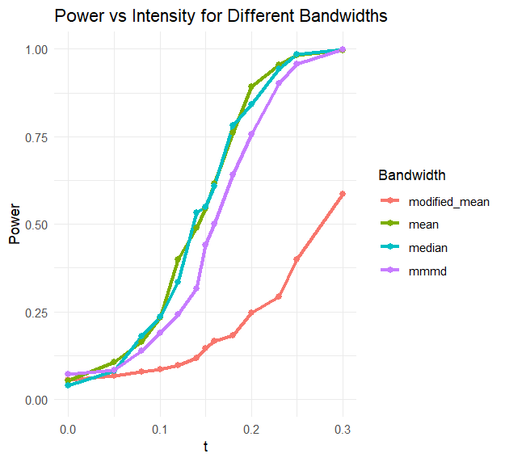
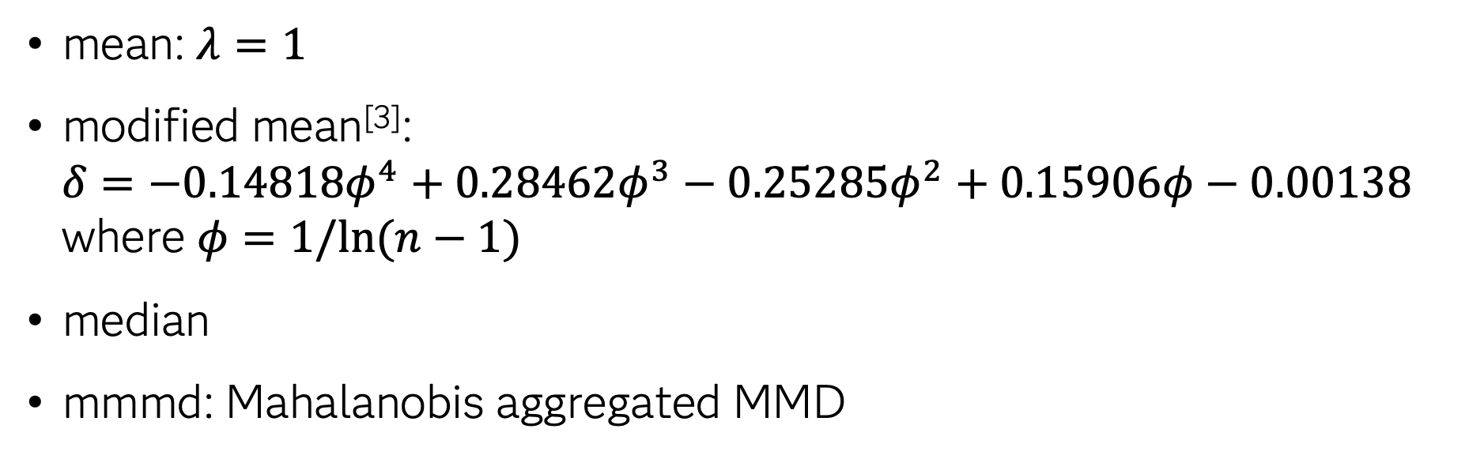
Comparing Performance Across Bandwidth Candidates
Gaussian i.i.d. mean drift: $X\sim N(0,I)$ and $Y\sim N(μ_{Y},I)$
mean: $λ=1$
modified mean^{[3]}:
$$δ=−0.14818φ^{4}+0.28462φ^{3}−0.25285φ^{2}+0.15906φ−0.00138$$
where $φ=1/ln⁡(n−1)$
median
mmmd: Mahalanobis aggregated MMD
mean and median bandwidths yield comparable performance
standard MMD can outperform MMMD in certain scenarios
bandwidth selection is problem-dependent
[3] Chaudhuri, Arin, et al. "The mean and median criteria for kernel bandwidth selection for support vector data description." 2017 IEEE International Conference on Data Mining Workshops (ICDMW). IEEE, 2017.

Slide 17
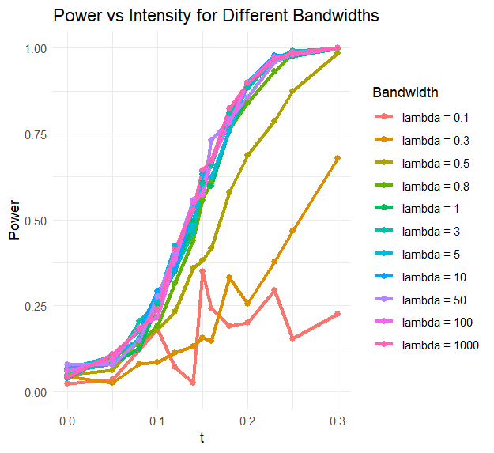
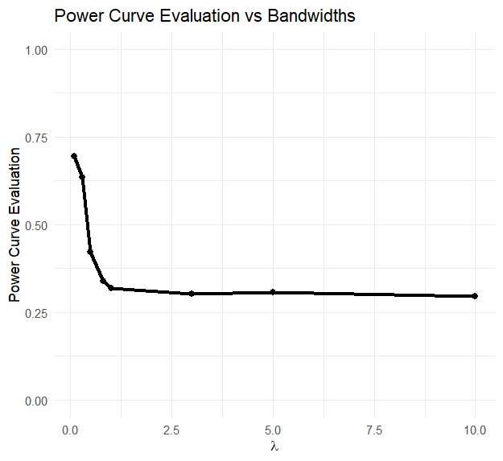
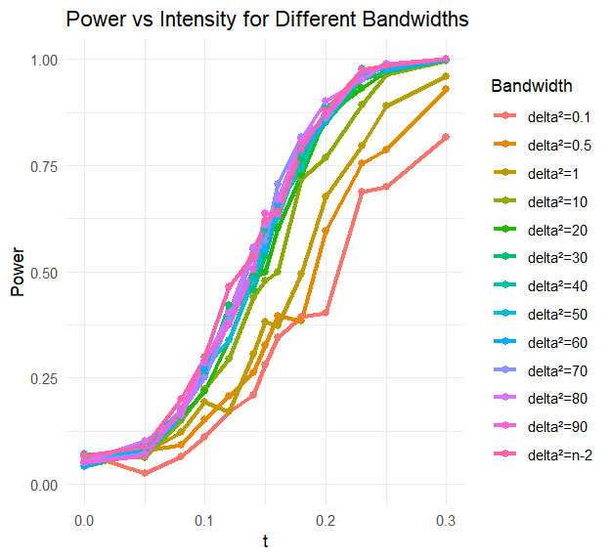
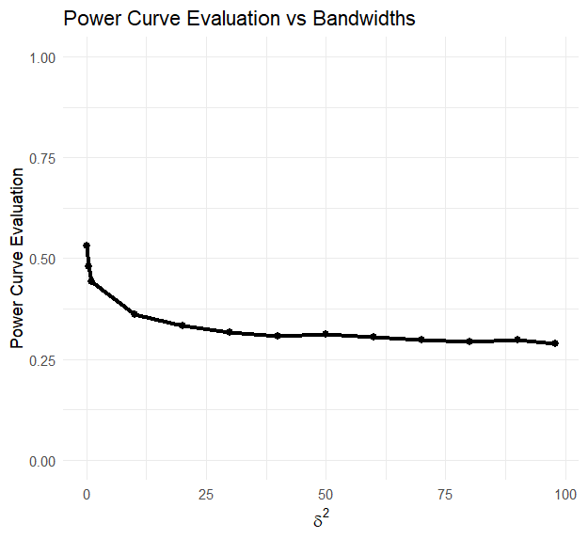
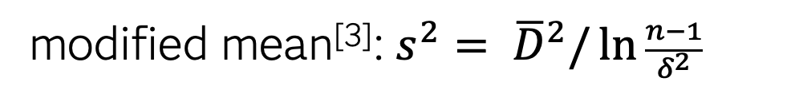
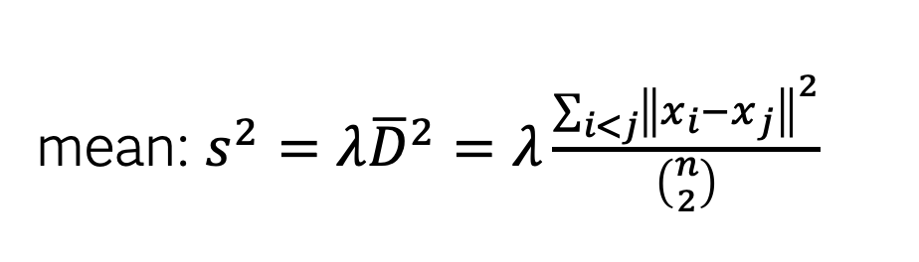
Comparing Performance Across Bandwidth Candidates
mean: ${s^{2}=λ\overline{D}}^{2}=λ\frac{\sum_{i<j}{{\left\|x_{i}−x_{j}\right\|}^{2}}}{\left({n \atop 2}\right)}$
modified mean^{[3]}: $s^{2}= {\overline{D}}^{2}/\ln{\frac{n−1}{δ^{2}}}$
Gaussian i.i.d. mean drift: $X\sim N(0,I)$ and $Y\sim N(μ_{Y},I)$
larger bandwidths are generally preferred over smaller ones
[3] Chaudhuri, Arin, et al. "The mean and median criteria for kernel bandwidth selection for support vector data description." 2017 IEEE International Conference on Data Mining Workshops (ICDMW). IEEE, 2017.

Slide 18
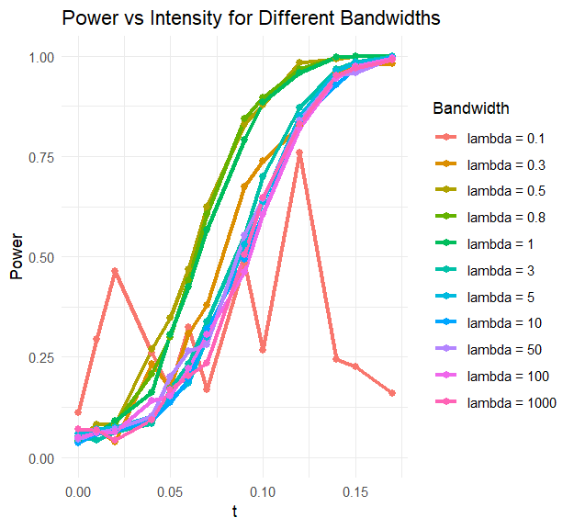
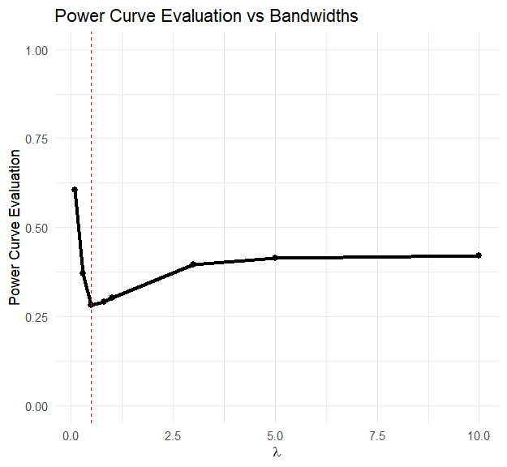
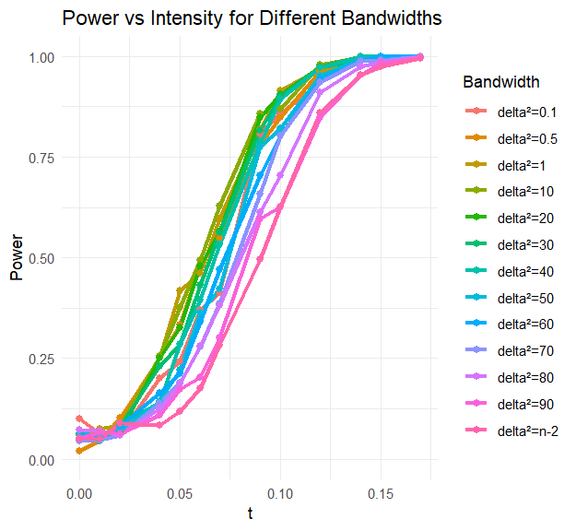
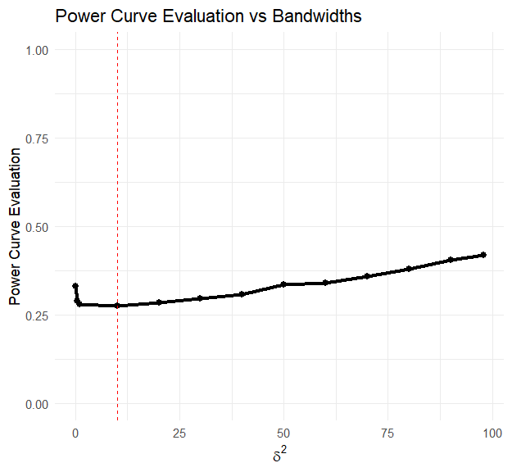
Comparing Performance Across Bandwidth Candidates
mean: ${s^{2}=λ\overline{D}}^{2}=λ\frac{\sum_{i<j}{{\left\|x_{i}−x_{j}\right\|}^{2}}}{\left({n \atop 2}\right)}$
modified mean^{[3]}: $s^{2}= {\overline{D}}^{2}/\ln{\frac{n−1}{δ^{2}}}$
exponential i.i.d. rate change: $X\sim Exp(1)$ and $Y\sim Exp(1/μ_{Y})$
moderate bandwidths are preferred over extreme values
[3] Chaudhuri, Arin, et al. "The mean and median criteria for kernel bandwidth selection for support vector data description." 2017 IEEE International Conference on Data Mining Workshops (ICDMW). IEEE, 2017.

Slide 19





On-Going Work
studentized MMD^{[4]}
check if studentization can lead to better-calibrated test statistics
comparative performance analysis
want a single bandwidth that its performance matches as close to the state-of-the-arts as possible
efficient threshold estimation
explore faster and scalable alternatives to bootstrap and permutation methods
streaming data implementation
develop lightweight and efficient algorithms for real-time detection
[4] Shekhar, Shubhanshu, Ilmun Kim, and Aaditya Ramdas. "A permutation-free kernel two-sample test." Advances in Neural Information Processing Systems 35 (2022): 18168-18180.

Slide 20
Kernel Bandwidth Selection for Maximum Mean Discrepancy
MMD is powerful for detecting distributional shifts, but its effectiveness is sensitive to kernel bandwidth choices
factors that affect MMD robustness and sensitivity:
tail heaviness
data dependence
drift orientation
distance from oracle power curve is used to find an appropriate kernel bandwidth, and preliminary results are informative

Slide 21

Contact Information
SAS: Hangcen.Zou@sas.com
Personal: hangcen.zou@outlook.com
LinkedIn

