Slide 1
The Responsible Use of AI Systems
Jim Box, SAS Institute
MWSUG 2025 AE-064

Slide 2
Framing the Problem
Let’s get calibrated

Slide 3
AI or ML?
What’s the Difference
AI systems perform tasks that typically require human-level intelligence
Understanding Language
Recognizing images and patterns
Making Decisions
Learning from the past
Machine Learning uses data & algorithms to learn and make decisions
ML may be part of the brains in an AI system, or it may be used in a stand-alone usage
Generally, we think of predictive modelling

Slide 4
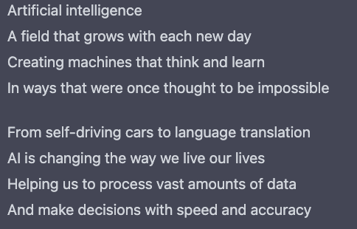
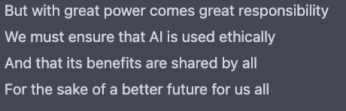
AI in Its Own Words:

Slide 5
Common Biases
Too Many to Talk About
Confirmation Bias
Cause/ Effect Bias
Confounding Bias
Collider Bias
Prediction Bias
Performance Bias
Hindsight Bias
Chronological Bias
Funding Bias
Automation Bias
Deployment Bias
Drift Bias
Aggregation Bias
Survivorship Bias
Attrition Bias
Reporting Bias
Proxy Bias
Availability Bias
Recall Bias
Exclusion Bias
Pre-processing Bias
Measurement Bias
Time-interval bias
Historical Bias
Selection Bias

Slide 6
Impact on Society
Financial Resources
Criminal Justice
Health Care
HR
Who gets approved for a loan?
Who gets a harsher sentence?
Who gets admitted to a care management program?
Who gets moved up to the next stage of the hiring process?

Slide 7
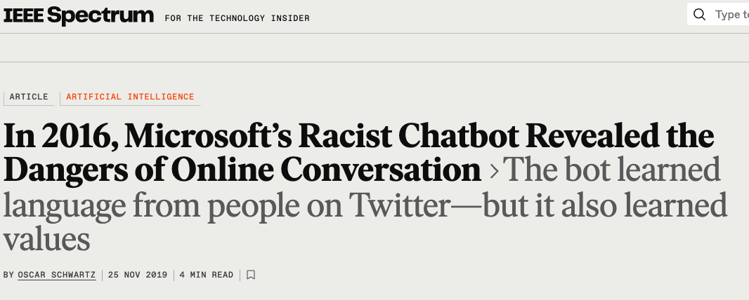
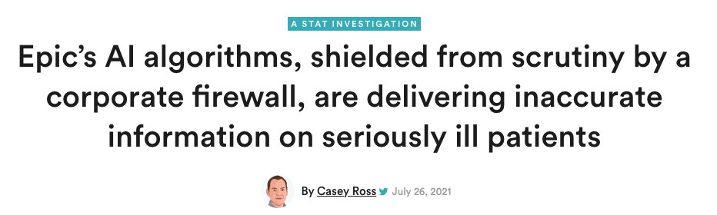
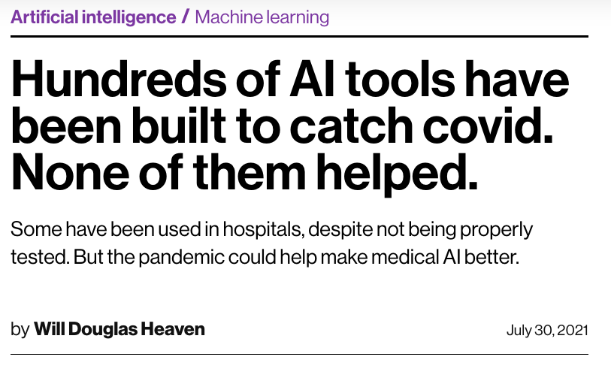
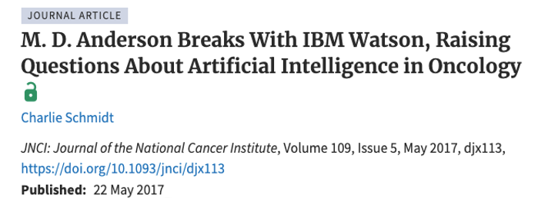
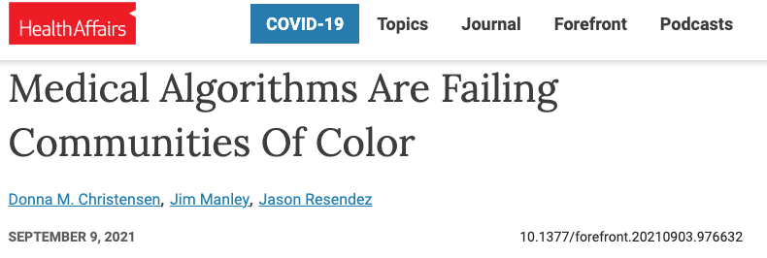
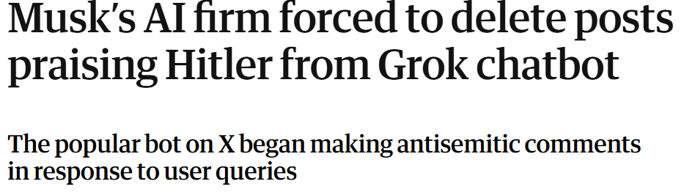
What Could Possibly go Wrong?

Slide 8
Biases in ML Models
Just a few Examples

Slide 9
Machine Learning Process
Input Data
Cool Algorithms
Prediction, Forecast, Recommendation,
Decision …

Slide 10
Biased Training Data
Input Data
Cool Algorithms
Prediction, Forecast, Recommendation,
Decision …
Biased data gives biased results

Slide 11
Biased Training Data
Amazon Automates Resume Reviews
Amazon receives hundreds of applications to open positions
They are in the business of ranking things
Created an AI system to comb through resumes and rank the applicants based on successful hires in the past
Focused on interviewing the 5-star candidates

Slide 12
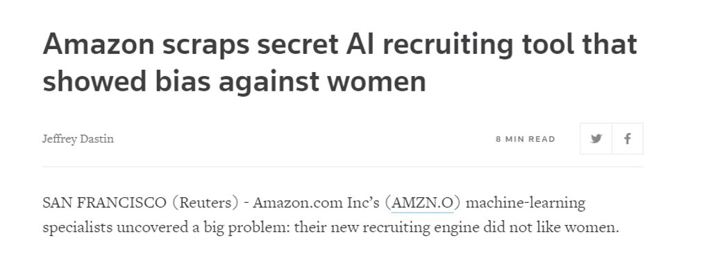
Biased Training Data
Amazon Automates Resume Reviews
https://www.reuters.com/article/us-amazon-com-jobs-automation-insight/amazon-scraps-secret-ai-recruiting-tool-that-showed-bias-against-women-idUSKCN1MK08G

Slide 13
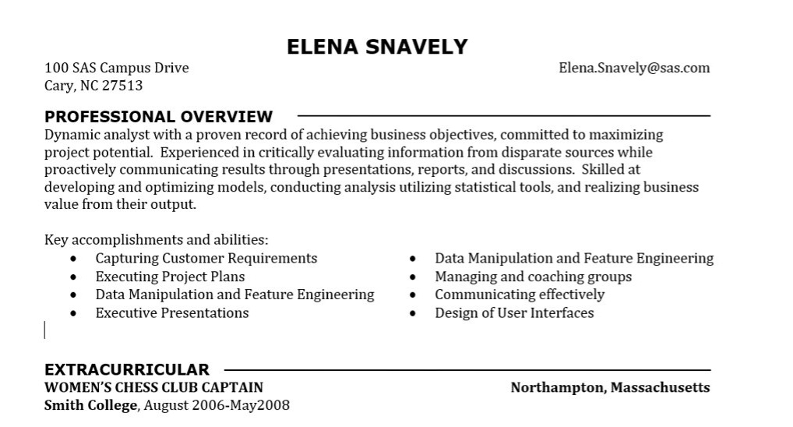
Biased Training Data
Example CV

Slide 14
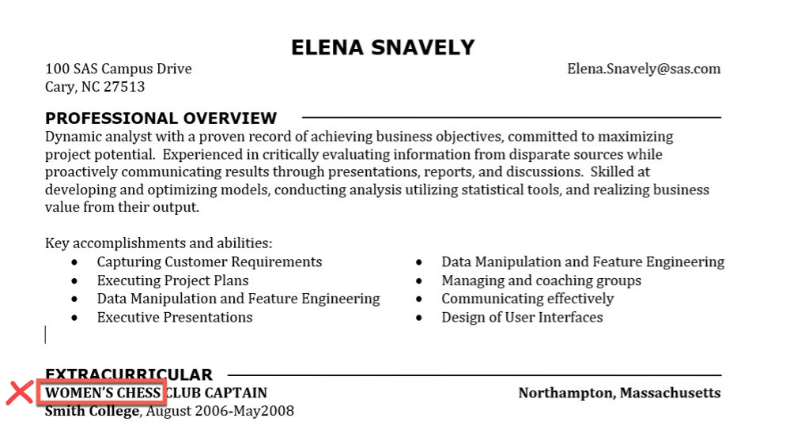
Biased Training Data
Keyword Exclusions

Slide 15
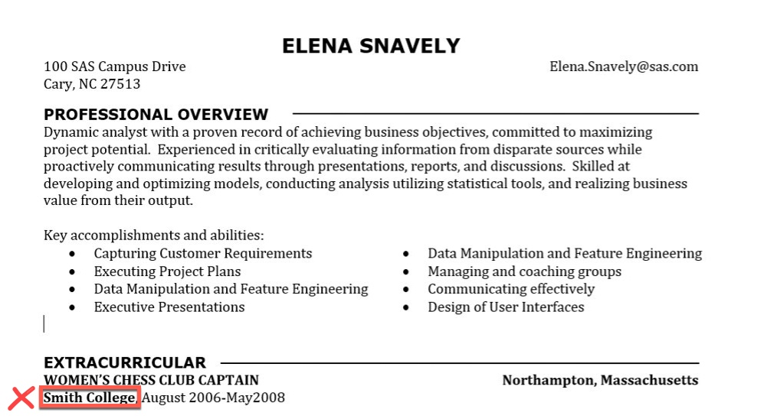
Biased Training Data
Correlations

Slide 16
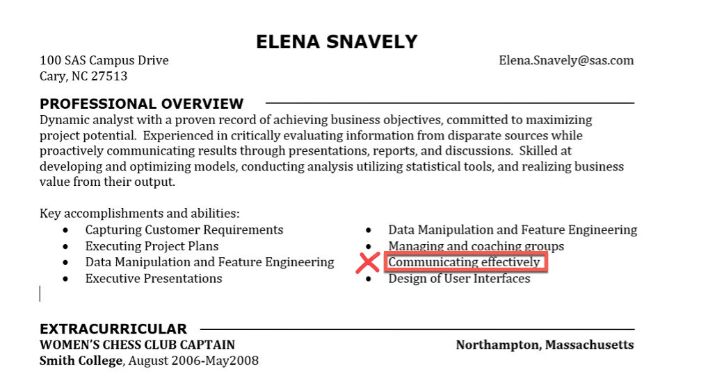
Biased Training Data
Language Usage

Slide 17
Biased Training Data
Takeaways
Models trained on biased data will excel at applying that bias – even more efficiently than humans
Your responsibility: Question the data
  Where did it come from
  How representative is it?
  How did it get labeled?
  Is there a feedback loop?

Slide 18
Models Do What you Tell Them
Input Data
Cool Algorithms
Prediction, Forecast, Recommendation,
Decision …
Biased data gives biased results
Models do what you tell them to do, which might not be what you wanted

Slide 19
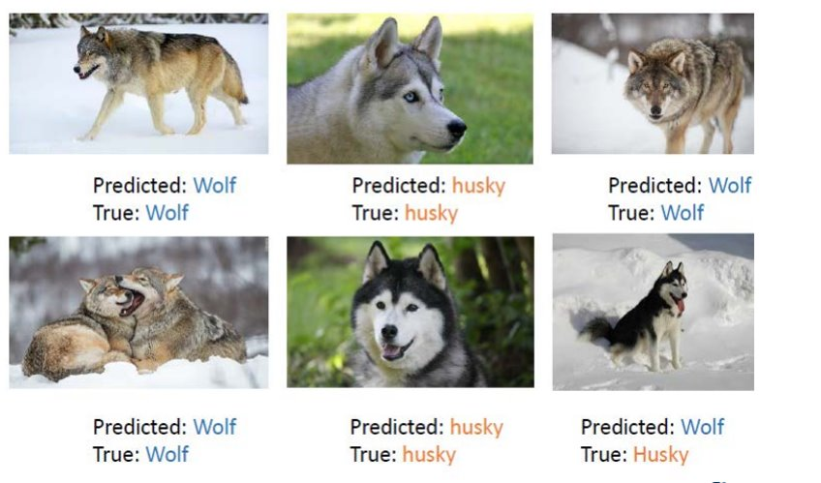
Models Do What you Tell Them
Husky or Wolf?
https://www.kdd.org/kdd2016/papers/files/rfp0573-ribeiroA.pdf

Slide 20


Models Do What you Tell Them
Husky or Wolf?
https://www.kdd.org/kdd2016/papers/files/rfp0573-ribeiroA.pdf

Slide 21
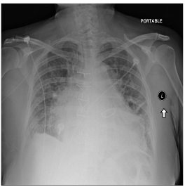
Models Do What you Tell Them
Automating Radiology
Diagnosing Cardiomegaly (Enlarged Heart)
Model trained on labeled images
Apply the model to new images to test how it does
This patient has the condition, and the model gave it a probability of 0.752, so it seems to have worked
https://medium.com/@jrzech/what-are-radiological-deep-learning-models-actually-learning-f97a546c5b98

Slide 22
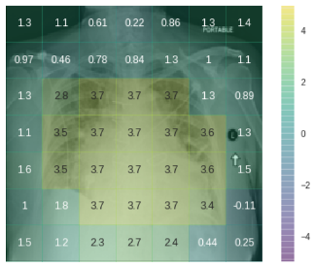
Models Do What you Tell Them
Automating Radiology
Heatmap shows how different parts of the image contribute to the prediction
Looks like the focus area is on the heart, which is good
https://medium.com/@jrzech/what-are-radiological-deep-learning-models-actually-learning-f97a546c5b98

Slide 23
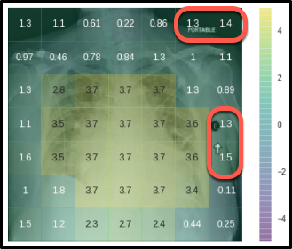
Models Do What you Tell Them
Automating Radiology
Heatmap shows how different parts of the image contribute to the prediction
Looks like the focus area is on the heart, which is good
Some surprises, though
https://medium.com/@jrzech/what-are-radiological-deep-learning-models-actually-learning-f97a546c5b98

Slide 24
Models Do What you Tell Them
Automating Radiology
Model is looking at markers of image metadata
Model is using the fact that this image was taken with a portable x-ray machine, which is mainly used on sicker patients
Model also considered the reviewing radiologist
https://medium.com/@jrzech/what-are-radiological-deep-learning-models-actually-learning-f97a546c5b98

Slide 25
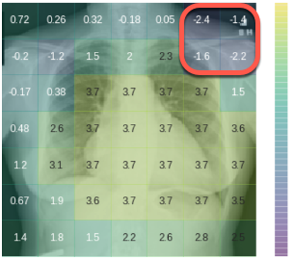
Models Do What you Tell Them
Automating Radiology
Different image of a patient with the same condition
Model downgraded the predication due to the lack of the portable stamp
https://medium.com/@jrzech/what-are-radiological-deep-learning-models-actually-learning-f97a546c5b98

Slide 26
Models Do What you Tell Them
Takeaways
Models are lazy, but effective
Models do not care about context unless specifically instructed
Your Responsibility: Question the Results
  Why did the model make a specific prediction for this specific case?
  What are the key inputs being used to make predictions?
  What, exactly, was the model set up to do?

Slide 27
Models on New Data
Input Data
Cool Algorithms
Prediction, Forecast, Recommendation,
Decision …
Biased data gives biased results
Models do what you tell them to do, which might not be what you wanted
Models exposed to new data may give unexpected results

Slide 28
Models on New Data
Surprises May be Very Harmful
Models should only be applied to data that is similar to the data they were trained on
Models will return a prediction on novel data, but it may not be trustworthy (although it will appear to be so)

Slide 29


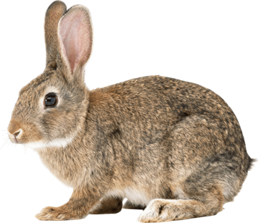
Models on New Data
How Models Learn
https://www.pngarts.com

Slide 30

Models on New Data
Predictions
Happy Dog and Other Furry Friends. Written by Robert Newton.
Illustrated by Ellie Boultwood

Slide 31
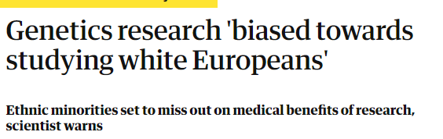

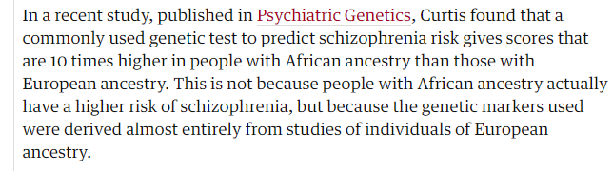
Models on New Data
Consequences can be Dire
https://www.theguardian.com/science/2018/oct/08/genetics-research-biased-towards-studying-white-europeans

Slide 32
Models on New Data
Takeaways
Your responsibility – Question the Application
  Is this data similar to what the model was trained on
  Do different groups (population subgroups) in my predictions get different results
  Is there a human feedback loop that allows for retraining the model

Slide 33
Where do These Biases Come From?
Bias Comes from Us
Like children, models can pick up patterns in the data that we are not explicitly trying to teach them
There is a lack of awareness by Data Scientists/Statisticians about how historical/societal biases may be present in data modeling
  How we collect data
  The problems we decide to solve
  The data we choose to train models on
  How we assess accuracy
  How we present the results

Slide 34
What’s Next
Where can you Learn More?

Slide 35

At the Movies

Slide 36

In a Book

Slide 37
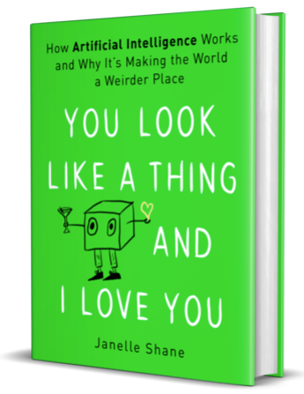
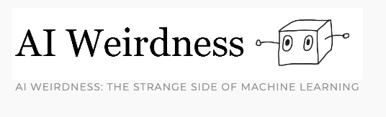
On a Blog
https://www.aiweirdness.com/

Slide 38
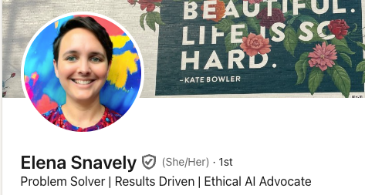
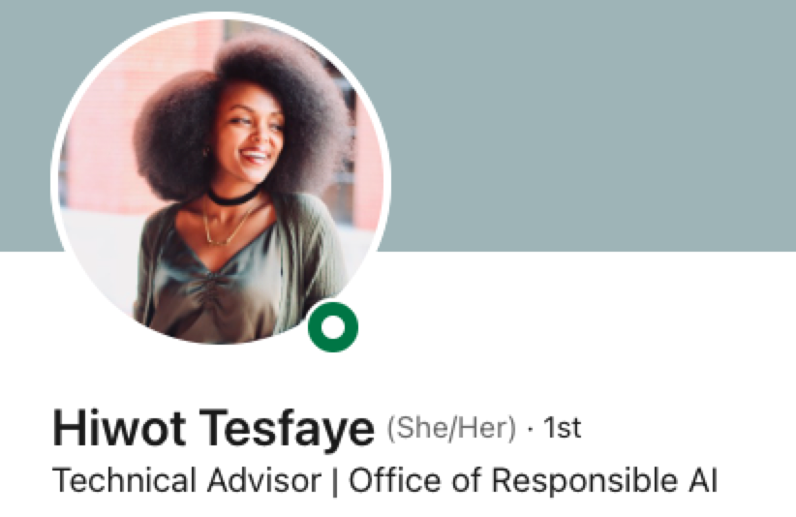

From Each Other

Slide 39
Thanks!
Jim Box
SAS Institute
Jim.Box@sas.com

