Slide 1

MWSUG 2025
Urvi has been using SAS since 2 years now.
She is a student pursuing her MS in Data Science at the University of Michigan, Ann Arbor.

Slide 2
Leveraging Self-Supervised Learning to
Synthesize Data
Helping Machine Learning Models Train More Efficiently

Slide 3
Outline
Introduction & Problem Definition
How does synthetic data solve the problem?
Generative Adversarial Networks
Methodology
How would the system look like?
Results
Advantages and disadvantages
Conclusion

Slide 4

Introduction
The inherent limitations with the traditional machine learning model training:

Slide 5
How Does Synthetic Data Solve the Problem?
“What if machines could teach themselves without us labeling every piece of data?”
Self-Supervision:
Uses data’s own structure & correlations
Generates labels automatically
Makes learning scalable without heavy annotation

Slide 6
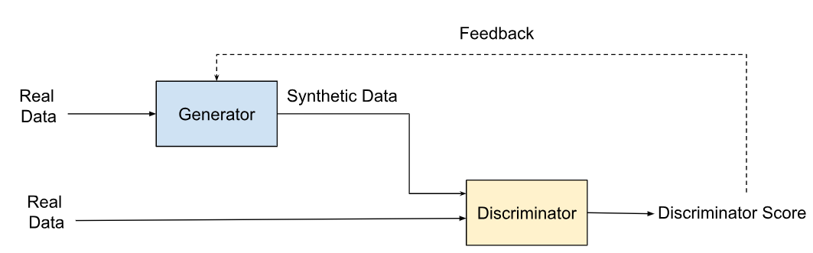
Generative Adversarial Networks
“Adversarial training loop drives improvement”

Slide 7
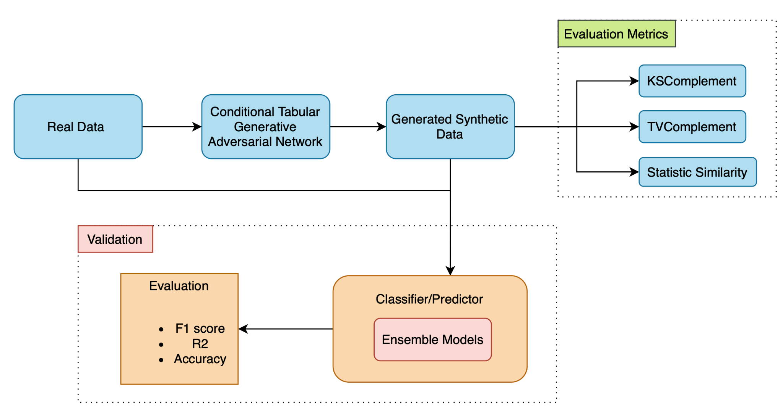
Methodology

Slide 8
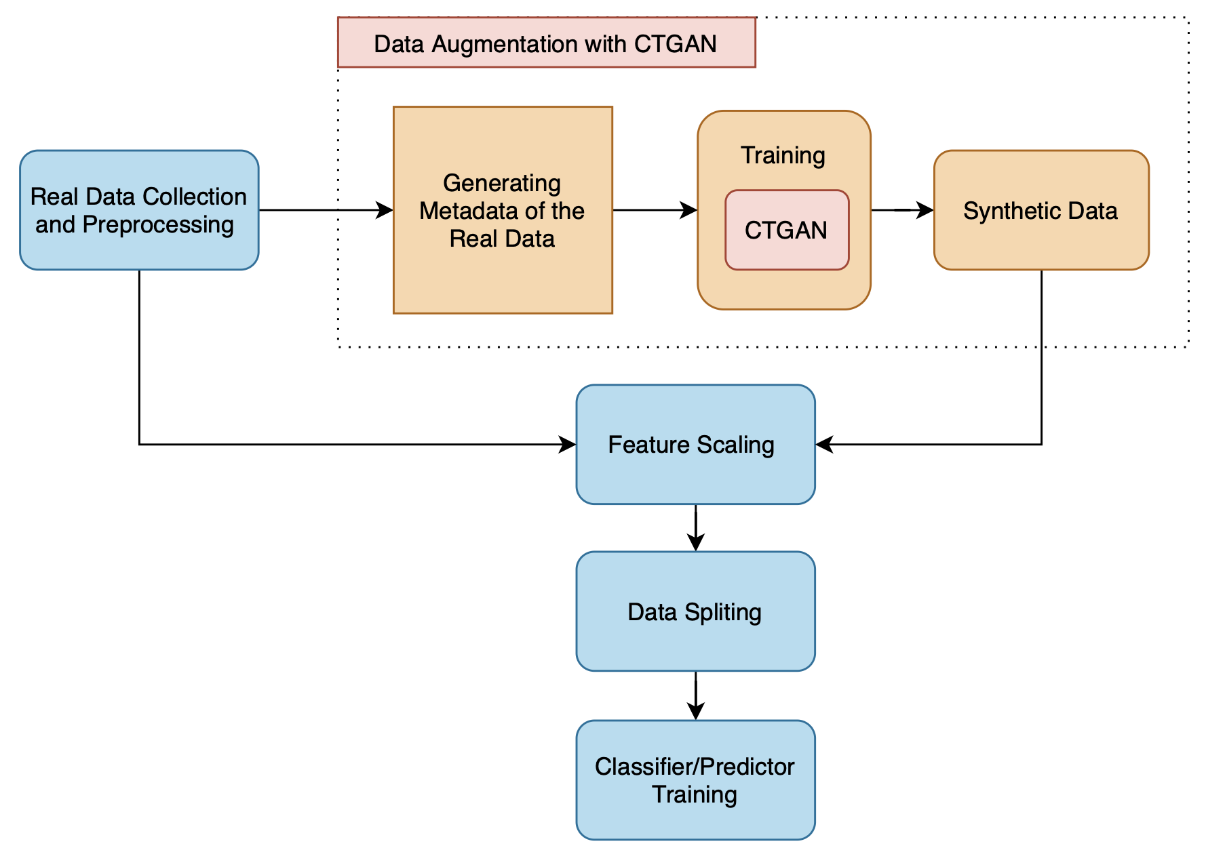
How would the system look like?

Slide 9
Results
Evaluation Metrics for Synthetic Data:
KS Complement- 0.707
TV Complement- 0.903
Statistical Similarity- 0.929

Slide 10
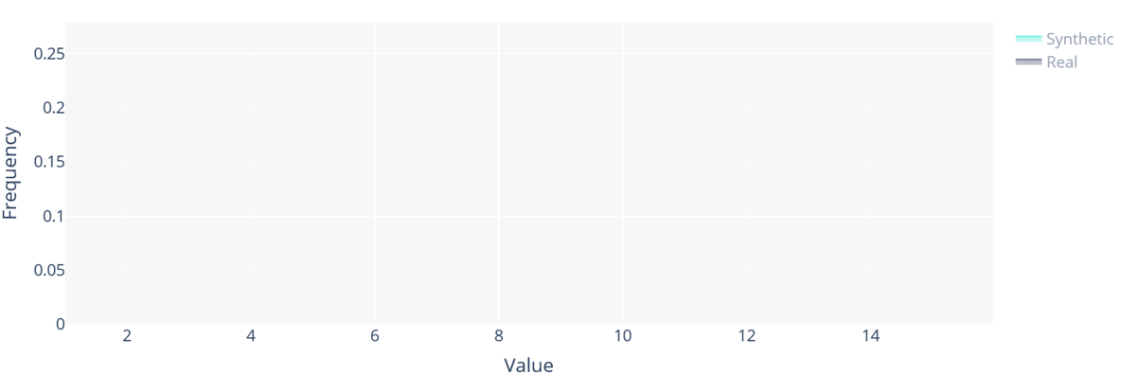
Real v/s Synthetic Data Distribution

Slide 11
Advantages & Limitations
Reduced Dependency on Labeled Data
Scalability
Enhanced Data Privacy
Improved Model Generalization
Data Quality Enhancement
Data Quality Dependency
Data Distribution Assumption
Overfitting Potential
Interpretability Trade-off

Slide 12
Conclusion
“Data scarcity and fear of data leakage shouldn’t hold back innovation!”
GANs can generate realistic synthetic datasets that preserve privacy and reduce labeling costs.
Results show that synthetic data can effectively support model training while maintaining statistical similarity to real data.
This approach opens opportunities in data sensitive domains.

Slide 13
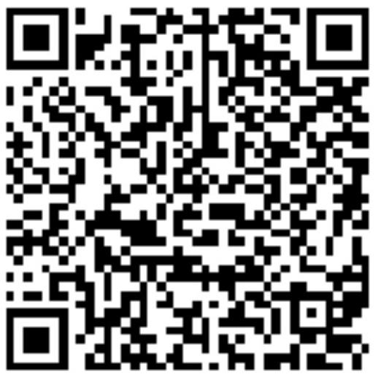
Thank You and Contact Information
Name: Urvi Manish Mehta
Company: University of Michigan
Address: Ann Arbor, MI
Phone: +1 (734) 5100336
Email: urvimehta48@gmail.com
Social Media:

