Slide 1
Predicting Farm Equipment Purchases and Trades AE-41
Koren Roland has years of experience as a software developer and is the owner of GroveSite and MyPBGames. She is also a consultant for Kansas Farm Management Association. Koren is collecting degrees with an undergraduate degree in Information Systems, an MBA and an MS in Management Information Systems. She is now adding a master’s degree in data analytics from Kansas State University to her collection to pivot her career from building data collection applications to interpreting data and driving informed decision-making.

Slide 2
Predicting Farm Equipment Purchases and Trades AE-41
Koren Roland
Kansas State University

Slide 3
Kansas Farms
Farm Income
Liquidity
Crop Prices
Crop Costs
Global Supply
Equipment Costs
Kansas Farm Management Association 2024 Executive Summary
https://agmanager.info/kfma/whole-farm-analysis/kfma-executive-summary/2024-executive-summary
Notes:
Liquidity decreased for the third year in a row
Current Ratio decreased which could indicate cash flow struggles in 2025
Factors such as weather, global politics and farm management (Brazil competition, over supply)
Timing equipment purchases and trades, especially large equipment like combines, can impact both crop production and depreciation costs.
Analyze historical depreciation and analysis data from the Kansas Farm Management Association to identify patterns and predict optimal timing for large equipment purchases.

Slide 4
Farm Equipment Costs

Slide 5
Use SAS Viya 4 to Predict Purchases
Data Preparation
Load and Clean Six Years of Analysis Data
Segmentation
Group farms to understand categories
Machine Learning
Use supervised machine learning to predict equipment purchases
Notes:
Using SAS Viya 4
Merge analysis and depreciation data
Grouping the farms to better understand the categories around the state
The farms are typically grouped by association, which ties to an area in Kansas, or farm type but other groupings may improve the models
Use supervised machine learning like regression, decision trees or random forest methods to predict the purchases of new equipment – specifically combines, self-propelled equipment such as sprayers, and planters.

Slide 6
Data Summary
Provided by Kansas Farm Management Association (KFMA)
Analysis data
Computerized in 1972
800 – 2000 farms per year
More than 2300 variables per farm
Depreciation data
Exported at the same time as the analysis data
New and Existing asset details
2019 to 2024
Notes:
This data is gathered every year by the KFMA Economists, summarized by K-MAR-105 Association and then provided to K-State for research purposes.
Data includes: income, expense, inventory and crop production
The previous year of depreciation records is exported at the same time as the analysis files and can be linked to the analysis data using a farm number. This data includes purchases, trades, sales and abandoned items. The records contain a category code so the equipment type can be identified

Slide 7
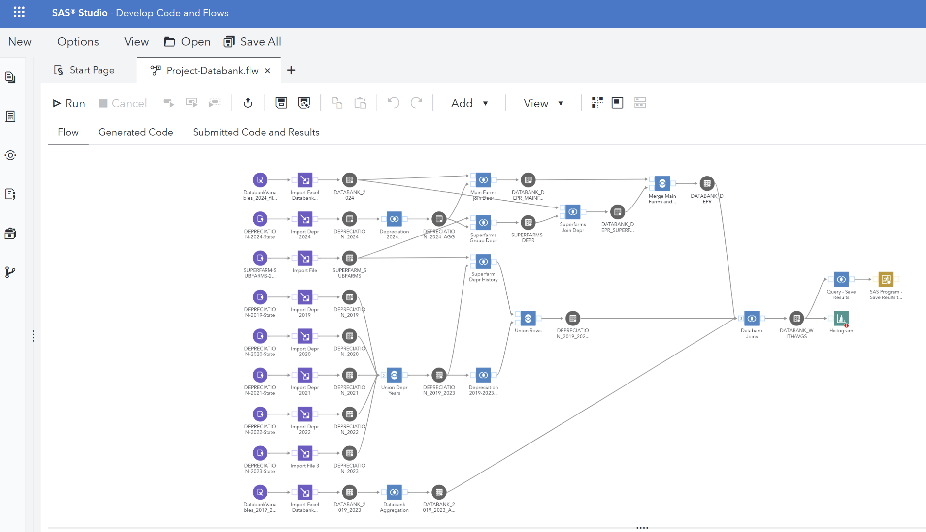
Data Preparation
Merge the data using a code flow
Analysis files, Depreciation Files and Superfarm File
Notes:
Data Exploration and Cleaning
Identified 48 farms missing previous year variables. These could be new farms or farms that ran as Superfarms or sub-farms in previous years.
Some farms missing depreciation data. The counts are set to zeros for these farms.
There are data outliers but there are big differences in farm sizes, so no data was removed.
Some variables had zeroes for every record, so these columns were removed.

Slide 8
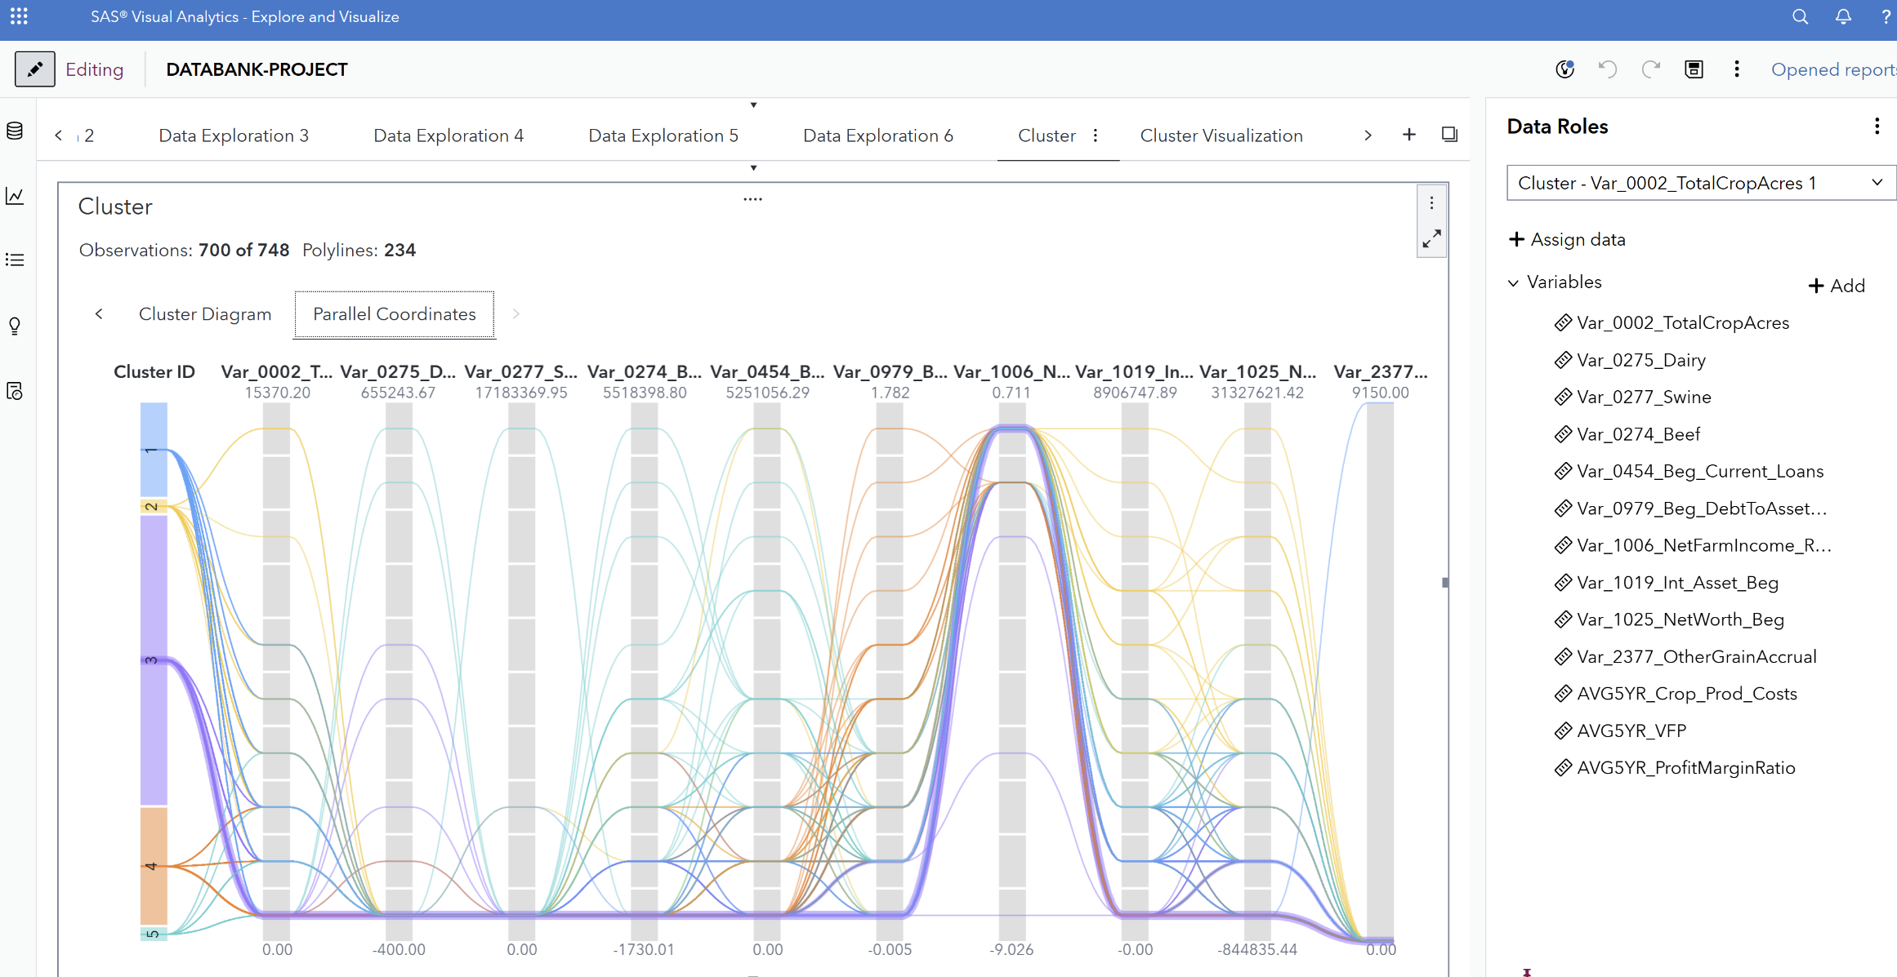
Clustering Analysis
Notes:
Used cluster variables code flow to reduce to thirteen variables for clustering analysis
Var_0002_TotalCropAcres
Var_1019_Int_Asset_Beg
Var_0274_Beef
Var_1025_NetWorth_Beg
Var_0275_Dairy
Var_2377_OtherGrainAccrual
Var_0277_Swine
AVG5YR_ManagedCapital
Var_0454_Beg_Current_Loans
AVG5YR_VFP
Var_0979_Beg_DebtToAsset_Ratio
AVG5YR_ProfitMarginRatio
Var_1006_NetFarmIncome_Ratio_VFP

Slide 9
Clustering Analysis
Cluster 1 | Mid-sized Farms | High: other grains All other variables in the middle
Cluster 2 | Large Crop Farms | High: crop acres, assets, net worth, avg 5-yr crop production costs, avg 5-yr VFP and profit margin ratio
Cluster 3 | Small Farms | Low: crop acres, livestock, loans and assets, debt to asset ratio
Cluster 4 | At-risk Farms | High: beginning debt to asset ratio Low: net worth and avg 5-yr profit margin ratio
Cluster 5 | Livestock Farms | High: dairy, swine, beef, loans, net farm income ratio
Notes:
Mid-size
High: Other Grain
All other variables in the middle farms
Large Crop farms
High: Total Crop Acres, Beginning Intermediate Assets, Beginning Net Worth, Average 5-yr Crop Production Costs, Average 5-yr VFP, Average 5-yr Profit Margin Ratio
Small farms
Low: Total Crop Acres, Swine, Beef, Beginning Current Loans, Beginning Debt to Asset Ratio, Net Farm Income Ratio, Beginning Intermediate Assets, Average 5-yr Crop Production Cost, Average 5-yr VFP
At-risk farms
High: Beginning Debt to Asset Ratio
Low: Beginning Net Worth, Average 5-yr Profit Margin Ratio
Livestock Farms
High: Dairy, Swine, Beef, Beginning Current Loans, Net Farm Income Ratio

Slide 10
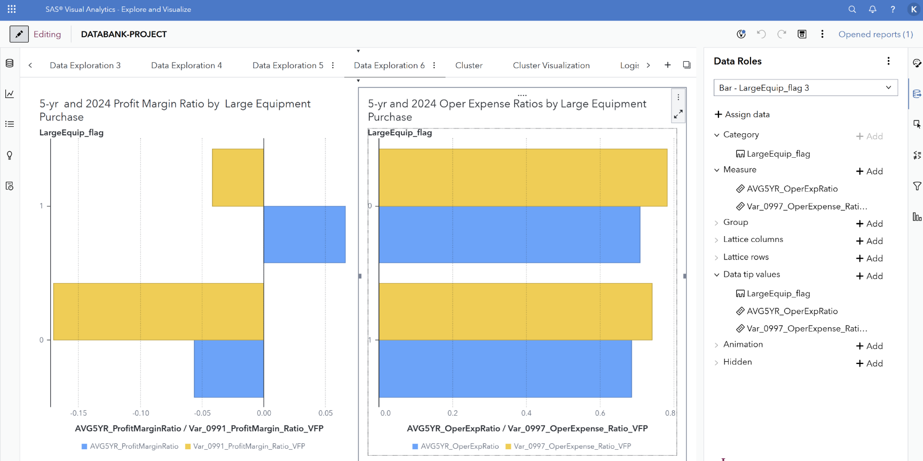
Data Visualizations
All profit margin ratios decreased in 2024
Farms that purchased equipment had higher profitability ratios for both the 5-year and 2024 averages.
All operating expense ratios increased in 2024
Farms that purchased equipment rose less and had lower ratios than farms that did not

Slide 11
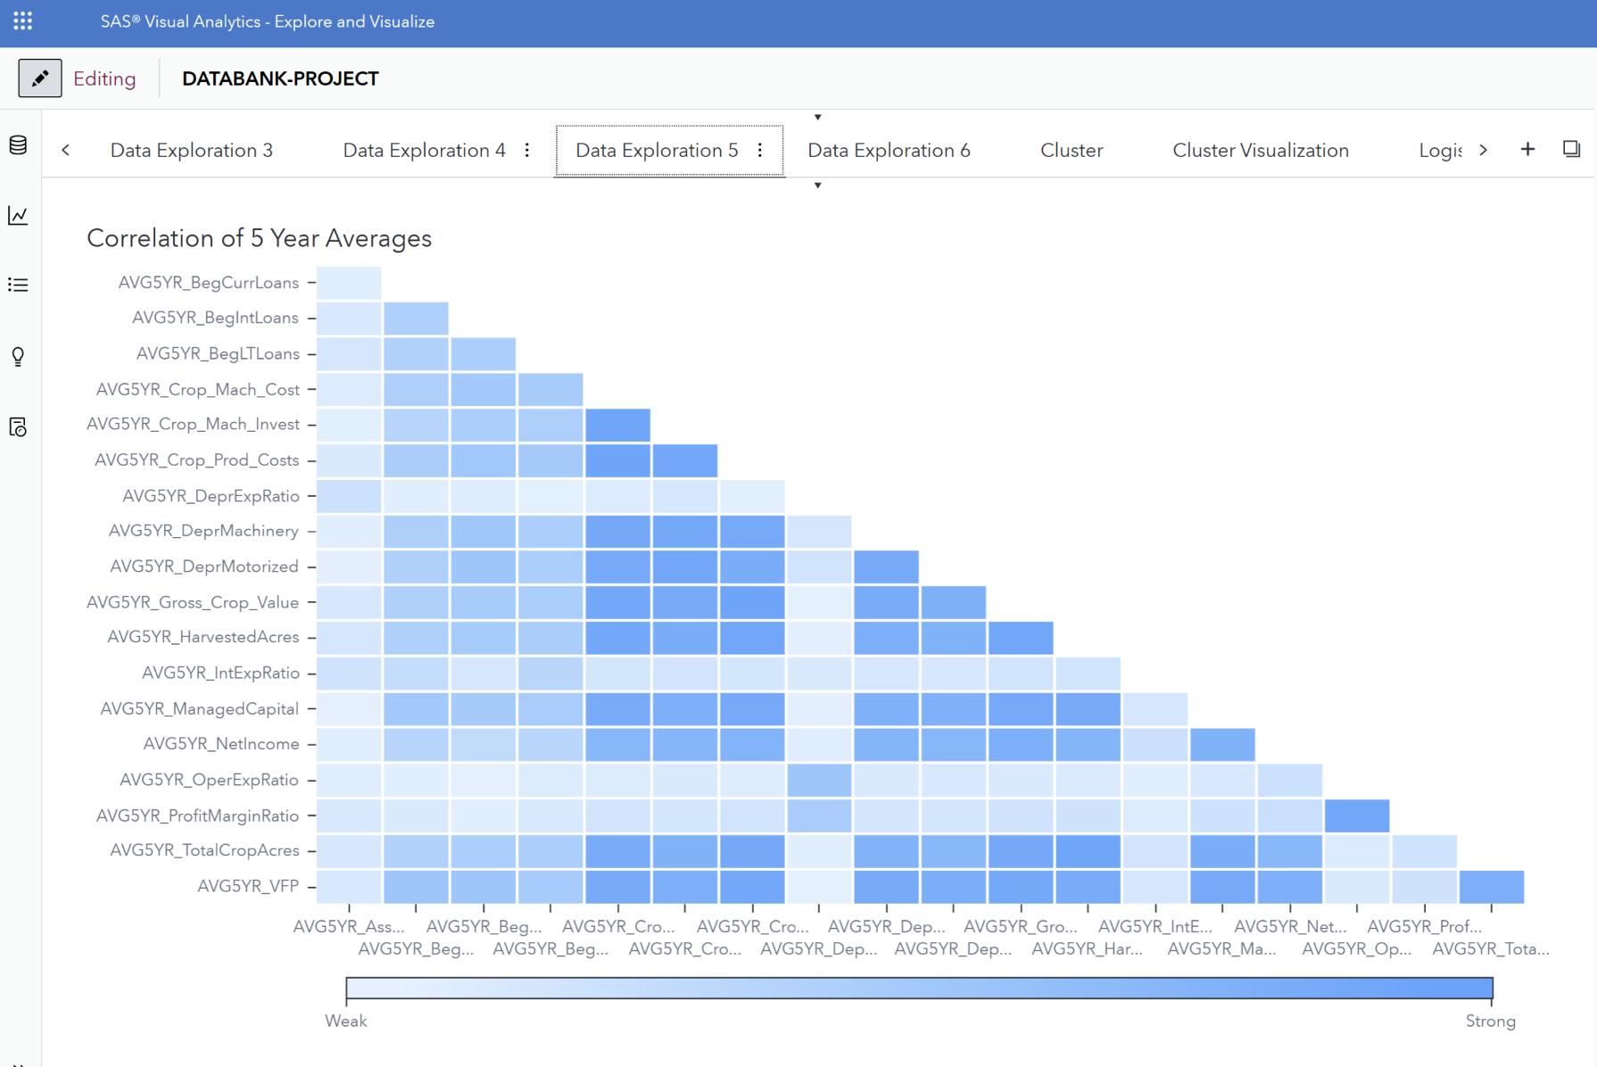
Data Visualizations
Correlation Analysis of the 5-year averages show the data is highly correlated.

Slide 12
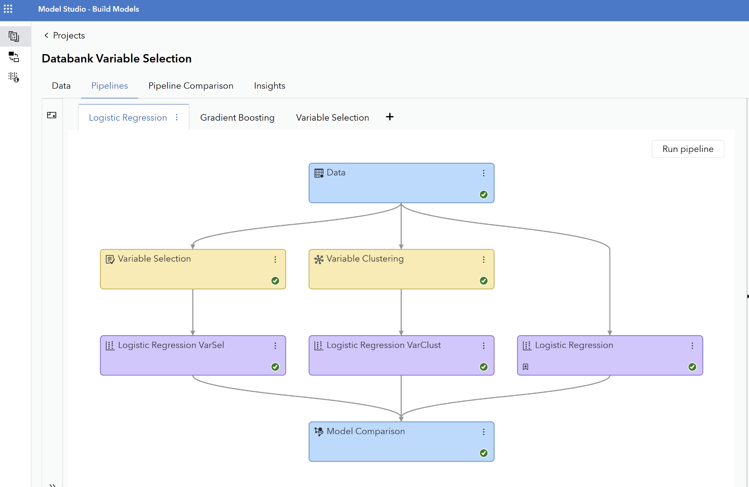
Prediction Models
Notes:
Built a pipeline model to reduce the variables using variable selection and variable clustering.
Models still had too many variables so variables that are related were removed. Ended up with 17 variables
AVG5YR_AssetTurnRatio
Var_0578_Acc_Fuel
AVG5YR_Crop_Prod_Costs
Var_0580_Acc_SeedOthCropExp
AVG5YR_VFP
Var_0581_Acc_Fertilizer
AVG5YR_Gross_Crop_Value
Var_0988_Oper_Expense_VFP
Var_0282_Grain
Var_1019_Int_Asset_Beg
Var_0451_Gross_Crop_Value
Count5yr_LargeEquip
Var_0453_Crop_Prod_Costs
Mnths_Last100kPurch
Var_0474_End_Intermediate_Loans
Cluster Id
Var_0479_HarvestedAcres

Slide 13
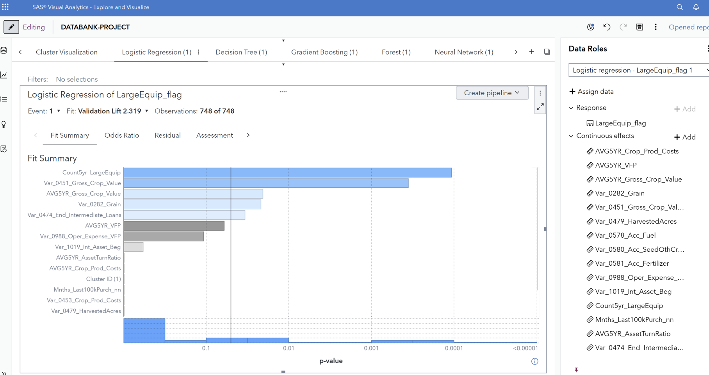
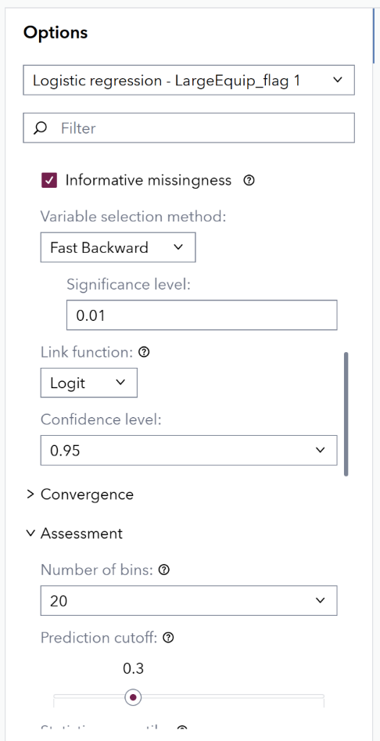
Prediction Models
Models:
Logistic Regression, Decision Tree, Gradient Boosting, Forest, Neural Network

Slide 14
Prediction Models
 | KS (Youden) | Lift | Misclassifcation Rate | F1 Score
Logistic Regression | .2792 | 2.3188 | .2813 | .4793
Decision Tree | .2381 | 1.7391 | .2768 | .4364
Gradient Boosting | .2906 | 2.0290 | .3214 | .4286
Forest | .3103 | 1.7391 | .2946 | .3400
Neural Network | .2617 | 2.3188 | .3080 | .4567
Notes:
Decision Tree important variables:
Gross Crop Value
Beginning Intermediate Assets
Average 5-year Asset Turnover Ratio
Months since last $100k purchase
Fuel
Crop Production Costs
Logistic Regression important variables:
5-year count of large equipment purchased
Gross Crop Value
Average 5-year Gross Crop Value
Grain
Ending Intermediate Loans
Average 5-year Value of Farm Production
Operating Expenses
Beginning Intermediate Assets
Gradient Boosting important variables:
Average 5-year Asset Turnover Ratio
Ending Intermediate Loans
Beginning Intermediate Assets
Harvested Acres
Fertilizer
Average 5-year Gross Crop Value
Fuel
Average 5-year Crop Prod Costs
Average 5-year Value of Farm Production
Gross Crop Value
Forest important variables:
Fuel
5-year count of large equipment purchased
Harvested Acres
Gross Crop Value
Seed Other Crop Expense
End Intermediate Loans
KS(Youden): useful in medical diagnostics where minimizing both false positives and false negatives is equally important
Lift: marketing and business applications to measure the efficiency of a model
Misclassification rate: simple overall measure but can be misleading for imbalanced datasets because a low rate can be achieved by simply predicting the majority class all the time
F1 Score: used when both false positives and false negatives are important particularly with imbalanced datasets
Lift: it is more effective than random guessing (above 1)

Slide 15
Next Steps
Improve variable selection for the models
Include more historical data
Use farm profitability as the dependent variable and equipment purchases as an independent variable

Slide 16
Questions?
Koren Roland
Kansas State University
klroland@ksu.edu

