Slide 1
The Dependency Whisperer:
AI That Sees What You Might Miss
Ming (Janice) Yan – Senior advisor, Computational Statistics, Eli Lilly and Company
Xingxing Wu – Senior advisor, Computational Statistics, Eli Lilly and Company
Vina Ro – Senior scientist, Clinical Data | Data and Analytics, Eli Lilly and Company
Chih-Chan Lan – Master candidate, University of Southern California

Slide 2
The Dependency Whisperer:
AI That Sees What You Might Miss, AE13
Ming (Janice) Yan, Eli Lilly and Company
Xingxing Wu, Eli Lilly and Company
Vina Ro, Eli Lilly and Company
Chih-Chan Lan, University of Southern California

Slide 3
Outline
Background
Solution demonstration
Backend Workflow
Result
Summary

Slide 4
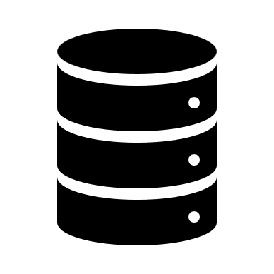



Statistical Reporting in Clinical Trials
Raw
Data
SDTM
Datasets
ADaM
Datasets
TFL
Outputs
Collected
from
clinical trials
Standardized
tabulation
datasets
Analysis-ready
datasets
Tables,
Listings,
and Figures
Adverse Event as example
TAFFY RUMS
AE3001
AE Domain
ADAE
AE Overview Table
Start Date(AESTDTC)
<AESTDTC>
<AESTDTC>
<ASTDT>
Adverse Event Listing

Slide 5


Why We Need Dependency Tracking
Value change in SDTM.AE.AEOUT
Stat Analyst
Where exactly does the variable flow?
Will it affect derived variables downstream?
Which TFLs are impacted?
How many programs do I need to re-run?
Notes:
Now imagine this: there is a value update of AESTDTC, the adverse event start date in the SDTM dataset.
You know this change matters. But how do you trace its impact?
Where does this variable flow next?
What derived variables are affected?
Which ADaM and TFL programs need to be re-run?
Right now, the answer isn’t clear.
Statisticians often go through code and specs manually, relying on experience to track dependencies.
To avoid missing updates, the safest option is to rerun the entire pipeline—from SDTM to ADaM to TFL.
That alone can take hours.
And even after rerunning, you still need to compare the new and old datasets, identify where values have changed, and document every impact.
This process can easily take more than two full days.
So what if there were a tool that could trace those dependencies for you—automatically, accurately, and visually?

Slide 6
Existing approaches
AstroGrep
  Unable to distinguish between active code and commented\
  Multiple searches to identify indirect dependency
  Need to manually document finding
  Completely rerun
  Time consuming
  Raise question about unintentional change

Slide 7
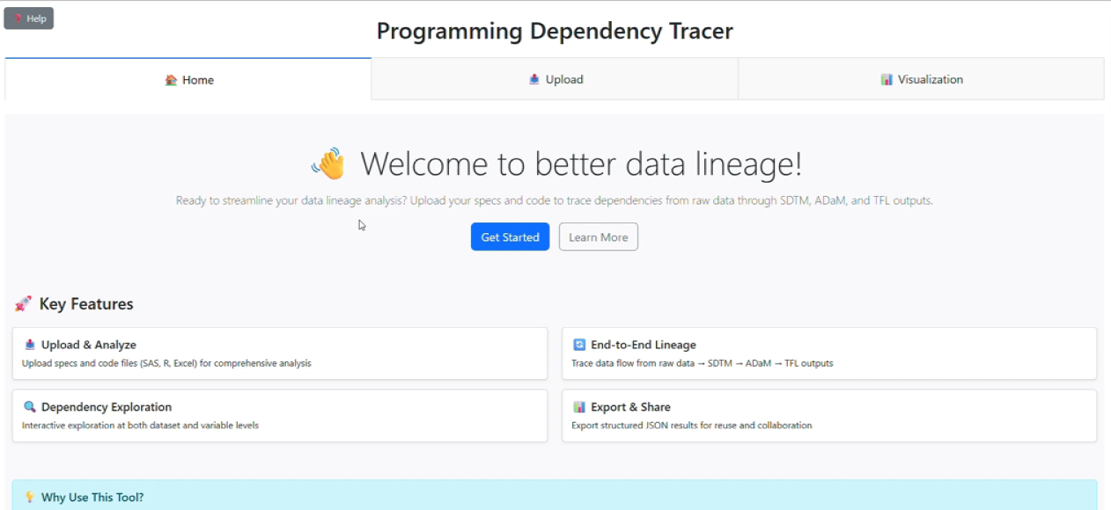



Solution: Programming Dependency Tracker
Read study specification and code files
Dependency Graph shows the downstream effect
Application
Statistician or analysts
Cross studies and Therapeutic Area (TA)
User
Expected time savings for refresh and documentation: from 2+ days to 0.5 day per update
Enables faster turnarounds and stronger collaboration
Impact

Slide 8



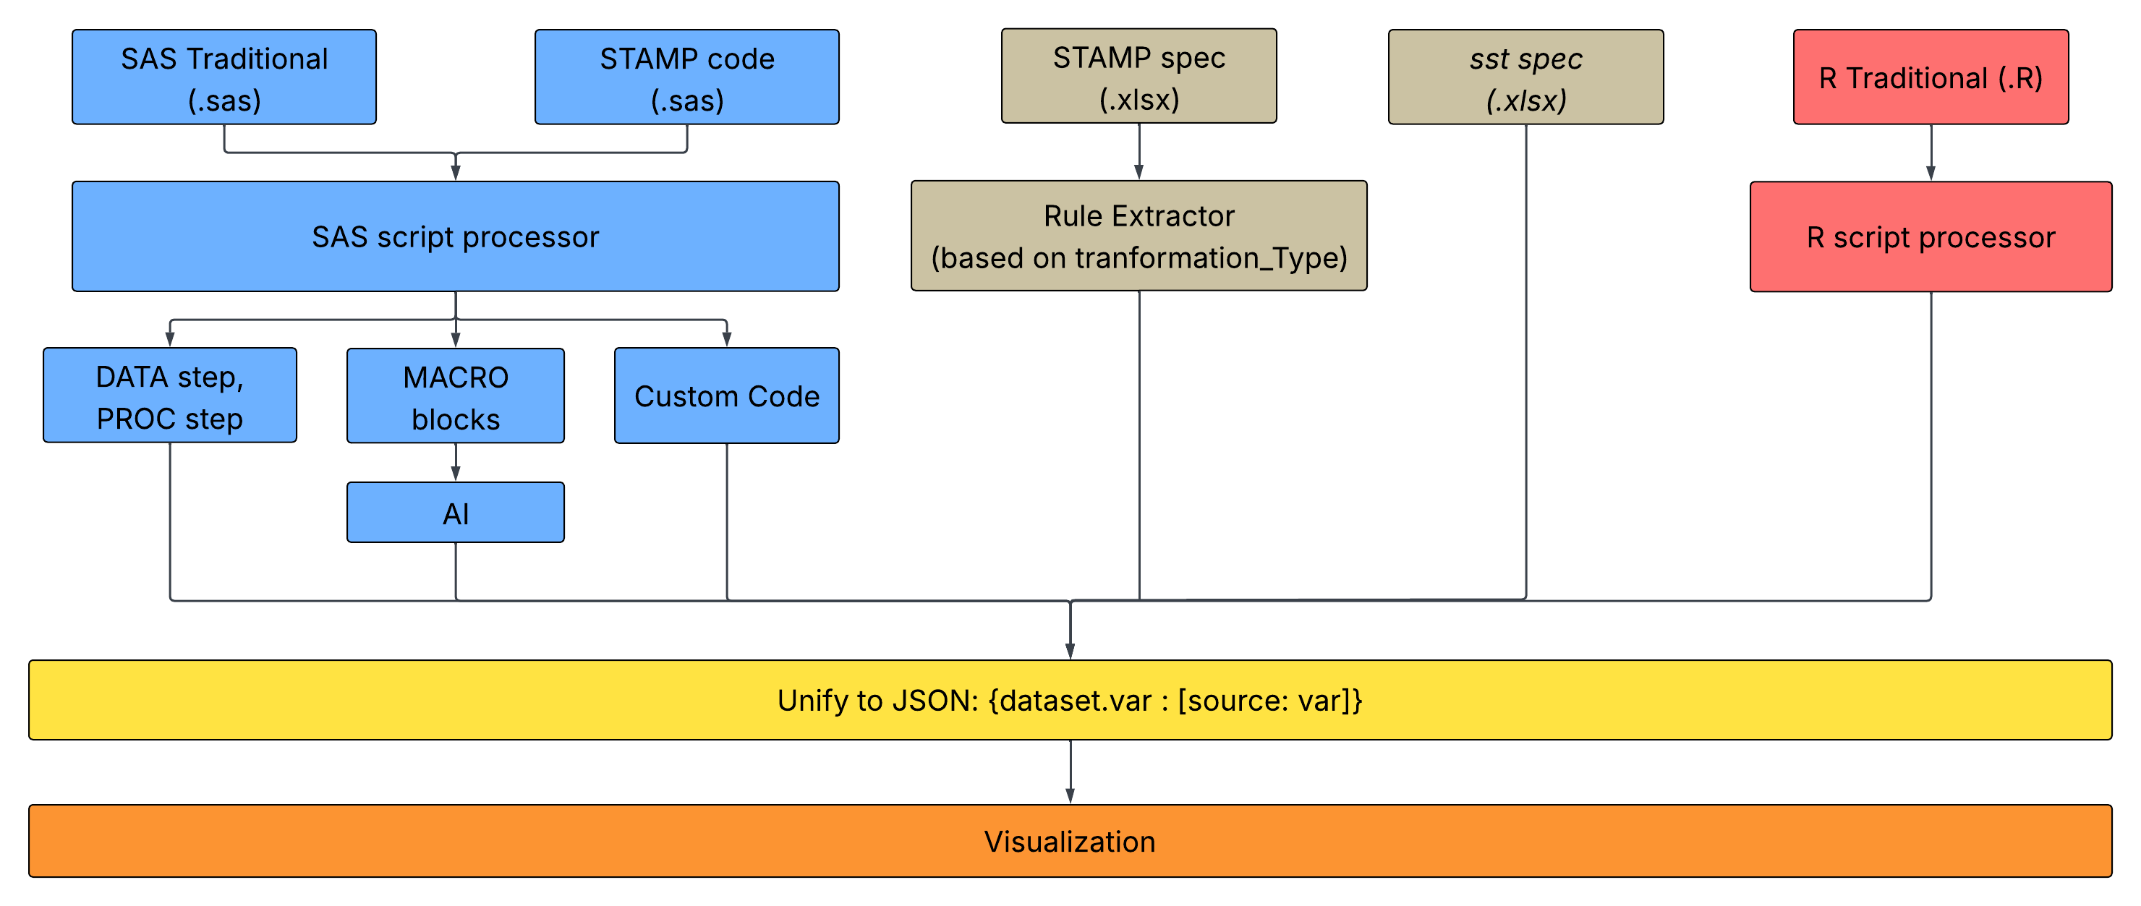


Dependency Extraction Pipeline
Input Files
SAS Standard
(.sas)
SAS Traditional
(.sas)
Standard spec
(.xlsx)
Traditional spec
(.xlsx)
Parsing Engine
Dependency Mapper
Build Dependency Graph

Slide 9

Code Parsing and Lineage Extraction
Input Code
AST (Abstract Syntax Tree)
data ADAE1;
set ADAE;
if trtst ne . then flag = 1;
run;
Data Block
<DATA>
body
<RUN>
Parser: grammar rules
DATA block:
<data> target_ds;
<set/merge> source_ds;
assignment;
<run>;
Assignment:
<if> source_var <then> target_var;
Target
dataset
<set>
assignment
ADAE1
Source
dataset
Source
var
Target
var
ADAE
trtst
flag

Slide 10




From Code to Dependency Connections
Input Code
Create Lineage
data ADAE1;
set ADAE;
if trtst ne . then flag = 1;
run;
ADAE.
trtst
ADAE1.
flag
Input Macro Code
%macro flag(input, output, var1);
data &input.;
set &output.;
if &var1. ne . then flag = 1;
run;
%mend;
%flag(ADAE, ADAE1, trtst);
"You are an expert SAS macro code analyst."
One-shot Prompting

Slide 11
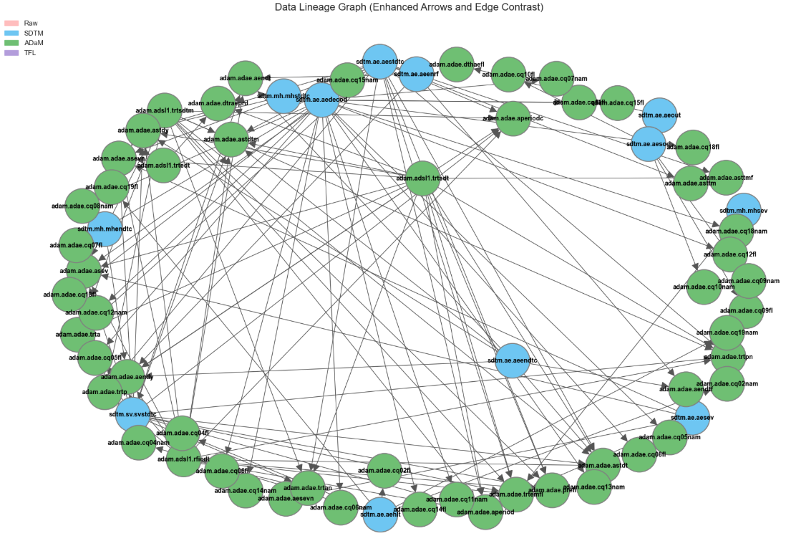
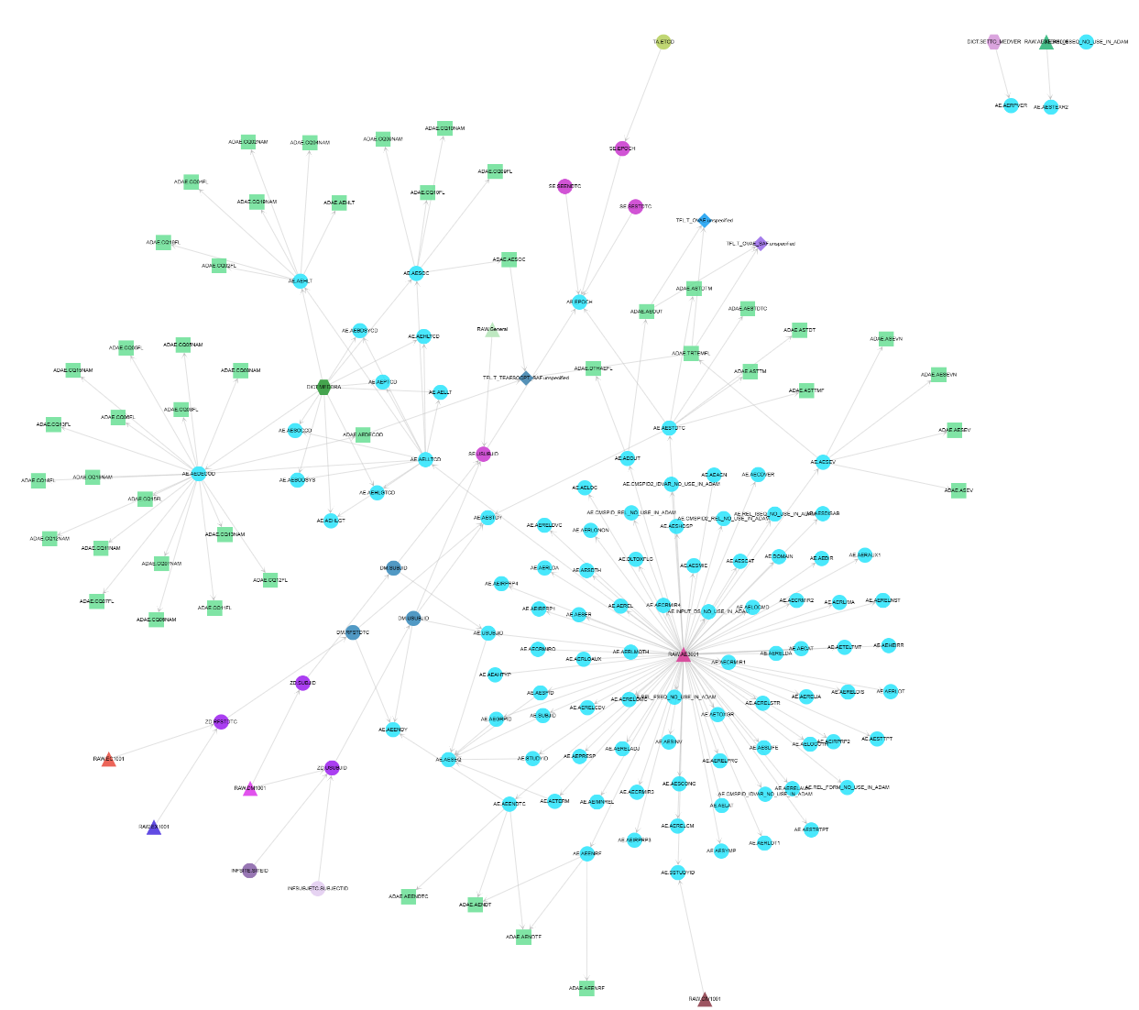
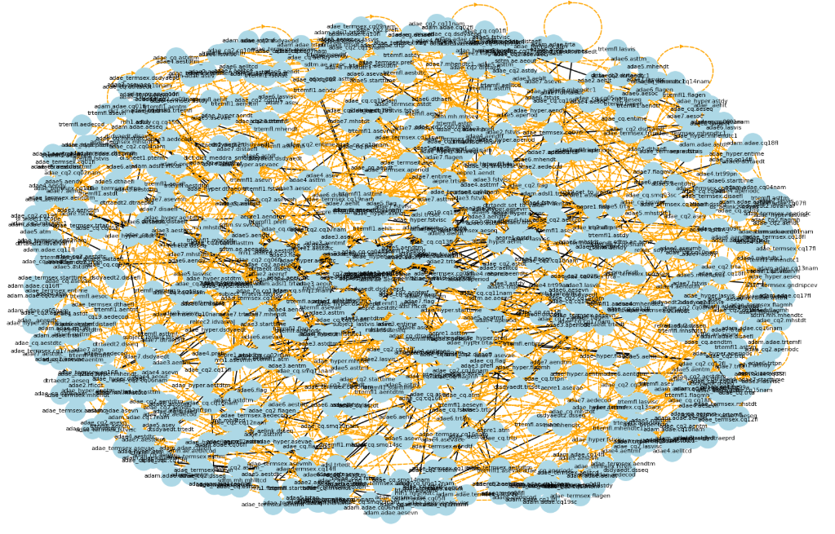
Results
For the flow of RAW → SDTM.AE → ADAM.ADAE → 3 tables,
mapped a total of 182 nodes and 256 relationships. With an accuracy of 90%.
Full ADAE graph
Cleaned ADAE graph
Visualized downstream impact
Fig 1. Mapped relationships from ADAE.sas
Fig 2. Graph from RAW to TFL

Slide 12



Summary
Translates complex code and spec into a clear data lineage graph
Reduces manual effort and speeds up impact analysis when data changes
Enhances traceability, enabling faster and higher-quality
QC workflows

Slide 13
Contact Information
Ming (Janice) Yan
Eli Lilly and Company
314-695-2879
Yan_ming_x1@lilly.com

