Slide 1
MWSUG 2016 Sample Paper
Author 1 name has been using SAS for xx years and is part of yyyy team. She is currently employed with ABC Corporation.
Author 2 name has been using SAS for xx years and is part of zzzz team. He is currently employed with DEF Corporation.

Slide 2
MWSUG 2016 Sample Paper
Author 1 name, ABC Corporation
Author 2 name, DEF Corporation

Slide 3
Writing a Paper

Slide 4
Preparing a Paper
Use templates
Follow guidelines

Slide 5
Displaying Lists
Ordered List
Unordered List
Ordered list item 1
Ordered list item 2
Ordered list item 3
Unordered list item 1
Unordered list item 2
Unordered list item 3

Slide 6
Use of Objects with Captions

Slide 7
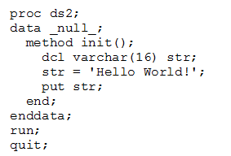
Adding Source Code
Don’t bury code in text
Use Courier New Font

Slide 8
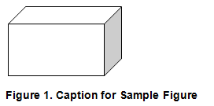
Displaying Objects with Captions

Slide 9
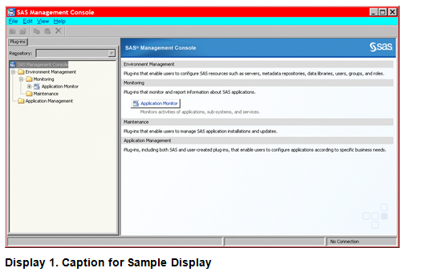
Displaying Objects with Captions

Slide 10
Conclusion

Slide 11
Conclusion
Paper should be a recap
Explain any benefits

Slide 12
Author 1 name
ABC Corporation
123-456-7890
author1name@abccorp.com
Author 2 name
DEF Corporation
234-567-8901
author2name@defcorp.com

Slide 13
Questions?

